Slide 1
The Role of RCEs in Creating a Sustainable Future: Issues and Challenges RCE Symposium Kuala Lumpur, 8 October 2018
Zinaida Fadeeva, Dr TERI SAS, INdia

Slide 2
Thoughts to share….
Context of RCE creation
Roles that were played
Aspirations

Slide 3
United Nations Decade of Education for Sustainable Development (DESD)
Global Action Programme on Education for Sustainable Development (GAP on ESD)

Slide 5
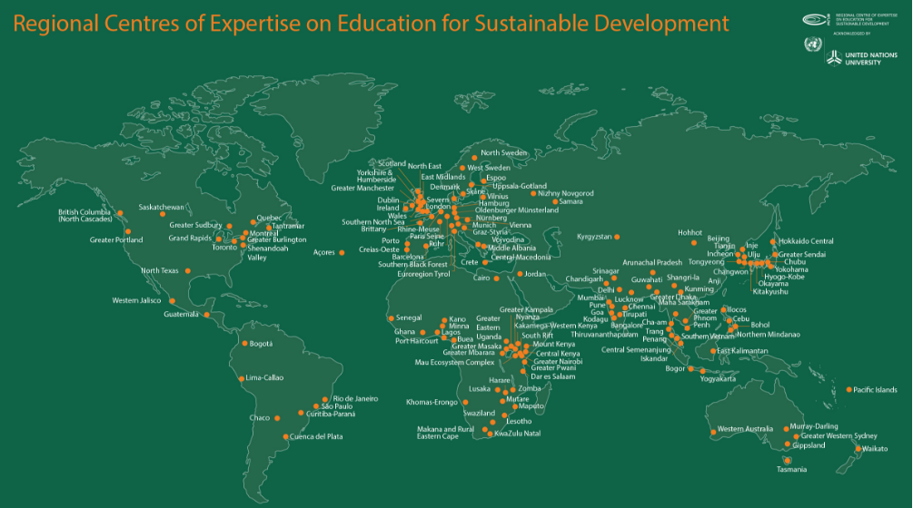
Nearly 170 members community

Slide 6
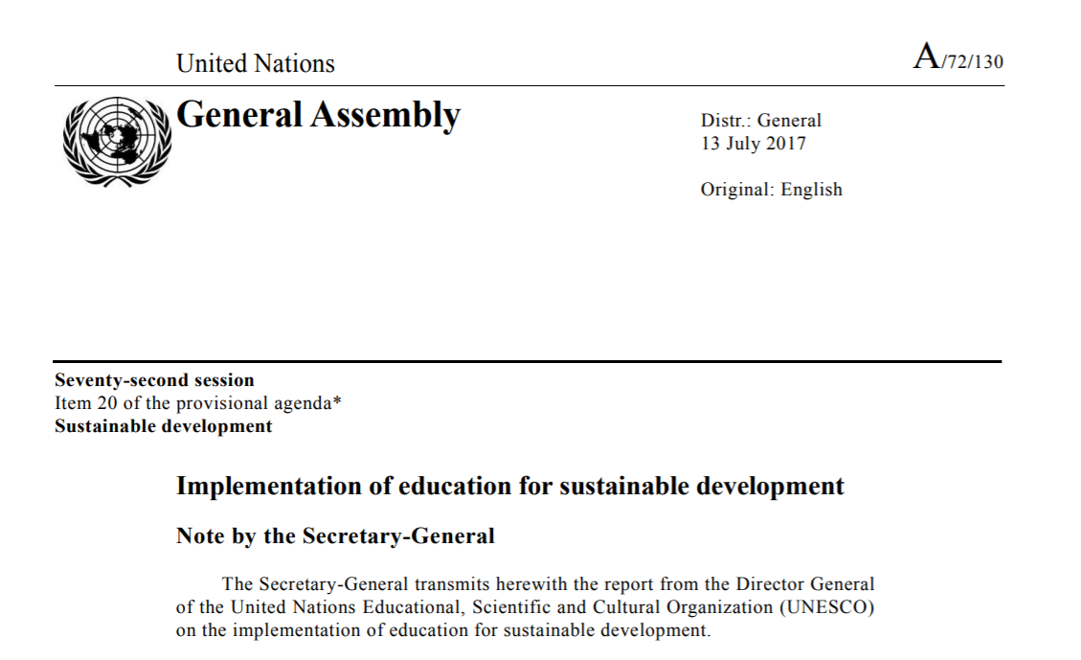
RCEs are recognized as a significant force in implementing ESD

Slide 7
Paradox
And yet….
Fragmentation of trust at the national levels
Conflicts among the states
Lack of decisive actions
Climate change is looming faster than scientists predicted
Technology is developing fast but international regimes are not sufficient to regulate them
Global terrorism
….

Slide 8
Role of the RCEs
Overcoming differences, preventing, responsible brokerage

Slide 9
Role of the RCEs
Overcoming differences, preventing, responsible brokerage
It is already happening in many areas, e.g.
engagement with the communities. But there is a need to deeper reflect on the practices towards stronger and more impactful engagement
Leadership development of the IHEs – collaboration with AKEPT
Integration of development agenda at the sub-national level
Knowledge partner in the international sustainability processes
Contribution into skills development (for sustainable development)
Contribution into development of the effective (!) capacity development processes

Slide 10
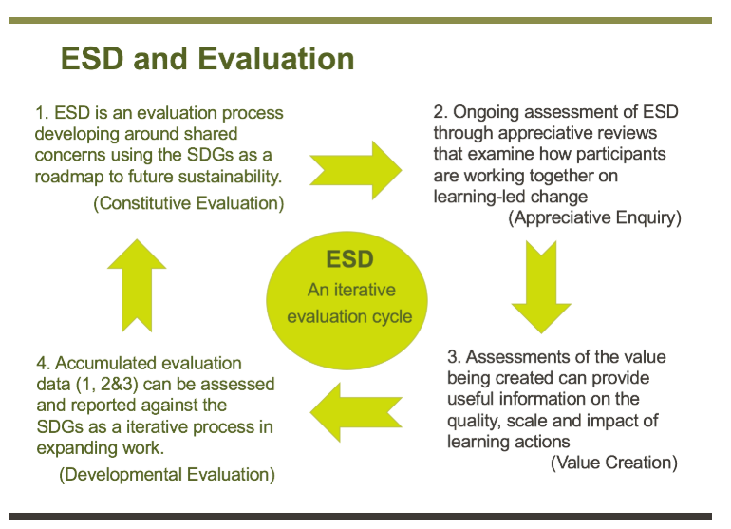
Starting from the position of strength
Evaluation and documentation of existing practicies

Slide 11
Terima kasih! Zinaida Fadeeva zina06@gmail.com

