Slide 1
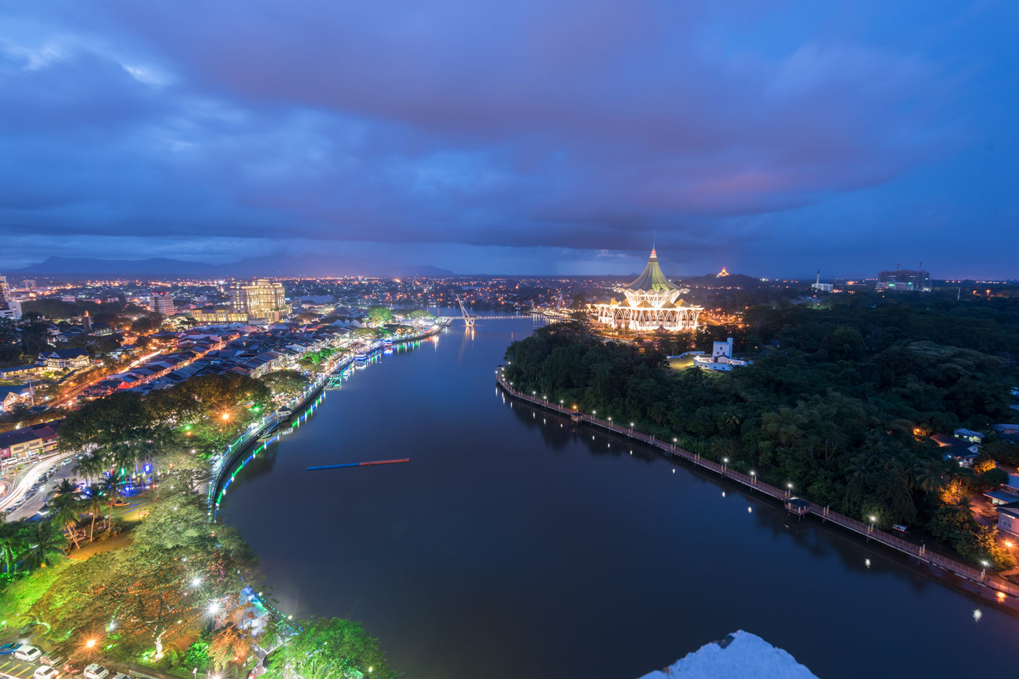
RIVER ART COMPETITION
IN CONJUNCTION WITH
PERAYAAN HARI SARAWAK
“Our River, Our Life”’
Jointly organized by:

Slide 2
JOINTLY ORGANIZED BY
Sarawak
State Government
Sarawak Multimedia Authority
(SMA)
Old Kuching Smart Heritage
(OKSHE)
UCSI University
RCE Kuching

Slide 3
POTENTIAL COLLABORATORS

Slide 4
CONTENTS
Smart partnership inclusivity
Introduction
Project’s objectives
Project’s objectives alignment
Focus scope area
Intended learners/participants
Categories
Paintings
Sculpture
Poetry
Event timeline
Programme Itinerary
Proposed site layout
Proposed budget – Prize-giving Ceremony
Risk assessment
Expected outcomes
Evaluation methods

Slide 5
SMART PARTNERSHIP INCLUSIVITY
STRATEGIC ROLES
STRATEGIC PARTNERS
PROFESSIONAL
PUBLIC
PRIVATE
PEOPLE
Conceptual framework
Proposal development
Volunteerism
Sponsorship
Logistics
Operations
Higher learning institution
Ministries
Sarawak government/agencies
Participations
Endowment
Industries
Financial institution
Awareness
Readiness
Immersion
Students
NGOs
Communities

Slide 7
PROJECT OBJECTIVES
Project Objective 1.0:
Cognitive learning
To improve society’s awareness of the importance of Sarawak rivers as part of the Kuching SMART city initiatives
Project Objective 2.0:
Behavioural learning
To empower individual to be influential ambassadors of Sarawak
Project Objective 3.0:
Psychomotor learning
To include the needs of digital inclusion among the artists by applying QR Code in the artworks
Project Objective 4.0:
Socio-emotional learning
To express individual’s feelings about Sarawak rivers sustainability in the form of arts among local communities

Slide 8
PROJECT’S OBJECTIVES ALIGNMENT TO RCE → SDG → SMART City
Project Objective 1.0
RCE LO 4: Education Sustainable Development (ESD)
Project Objective 2.0
RCE LO 3: Promote collaborative research and innovation
SDG 4: Quality Education
(Target 4.7)
Project Objective 3.0
SDG 4: Quality Education
(Target 4.7)
SDG 4: Quality Education
(Target 4.7)
RCE LO 4: Education Sustainable Development (ESD)
Project Objective 4.0
SDG 4: Quality Education
(Target 4.7)
SMART City: Physical Infrastructure and Utilities
SMART City: Physical Infrastructure and Utilities
SMART City: Physical Infrastructure and Utilities
SMART City: Physical Infrastructure and Utilities
RCE LO 1: Build cross-sector network

Slide 9
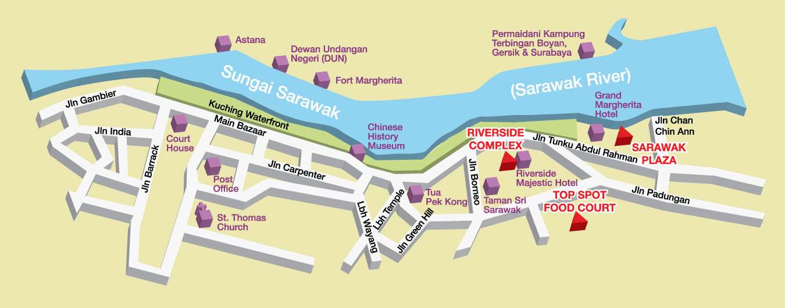
FOCUS SCOPE AREA
Rationale for focus scope area:
Main scope includes Sarawak River due to the need in creating awareness
among the public and Sarawak Riverine community

Slide 10
INTENDED PARTICIPANTS
Kuching secondary schools
52 secondary schools around Kuching
Involving Form 4-6 students only
Higher institutions
Open to 26 higher institutions
Involving university/college students
Competition quota: 4 participants from each school
Competition quota: 4 participants from each school
Total expected participants:
312 students

Slide 11
COMPETITION CATEGORIES
Tangible art
Painting
(consisting of any types of drawing or painting)
Sculpture
(consisting of any sculpture made from waste and recyclable materials)
Intangible art
Poetry
(consisting of poems in English and Bahasa Malaysia)

Slide 12
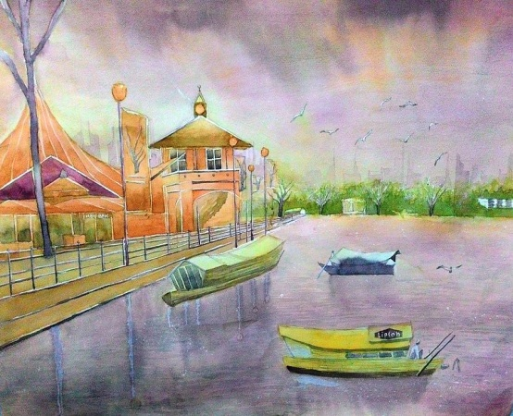
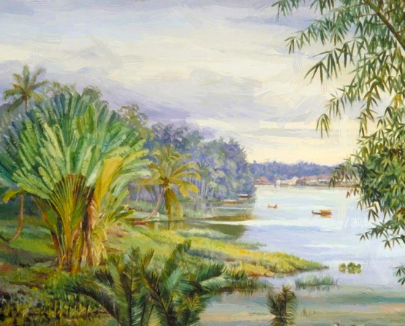
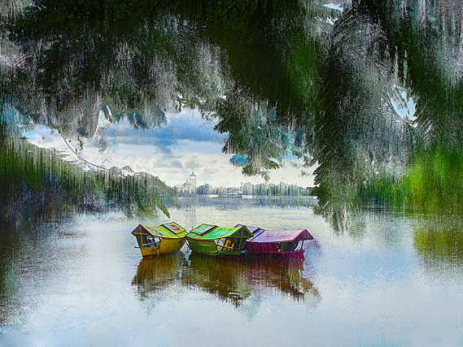
COMPETITION 1: PAINTING
Each participant can compete in only one of the following categories; painting, sculpting or poetry.
(consisting of any types of drawing or painting)
Painting guidelines:
Drawing paper of A2 size (42cm x 59.4cm) painting works in any kind of art media.
You can send in as many artworks as you like but each person is only eligible for ONE prize only.
All artworks must be submitted together with an artist’s statement (not more than 300 words in either English or Bahasa Melayu) that describes their work.
Each entry must be an authentic work of the participating artist.
Each entry must be accompanied by a separate and completely filled entry form.
Artists are encouraged to submit original art work completed within this year or the previous year.
All art or raw materials must be prepared by the participating artist.
All artworks must be approved by the school’s art teacher or principal.
All art submissions are the property of the organisers and are non-returnable.
Except where prohibited by law, an entry submission to this competition constitutes the permission to use the winner’s name, likeness, prize information, and information provided on the entry form for publicity purposes, without further permission or compensation. However, a 10% royalty will be extended to the artist should any artwork be sold.

Slide 13
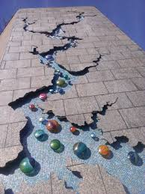
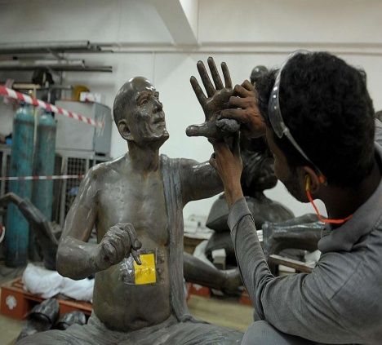
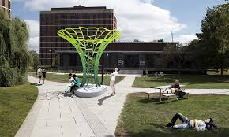
COMPETITION 2: SCULPTURE
(consisting of any sculpture made from recyclable materials)
Sculpture guidelines:
Size (below a 3ft height) sculpture works made from RECYCLABLE materials. Any further size must seek approval from the organizers.
You can send only ONE artwork.
All artworks must be submitted together with an artist’s statement (not more than 300 words in either English or Bahasa Melayu) that describes their work.
Each entry must be an authentic work of the participating artist.
Each entry must be accompanied by a separate and completely filled entry form.
Artists are encouraged to submit original art work completed within this year or the previous year.
All art or raw materials must be prepared by the participating artist.
All artworks must be approved by the school’s art teacher or principal.
All art submissions are the property of the organisers and are non-returnable.
Except where prohibited by law, an entry submission to this competition constitutes the permission to use the winner’s name, likeness, prize information, and information provided on the entry form for publicity purposes, without further permission or compensation. However, a 10% royalty will be extended to the artist should any artwork be sold.

Slide 14
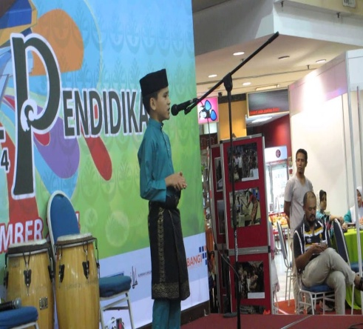
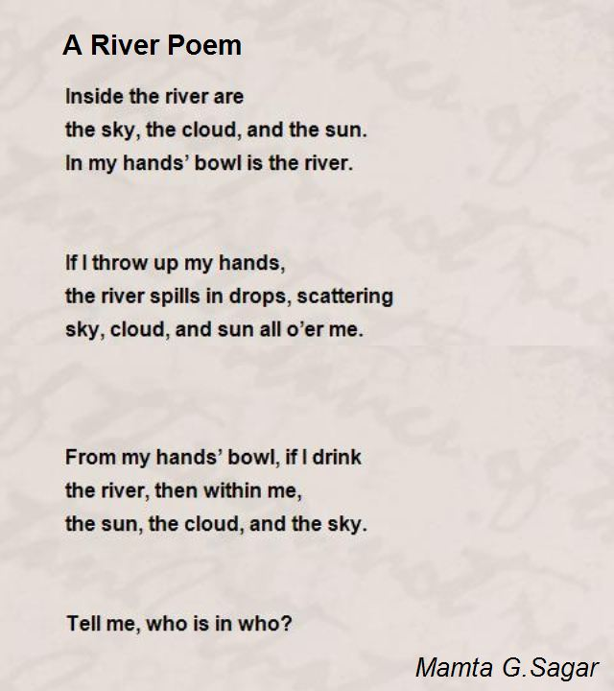
COMPETITION 3: POETRY
(consisting of poems in English language to promote the language among the students)
Poetry guidelines:
Poem must be written in English or Bahasa Melayu and submitted in hardcopy of A3 paper size.
You can send only ONE poem.
Each entry must be an authentic work of the participating artist.
Each entry must be accompanied by a separate and completely filled entry form.
Artists are encouraged to submit original poem completed within this year or the previous year.
Poem must be prepared by the participating artist.
Poem must be approved by the school’s English teacher or principal.
All poems are the property of the organisers and are non-returnable.
Except where prohibited by law, an entry submission to this competition constitutes the permission to use the winner’s name, likeness, prize information, and information provided on the entry form for publicity purposes, without further permission or compensation.
Selected participants will present their poem for 5-10 minutes at the River Art Competition which is to be held on 22 July 2019.
10% royalty will be extended to the artist should any poem be sold.

Slide 15
COMPETITION ASSESSMENT
A panel of judges will review all eligible entries received and select, at their sole discretion, the entries that are eligible to receive prizes. Rubric or competition criteria will be developed for judging purpose.
The judging panel will evaluate the art submissions based on various criteria such as the originality of expression, creative use of materials and presentation, to name a few. The judges reserve the right to disqualify any entry if there is any reasonable doubt about the authenticity of the artwork. Contributing marks for judging panel will be 70%.
In addition, the public can also do e-vote by scanning the QR Code on each artwork. The public contributing marks would be 30%.

Slide 16
COMPETITION PRIZES
Prizes to be won for each category:
Champion: Cash prize RM500 + UCSI Bursary RM10,000 + certificate for student & special token for teacher
1st Runner-up: Cash prize RM300 + UCSI Bursary RM8,000 + certificate for student & special token for teacher.
2nd Runner-up: Cash prize RM200 + UCSI Bursary RM5,000 + certificate for student & special token for teacher.
5 x Consolation Prizes: Cash prize RM100 x 5 + UCSI Bursary RM3,000 x 5 + certificate for students & special token for the teacher.
All participants will be awarded with certificate and appreciation letter.
Note: UCSI Bursary is also known as tuition waivers for the programme and duration offered granted by UCSI University and is neither transferable to another candidate nor exchangeable for cash

Slide 17
EVENT TIMELINE
TENTATIVE PLAN TIMELINE | JAN | FEB | MAR | APR | MAY | JUN | JUL | AUG | SEP | OCT | NOV | DEC
Preparation period (proposal, network, etc.)
Poster distribution/Marketing to selected schools/universities
Pre-event press release
Registration |  |  |  |  | 30th June Registration close
Art competition period |  |  |  |  | 12th July – last submission
Filtration of entries |  |  |  |  |  |  | 12th -20th July
Exhibition (30 finalists) |  |  |  |  |  |  | 22nd July
Poem competition (10 finalists) |  |  |  |  |  |  | 22nd July
Judge and public voting |  |  |  |  |  |  | 22nd July
Prize giving ceremony |  |  |  |  |  |  | 22nd July
Post-event press release (newspapers, social media, etc) |  |  |  |  |  |  | 23rd -31st July
Distribution of UCSI Gazette to all participating institutions

Slide 18
PROGRAMME ITINERARY
Programme Itinerary Details
Time | Activity
9:00 A.M | Registration of vendors and participants
9:30 A.M | ‘Kids Activity’ starts Judging session for ‘Kids Activity’ Prize giving for ‘Kids Activity’
 | Exhibition starts Public voting via QR code (for painting & sculpture categories)
1:30 P.M | Final Poetry Competition (10 finalists)
2:30 P.M | Talk by a representative from Natural Resources and Environment Board (NREB) Talk by a representative from Sarawak River Board (SRB)
3:30 P.M | Arrival of VIPs and RCE Kuching Stakeholders
4:00 P.M | Lagu Sarawak Ibu Pertiwiku Bacaan doa Welcoming speech by Mdm Mukvinder Sandhu, RCE Kuching Vice Chairperson Opening speech by YBhg. Tan Sri Datuk Amar Haji Mohamad Morshidi Abdul Ghani, Deputy Chairman Old Kuching SMART Heritage (OKSHe) Poem performance by Mr Taksu Zacharia, Creative Director of Studio Labu Sakti Awards presentation Painting competition Sculpture competition Poetry competition Token of appreciation to VIPs Closing ceremony Group photo session Refreshment
6:00 P.M | Dismiss

Slide 19
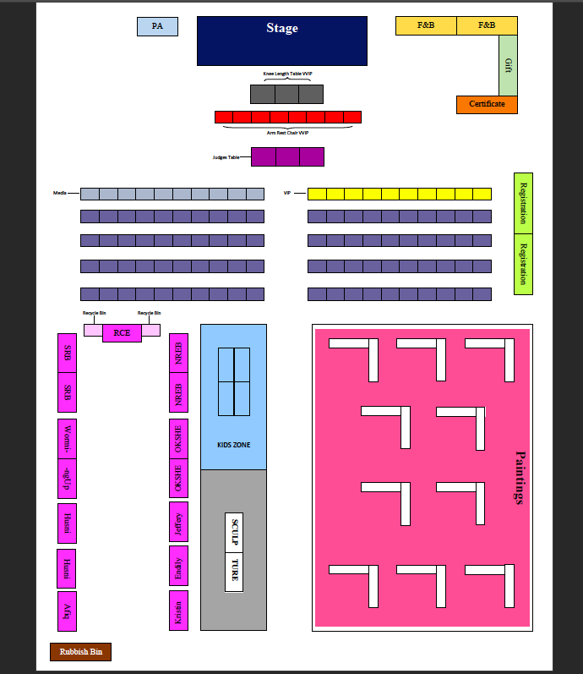
SITE LAYOUT

Slide 20
PROPOSED BUDGET PRIZE-GIVING CEREMONY (22nd JULY 19)
 | Quantity | Unit Price | Total (RM)
INCOME
Funds from various organisations | - | - | 19500.00
Booth exhibition fee (RCE stakeholders) | 10 | 50.00 | *500.00
Total Estimated Income (RM) |  |  | 20000.00
EXPENSES
Food & Beverages (Lunch only)
VIPs | 10 | 30.00 | 300.00
Organizers (collaborators) | 50 | 15.00 | 750.00
Volunteers | 30 | 15.00 | 450.00
Finalists | 90 | 15.00 | 1350.00
Teachers | 30 | 15.00 | 450.00
 | 210 pax |  | 3300.00
Mineral water (in boxes) | 20 | 12.00 | 240.00
 |  |  | 3540.00
Awards/Gifts
Cash prizes | - | - | 7500.00
Certificates (for volunteers, participation and awards) | 300 | 1.00 | 301.00
Token (for schools) | 24 | 12.00 | 288.00
VVIP Souvenirs (i.e plaque) | 5 | 65.00 | 325.00
Mock cheque | 24 | 50.00 | 1200.00
 |  |  | 9614.00

Slide 21
PROPOSED BUDGET – CONT.
Stationary
Painting frames (A3 size) for exhibition | 100 | 12.00 | 1200.00
General stationary (tacks, pens, markers, A4 paper, landyards) | - | - | 500.00
 |  |  | 1800.00
Rental of transportation lorry, canopies, chairs, tables, fans, etc |  |  | 1000.00
Promotion/Marketing
Stage Backdrop (6ft x 16ft) | 1 | 150.00 | 150.00
Bunting T-stand (2ft x 6ft) | 5 | 90.00 | 450.00
Banner (5ftx5ft) – along Main Bazaar Street | 10 | 35.00 | 350.00
 |  |  | 950.00
Miscellaneous
Volunteer T-shirt | 40 | 25.00 | 1000.00
RELA security team (for 6 hours = RM10/hours) | 10 | 60.00 | 600.00
Others / Contingency |  |  | 496.00
 |  |  | 2096.00
Total Estimated expenses (RM) |  |  | 19500.00
Net Profit/Loss (RM) |  |  | *500.00
Any excess funds will be channeled into RCE Kuching funds for future activities.
Booth exhibition fee will be channed into RCE Kuching funds for future activities.

Slide 22
RISK ASSESSMENT
Cost control
Quality control
Manpower control
Health & safety control
Time control

Slide 23
EXPECTED OUTCOMES
The learners will become aware about Sarawak rivers sustainability.
Participants contribute to the four domains of teaching and learning: Cognitive learning, Socio-emotional learning, Behavioural learning, Psychomotor learning by being able to producing arts through painting, sculpture from recycled materials or by presenting poem.
Develop database from participants so that future programmes to upgrade their skills can be done. They can be icon or ambassadors in their school and community.
The acceptance and readiness of participants and the public on QR code as a trending in moving towards digital economy.

Slide 24
EVALUATION METHODS
Feedback Survey
Supports Received
How: Attendance lists (database) and sponsors received
How: The use of e-survey (link or QR code)

Slide 26
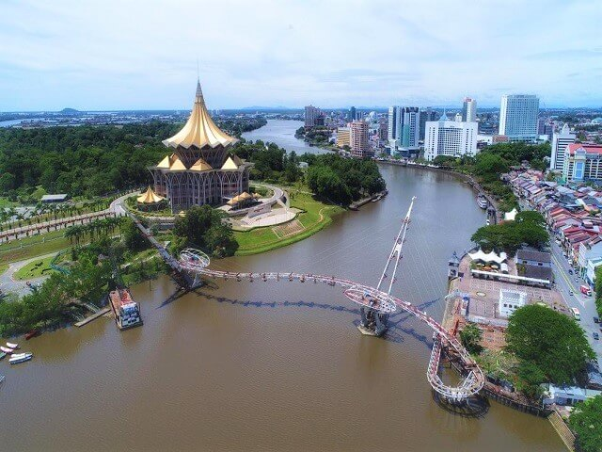
THANK YOU

