Slide 1
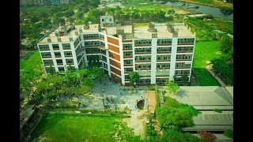
Topic: Recycle Bins in campus and activities of RCE greater Dhaka youth forum to achieve sustainability goals .
Presented By-
Md. Shariar Abir
President(Acting) , RCE greater Dhaka Youth Forum

Slide 2
IUBAT Green Campus
A green campus is a safe and healthy learning environment that conserves energy, resources, and money.
Green campus is achieved by
Promoting sustainable construction design and construction.
Greening the operations and maintenance of existing institute

Slide 3
Recycling Bins at Campus

Slide 4
Sustainability Practice among students

Slide 5
Youth Forum Cleaning campaign in Campus

Slide 6
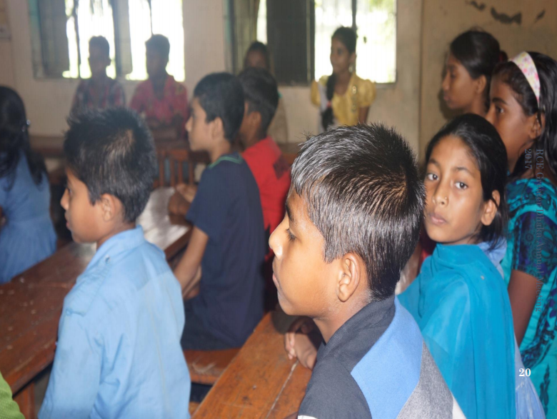
Raising awareness about Environment among School Students

Slide 7
Planting Trees in different schools

Slide 8
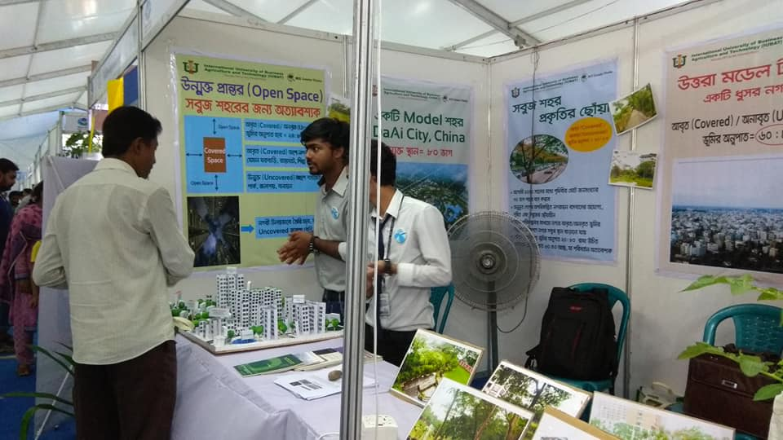
Green City presented in National Environment Fair

Slide 9
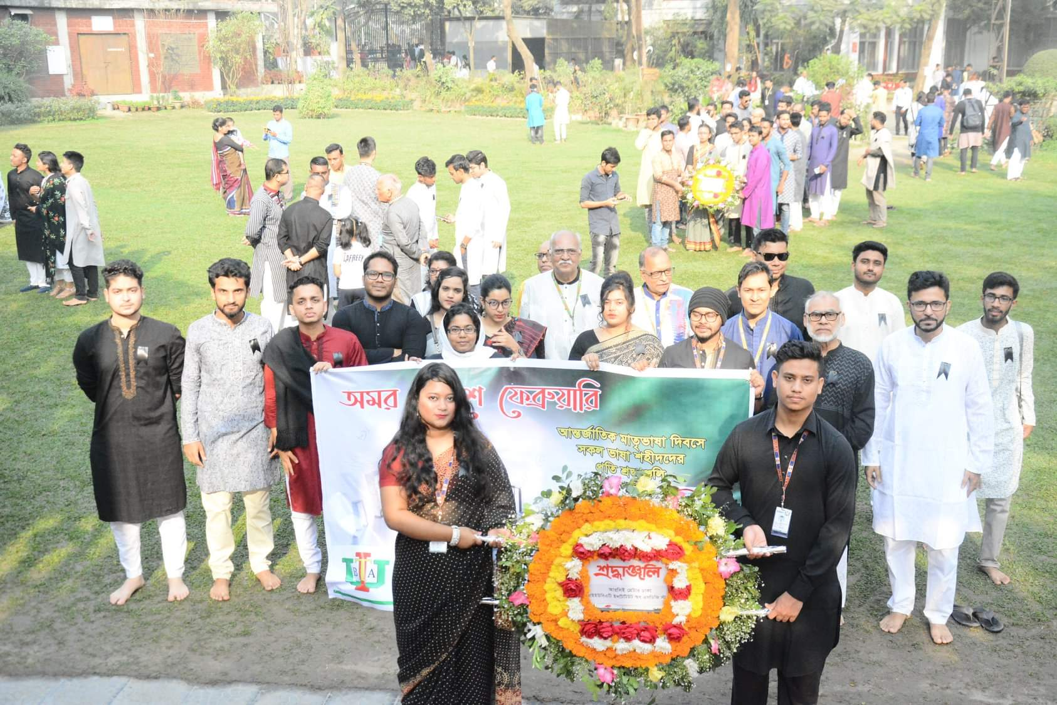
Observance of International mother Language Day

Slide 10
Learnings that I will implement in my work Place
Will set up proper waste management in hotel .
Reuse few accessories.
Encourage to use renewable energy .
Will plant more trees in the hotel premises .
Save water and less CO2 emission.

Slide 11
Green Hotel in Bangladesh and contribution of Youth Forum Alumni
One of our Alumni Mr . Mahumudul Hasan is currently working in Radison Blu Chattogram Bay view hotel as F&B Associate .
He has replaced all plastic water bottles available at the hotel premise with reusable glass bottles on January 18,2021 .
He also took initiative to remove plastic straws and drink stirrers from entire F & B operation and replaced them with locally made bamboo alternatives.

Slide 12
Conclusion
Every little steps matters when it comes to sustainability . If we (youth) can play a significant role to achieve the sustainability goals ,the earth will be safe for future generation to live in .

