Slide 1
RCE Penang Progress Update
Project: Empowering Students’ Leadership in Sustainable Development Goals (SDGs) via Intergenerational Knowledge Transfer

Slide 2
Objectives
To develop student leadership for building a sustainable society through education focus on the following themes which are No Poverty (SDG 1), Responsible Consumption and Production (SDG 12) and Life Below Water (SDG 14).
To promote Penang as a state in Malaysia that is actively engaging students in promoting SDGs at school level
To strengthen the collaboration between industry and school in cultivating an innovation ecosystem for the creation of knowledge, talent development and product excellence.
To create leaders who are able to transform their knowledge for a sustainable society
To empower students to be the leaders in promoting SDGs

Slide 3
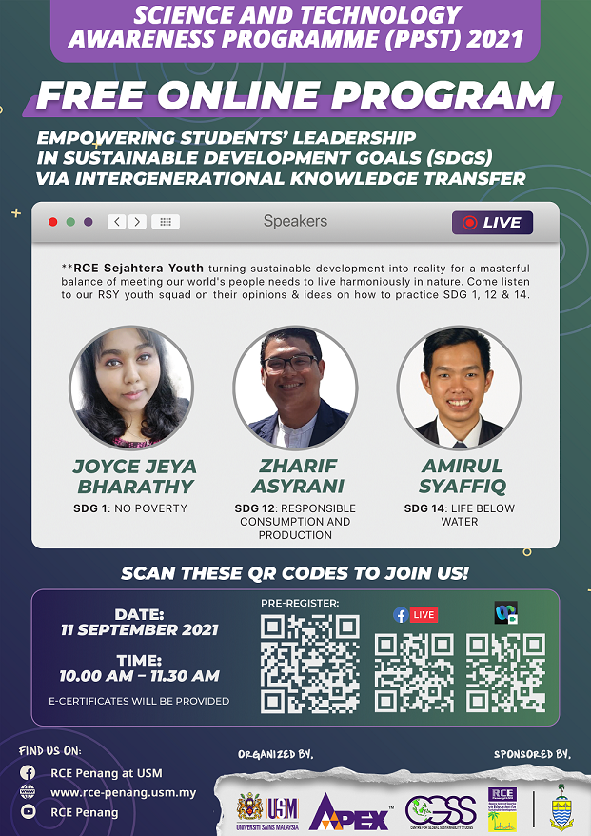

Slide 4
Timelime
May - Aug
11 Sept
08 Oct
15 Oct
22 Oct
Online Program and Call for entries for the video competition
End of Judging
Collaboration with PSED, meetings with speakers, content expert and preparation for Online Program
Deadline of Video submission
Announcement of Winners

Slide 5
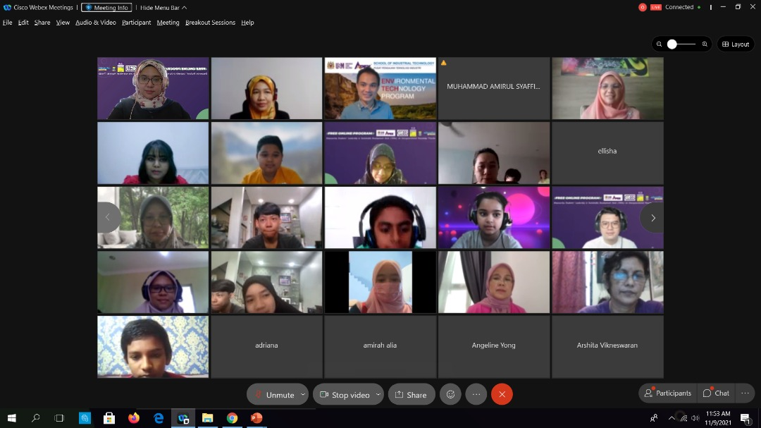
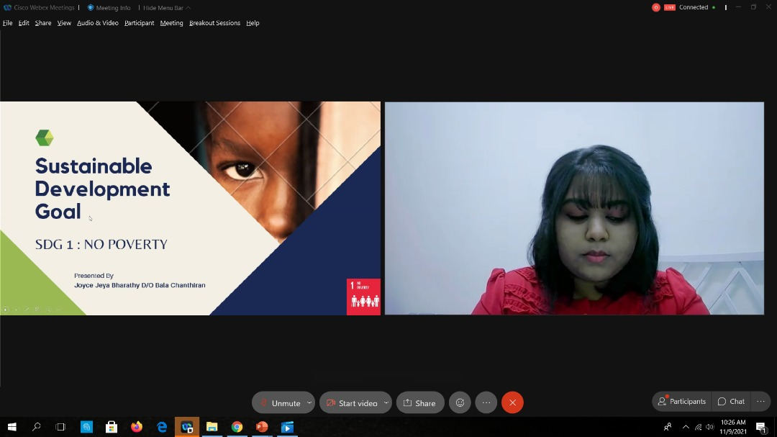
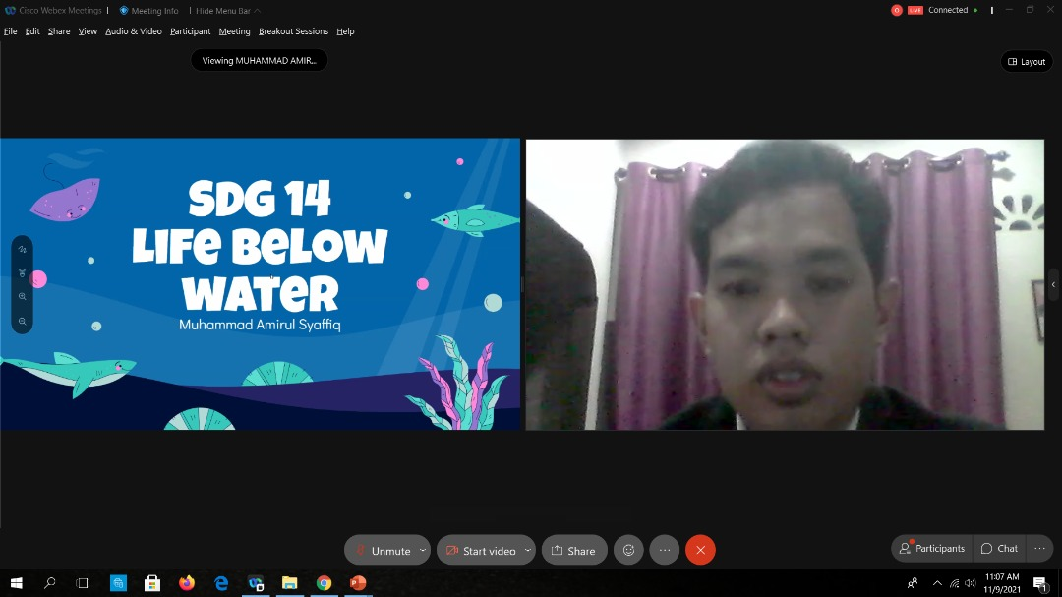
PROGRESS
31 May 2021 – Collaborated with Penang State Education Department to organize the program
02 July 2021 – Organized meeting with content experts and youth
July to Aug 2021 – Trained and prepared youth for online program
11 Sept 2021 – Organized online program on SDG 1, SDG 12 and SDG 14 in collaboration with RCE Global and Penang State Education Department
12 Sept 2021 to 08 Oct– On going video competition

Slide 6
Update on Online Program

Slide 7
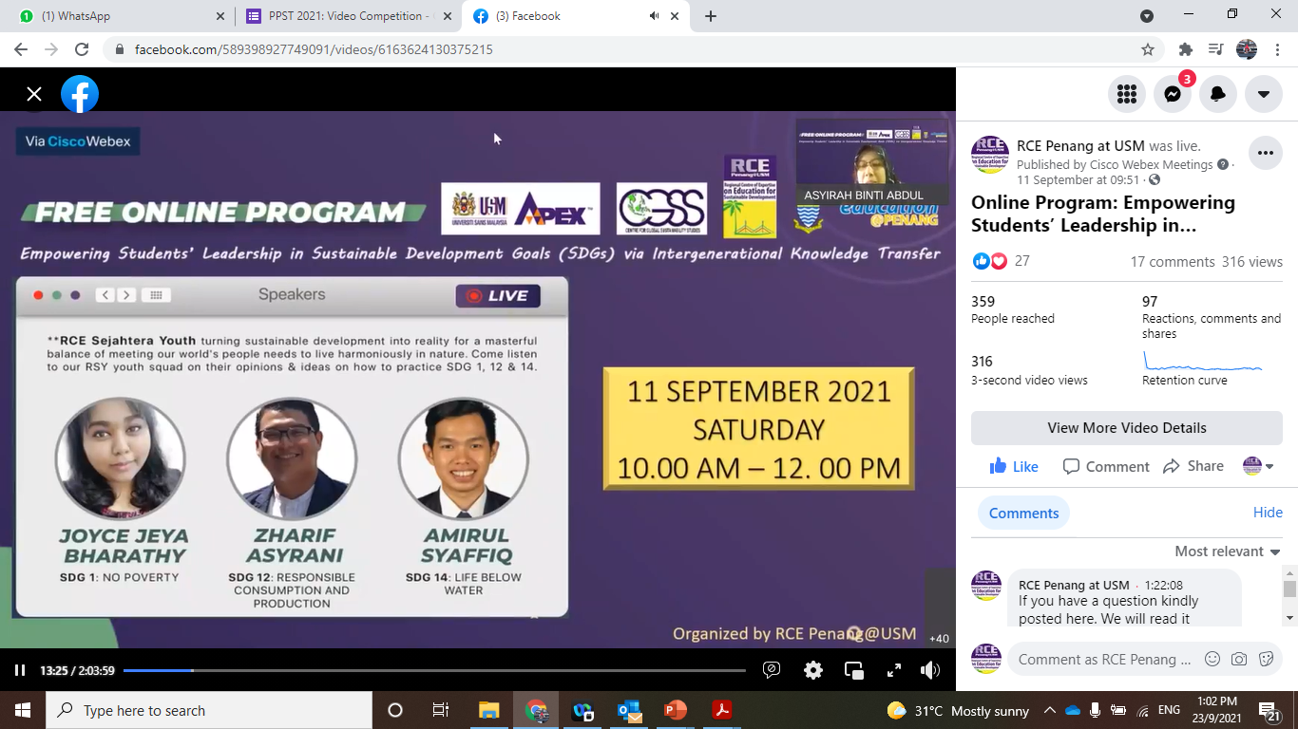
Update on Online Program
316 Facebook viewers
81 participants answered the surveys
26 from primary school
39 from secondary school
School in Penang

Slide 8
SCHOOLS
SJKT
SK SUNGAI ULAR
SK CONVENT BUKIT MERTAJAM
SK CONVENT BUTTERWORTH
SK BUKIT GELUGOR
SK STOWELL BUKIT MERTAJAM
SK TAMAN SENANGAN
SMK PENANTI
SMK PONDOK UPEH
SMK METHODIST
SMK BATU 5
SMK CONVENT GREEN LANE
SJKT BAYAN LEPAS
SJKT LADANG JAWI
SJKT LADANG CHANGKAT
SJKT LADANG KRIAN
SJKC /SMJK
SMJK HENG EE
SMJK CONVENT DATUK KERAMAT
SMJK JIT SIN
SJKC PULAU BETONG

