Slide 1


DATUK ONN SECONDARY SCHOOL
THE CLUSTER SCHOOL OF EXCELLENCE
SHARING OF BEST PRACTICES
BEFORE & DURING PANDEMIC
PRACTICE GREEN
SAVE LIFE
SUSTAINABILITY

Slide 2


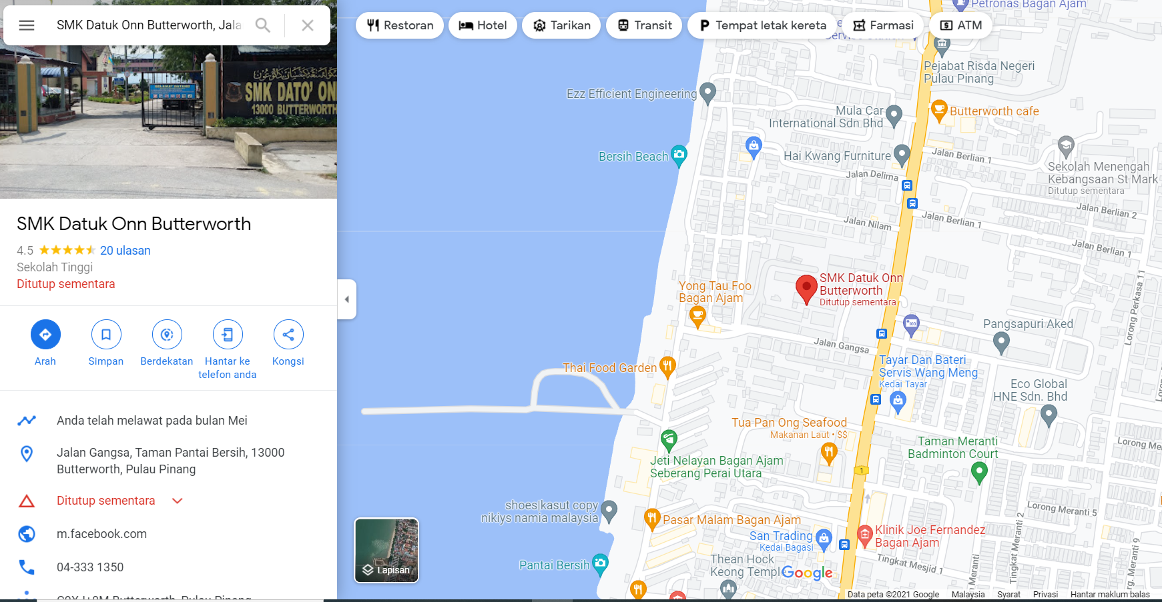
SCHOOL LOCATION
WELCOME TO DATUK ONN SECONDARY SCHOOL
WELCOME TO PENANG, MALAYSIA!!

Slide 3

INTRODUCTION TO SUSTAINABLE
GREEN INITIATIVES IN
DATUK ONN SECONDARY SCHOOL

Slide 4
6 ASPECTS IN GREEN PRACTICES
PLANNING & MANAGEMENT
INNOVATION & CREATIVITY
ZERO WASTE PRACTICE
CLEANING & GREENING
COMMUNITY INVOLVEMENT
PRESENTATION

Slide 5
VISI0N
DATUK ONN SECONDARY SCHOOL INSPIRES TO BECOME AN EXCELLENT SUSTAINABLE SCHOOL BY 2022
MISSION
TO PRODUCE A GREEN SCHOOL COMMUNITY WHICH ALWAYS PRACTICES GREEN AS AN EFFORT TO SUSTAIN THE ENVIRONMENT, THROUGH THE INCORPORATION FROM THE MANAGEMENT, ADMINISTRATION, CURRICULUM AND CO CURRICULUM LEVEL.

Slide 6
OBJECTIVES
To preserve the environment based on 3 main aspects, namely environmental, economic and social.
To cultivate environmental friendly values among school community by using 4 approaches which are management, curriculum, co curriculum and greening aspects.
To increase the awareness of the school community on the importance of environmental conservation and preservation.
To encourage the integration of school staffs, community, professionals, institutional staffs, university staffs to carry out environmentally friendly activities effectively
To enhance cooperation between schools and the community to ensure the success of environmental education
To encourage the reserve of 7R resources and practices - Reflect , Reduce, Reuse, Rethink, Repair, Recycle, & Re-educate

Slide 7
OBJECTIVES
To create a conducive and joyful school atmosphere in order to produce a school community which practice sustainable green practices.
To ensure the earth's atmosphere is clean, healthy and refreshing.
To transform Datuk Onn Secondary school into a Green Centre in North Seberang Perai District .
To increase environmental awareness through innovation and green creativity which is suitable with the school’s location near to urban agriculture.

Slide 8
ECO SCHOOL LOGO INTERPRETATION
1. OVERALL SHAPE
Round shape : Earth
Leaves : Green Practices
Tree trunk : Staffs of SMKDOB, PTA & local community
2. COLOUR
Blue & yellow : Penang state flag & School badge
Green : Environment
3. PRACTICE GREEN DESCRIPTION
Green Practices save the earth and lives

Slide 9
ECO SCHOOL PLEDGE
At Datuk Onn Secondary School, we pledge to:
1. Maintain and ensure the cleanliness of the school surroundings.
2. Practice7R.
3. Support all sustainable school programmes.
4.Transform our school into a school in the park.

Slide 10

A. PERANCANGAN DAN PENGURUSAN
ECO COMMITTEE
GREEN MANAGEMENT
&
ORGANIZING COMMITEE

Slide 11
CHAIRMAN
PN NOORHAYATI ABDUL HALIM
P
ADVISOR
PTA REPRESENTATIVE + ADMINISTRATOR OF SMK DATUK ONN
SUSTAINABLE SCHOOL REPORTING COMMITTEE-ENVIRONMENTAL AWARDS
CIK FASYA BT ABDULL HAMID
MANAGEMENT AND MONITORING COMMITTEE
CO-CURICULUM COMMITTEE
PN MUNIRAH HUSSAIN
HEAD OF HUMANITIES DEPARTMENT
HEAD OF LANGUAGE DEPARTMENT
HEAD OF TECHNICAL & VOCATIONAL DEPARTMENT
HEAD OF SCIENCE & MATHEMATICS DEPARTMENT
CLUBS & SOCIETIES
ENVIRONMENTAL CLUB, LANGUAGE CLUBS, MORAL CLUB, GEOGRAPHY CLUB, ARTS CLUB, COMPUTER CLUB & CULTURAL CLUB.
UNIFORM UNITS
POLICE CADETS, RANGERS, GIRL GUIDES,, SCOUTS, KRS
SPORTS AND GAMES
ANNUAL SPORT , CROSS COUNTRY,
CURRICULUM COMMITTEE
TN HJ RAHIM
HEAD OF DEPARTMENTS
BAHASA MELAYU PANEL HEAD
ENGLISH LANGUAGE PANEL HEAD
GEOGRAPHY PANEL HEAD
CIVIC STUDIES PANEL HEAD
ARTS EDUCATION PANEL HEAD
LIVING SKILLS PANEL HEAD
PHYSICAL EDUCATION PANEL HEAD
SCIENCE & MATHS PANEL HEAD
PRE UNIVERSITY
LIBRARY
GREEN UNIT COMMITEE
EN ZULIDZAM ZAKARIAH/CIK FASYA ABD HAMID
SCHOOL PARK PROJECT
BUTTERFLY PARK PROJECT
REUSE PROJECT
REDUCE PROJECT
RECYCLE PROJECT
3K PROJECT
HOSTEL , BCCC
NETWORKING PROGRAM
ASSISTED BY SCHOOL COMMUNITY

Slide 12
WAYS OF IMPLEMENTATION
Planning & Management
Briefing
Teaching & Learning
Co curriculum
Demonstrations and School Policy
Pledge
Green School Promotion
Campaign
Visits
Sharing of information through the school's website
School Open Day
Projects
Competition
Daily tasks
Green Ambassador

Slide 13
MEETING FREQUENCY
NO | MEETING | ACTION BY
1 | 1st meeting : JANUARY | TEACHERS
2 | 2nd meeting : JANUARY | STUDENTS
3 | 3rd meeting : MARCH | PARENTS
4 | 4th meeting : MAY | TEACHERS
5 | 5th meeting 0-waste & E-waste, 7R : JUNE | TEACHERS
6 | 6th meeting : JUNE | TEACHERS & STUDENTS
7 | Briefing & Assignment delegations : DECEMBER to new teachers | TEACHERS, PTA, SCHOOL STAFFS, STUDENTS, NGO, JAS,TOWN COUNCIL

Slide 14
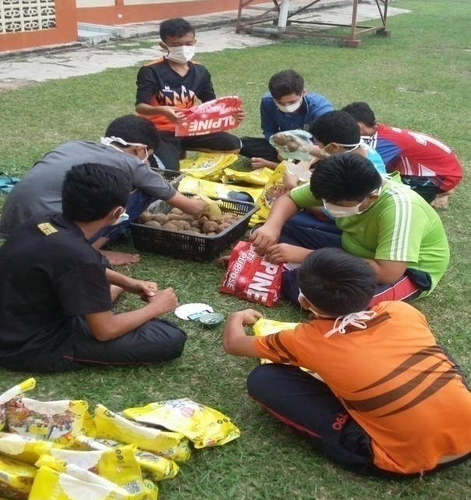
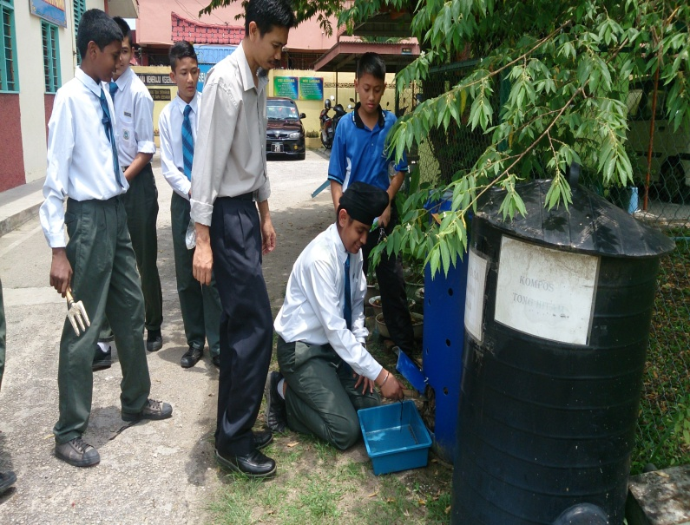
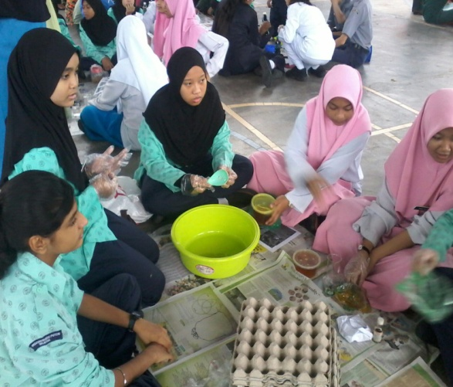
SUSTAINABLE GREEN PRACTICES
BEFORE COVID 19 PANDEMIC

Slide 15

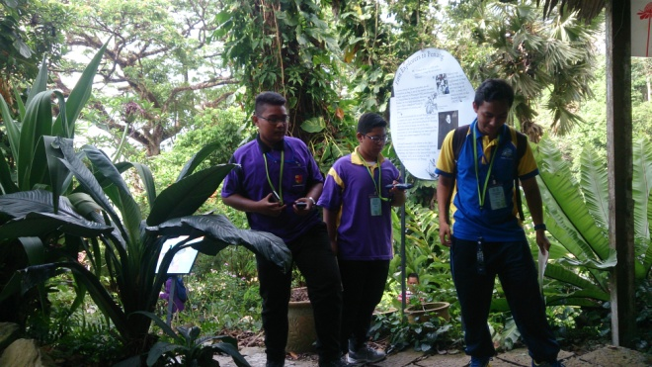
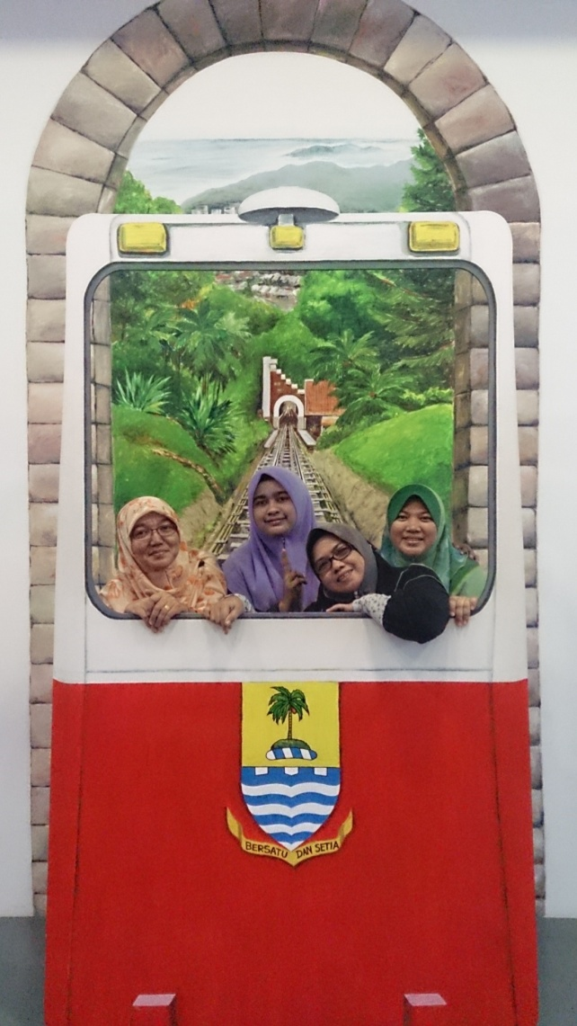
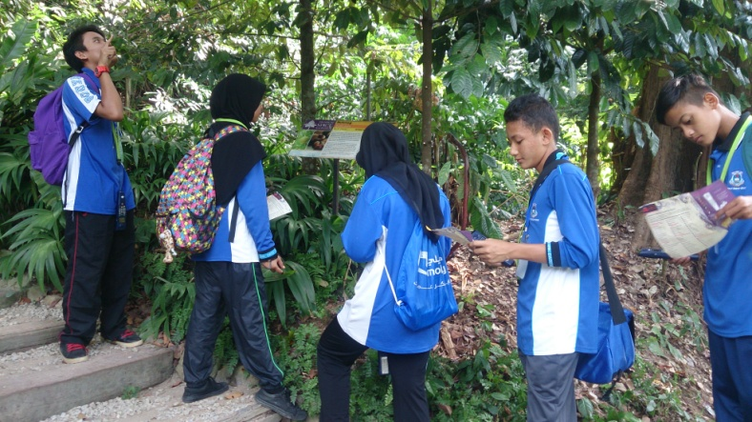
OBJECTIVES ACHIEVED THROUGH
CURRICULUM
CO CURRICULUM

Slide 16

HOW WERE THE SUSTAINABLE GREEN PRACTICES EXECUTED THROUGH CURRICULUM AMONG DATUK ONN STUDENTS???

Slide 17

CURRICULUM
INFORMAL EDUCATION
FORMAL
EDUCATION
INFRASTRUCTURE
LEARNING STATIONS
SUBJECTS

Slide 18
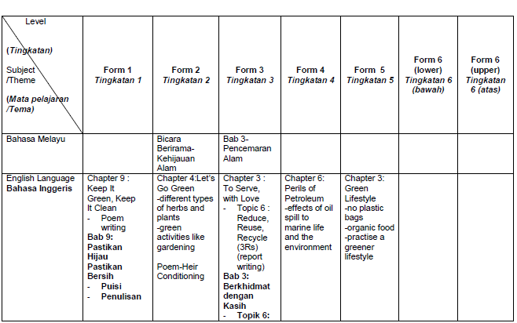
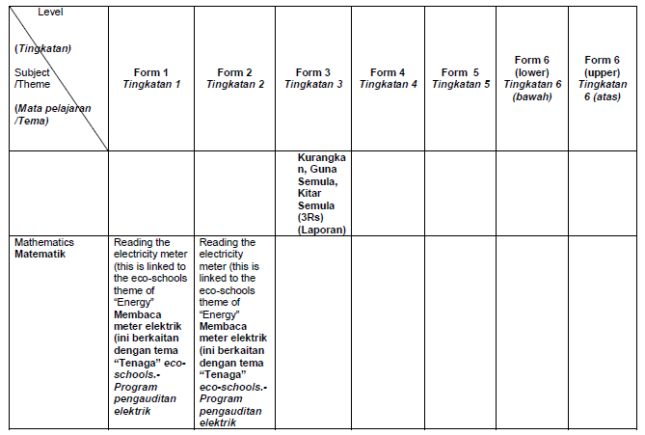
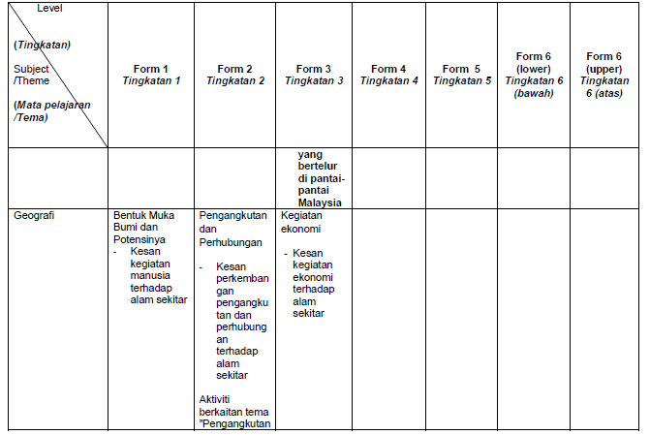
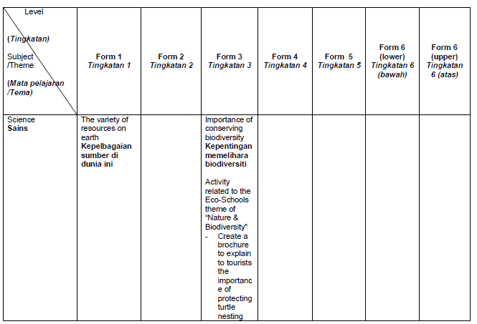
ECO-Curriculum Mapping for Secondary School
SCIENCE
ENGLISH
GEOGRAPHY

Slide 19
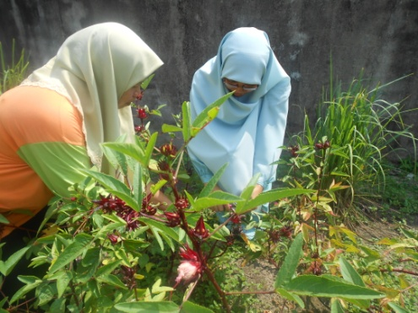
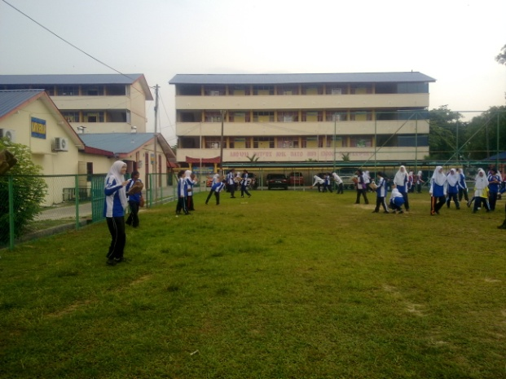

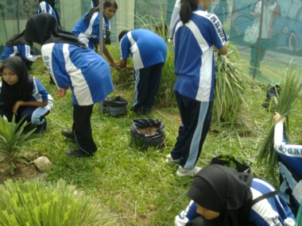
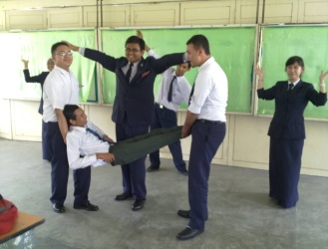
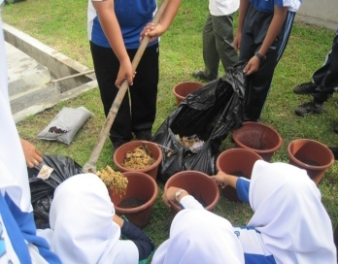
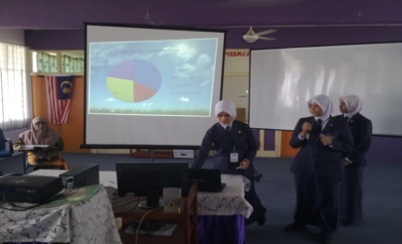
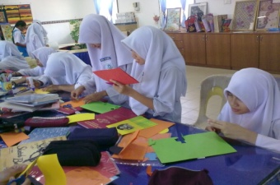
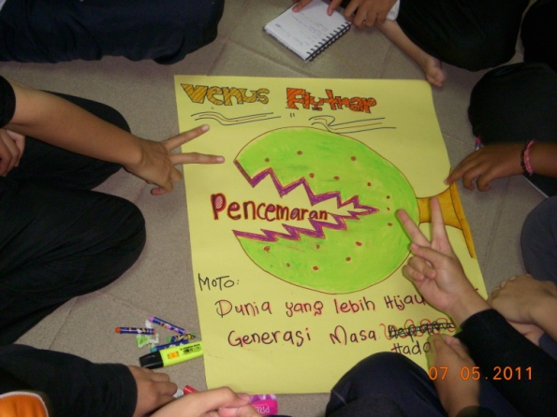
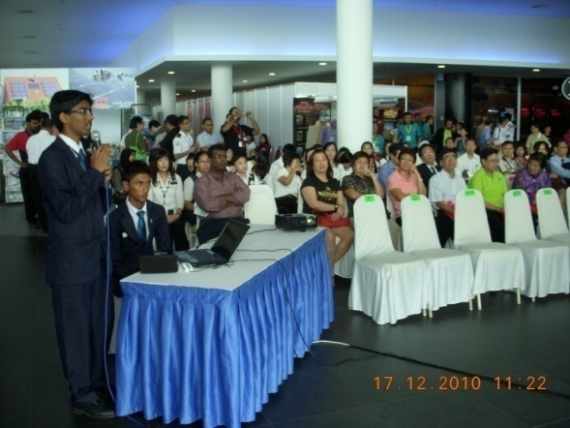
SUSTAINABLE EDUCATION ACROSS THE CURRICULUM
Civic & Moral Education – School Gardens, ‘Gotong Royong’/ Clean up
MUET-Sketch, Writing, Procedure Speaking
Form 6 Colloquium-Environmental Issues
Art Education-Recycling cards, Poster Drawing Competitions

Slide 20
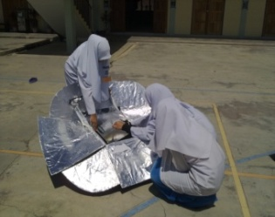
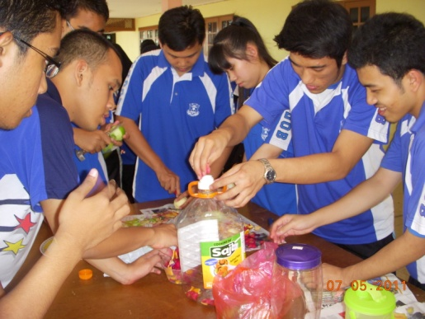
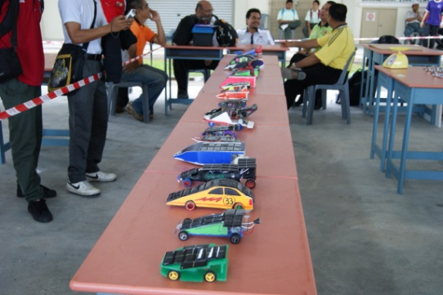
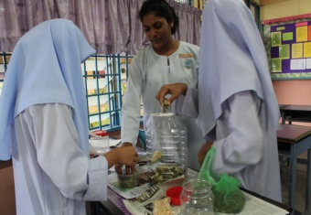
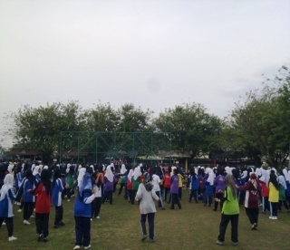
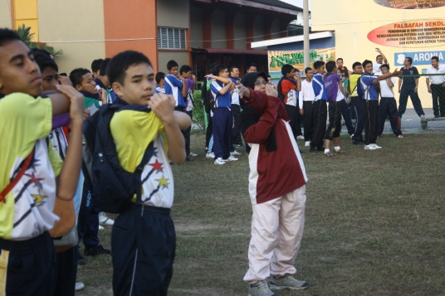
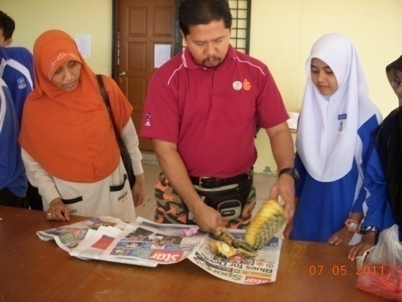
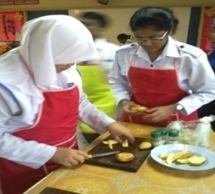
English Language-Producing, Organic, Enzyme, Descriptive, Writing
Science-Solar Cooking dan SOLAR CAR
Living Skills- Food Compost, School Gardens
Physical Education- Aerobics

Slide 21



NON FORMAL LEARNING
LEARNING STATIONS AROUND SCHOOL GROUND

Slide 22
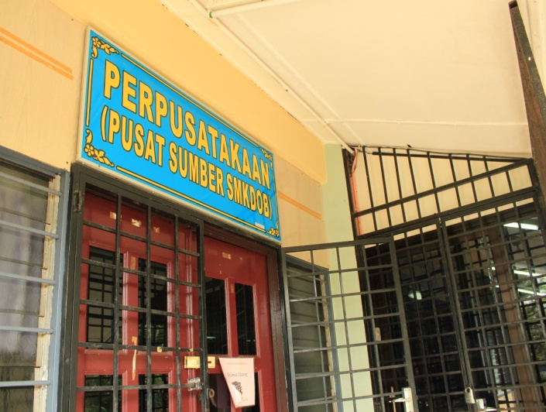
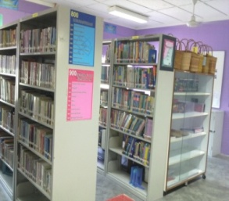
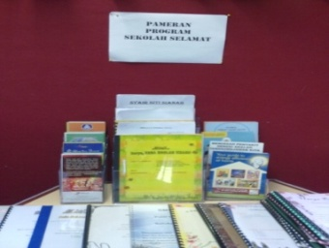
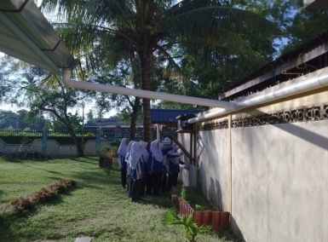
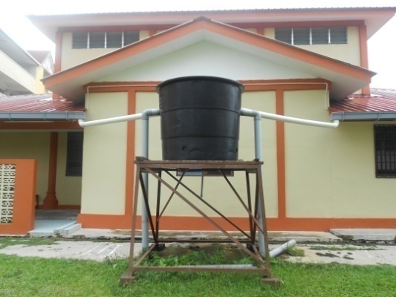
INFRASTRUCTURE AND LEARNING STATIONS IN SMKDOB
LIBRARY :
GREEN RESOURCES
RAIN HARVESTING SYSTEM

Slide 23
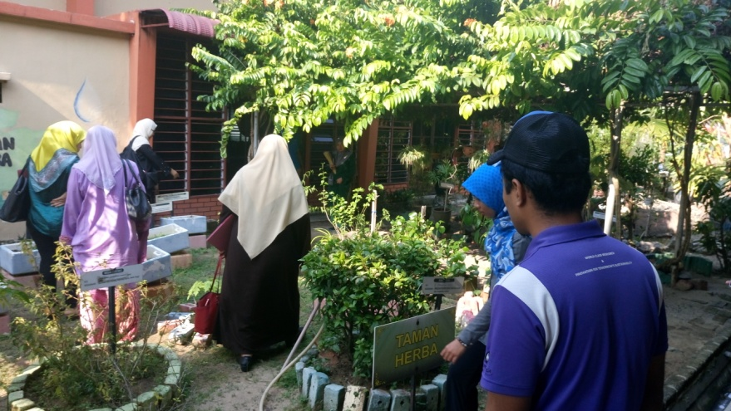
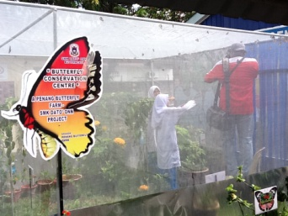
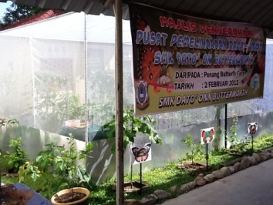
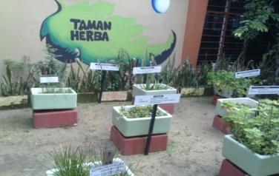
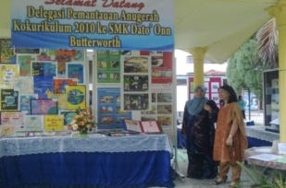
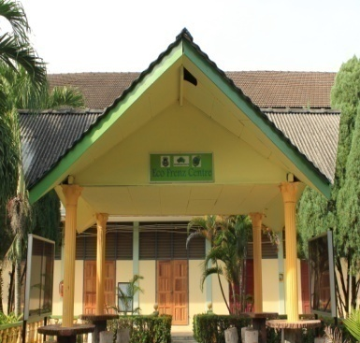
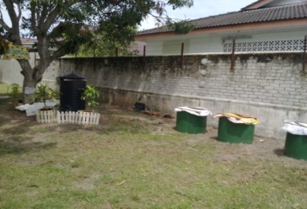
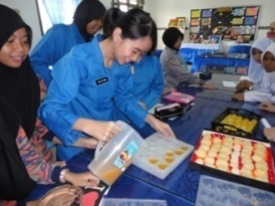
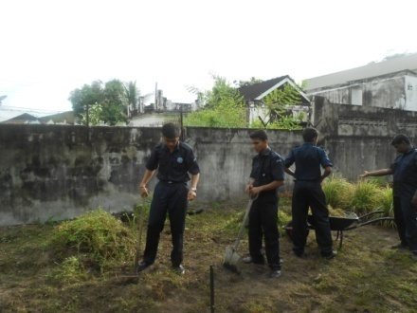
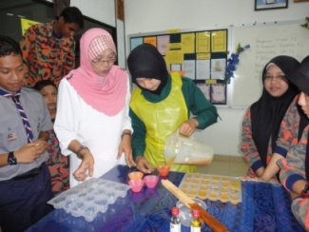
MINI BUTTERFLY FARM
ECO-FRENZ CENTRE
HERB GARDEN
COMPOSTING SITE
ART ROOM : SOAP MAKING

Slide 24
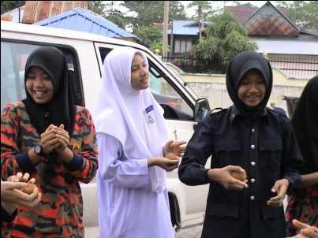
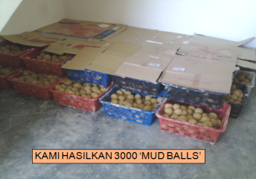
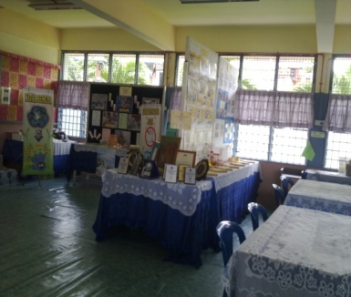
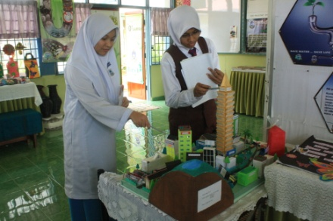
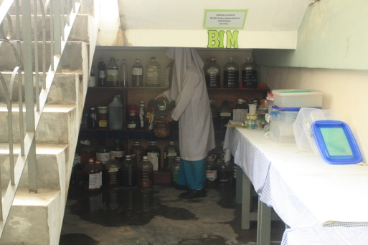
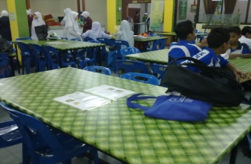
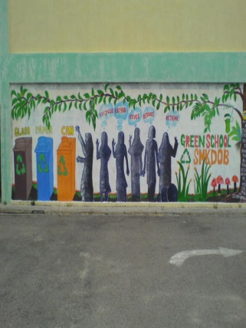


‘Info Green Centre’
MUDBALL STORAGE
Organic Enzyme storage
CANTEEN TABLES
Recycle Centre

Slide 25




VERMICOMPOST
NOTICE BOARDS
WETLAND
STINGLESS BEES

Slide 26






Living Skill Room : Innovations from recycled items
Composting Site 2
Classroom Green Corners

Slide 27
HOW WERE THE SUSTAINABLE GREEN PRACTICES EXECUTED THROUGH CO-CURRICULUM AMONG DATUK ONN STUDENTS???

Slide 28
NETWORKING
OUTREACH ORGANIZATIONS
COMMUNITY
UNIVERSITI SAINS MALAYSIA, EDUCATION FACULTY
CEMACS,USM
ENVIRONMENTAL DEPARTMENT
MPSP
BERTAM PROPERTIES
JPAM
KPDNKK
UNIVERSITI SAINS MALAYSIA (RSEN)
YONSEI UNIVERSITY KOREA
MINISTRY OF EDUCATION (KPM)
PENANG BUTTERFLY FARM
TEACHING INSTITUTES
SMK BAKTI
SMK SG ACHEH
COMMUNITY IN BAGAN AJAM
COMMUNITY IN BERTAM
COMMUNITY IN USM
COMMUNITY IN GELUGOR
COMMUNITY AROUND ESPLANADE
SMK KOTA TINGGI JOHOR
COMMUNITY AROUND KUALA LUMPUR
SCHOOLS IN PENANG AND OUTSIDE OF PENANG ISLAND
1000 COMMUNITIES

Slide 29
SCHOOL ENVIRONMENTAL STUDIES

Slide 33
ACTION PLAN
REUSE UNIT
RECYCLE UNIT
3K UNIT

Slide 34

MONITORING & EVALUATION
ACTIVITIES
REPORTS
DATA

Slide 35



`0`-WASTE
ACTIVITIES

Slide 36






REUSE

Slide 37



RECYCLE
OLD NEWSPAPERS
COLLECTION
PAPERS/BOXES
COLLECTION
COLLECTIONS OF
E-WASTE
INNOVATIONS
&
CLASS DECORATIONS

Slide 38


RETHINK-INNOVATION FROM RECYCLED ITEMS

Slide 39


E-WASTE
EVALUATION OF E-WASTE

Slide 40



REDUCE
STUDENTS BRING THEIR
OWN FOOD CONTAINERS
PLASTIC SAVING
FLOWER POTS REPLACED
WITH RECYCLED
BOTTLES/SHOES
‘0’-FLOWER POTS

Slide 41




INNOVATIONS OF COMPOSTING

Slide 42




INNOVATIONS OF VERMICOMPOST
COMPOST DRAWERS
VERMITEA
COMPOST

Slide 43





CLEANING LIQUID-BIM

Slide 44




SOAP MAKING ACTIVITY ORGANIZED BY
MATHEMATICS CLUB

Slide 45




O-TIME
URBAN FARMING
O-MONEY
O-SPACE

Slide 46




URBAN FARMING
PLANTS IN MINERAL BOTTLES
FENCING PLANTS
PLANTS IN UNUSED TYRES
PLANTS IN BARRELS

Slide 47


MINI BUTTERFLY FARM
PENANG BUTTERFLY
FARM
HABITAT YELLOW BIRDWING
LEARNING
STATION

Slide 48




‘SCHOOL COMPOUND CLEAN UP ACTIVITY’ ORGANIZED BY
PARENTS AND TEACHERS ASSOCIATION(PTA)

Slide 49





MUDBALL

Slide 50




MUDBALL PROGRAM WITH THE COMMUNITY AT VISION PARK

Slide 51




RAIN HARVESTING SYSTEM

Slide 52





GREEN CAMP
HERBAL
GARDEN
3D
MUSEUM
BEACH
CLEAN UP

Slide 53





KNOWLEDGE TRANSFER PROGRAMME
LEARNING WITH
KDU + USM
TRANSFER KNOWLEDGE-BENCHMARKING VISIT

Slide 54




SAFETY AND CLEANLINESS
CLEAN UP
PROGRAM
SAFETY
CLASS
DECORATIONS

Slide 55



REUSE

Slide 56



FIG TREE
NUTRITIONAL TREE
EXPLORING NEW SPECIES

Slide 57



VERMICOMPOST WITH USM
COW DUNG
NIGHT AFRICAN CRAWLING
VERMICOMPOST

Slide 58





CARBON FOOT PRINT COMPETITION
CARBON FOOTPRINT WITH ASEAN COUNTRIES ORGANIZED BY KOREA

Slide 59



WATER FOOTPRINT
STATE LEVEL

Slide 60

BEACH CLEAN UP
BAGAN AJAM
BEACH

Slide 61






GREEN INNOVATIONS
TYRE CHAIRS
FAN STAND
NOTEPADS FROM RECYCLED FABRICS
PLANTS GROWN IN UNUSED SHOES
CHAIR FROM UNUSED BARREL
OLD SEWING MACHINE

Slide 62


FLAT TYRE
CHAIRS
SINK MADE
FROM
OLD
SEWING
MACHINE

Slide 63







COLLECTIONS
BIM &MUDBALL
RECYCLE
O-WASTE
REUSE
E-WASTE
COMPOST
SOAP

Slide 64

REPORTS

Slide 65





SUSTAINABLE GREEN PRACTICES
DURING
COVID 19 PANDEMIC

Slide 66






TOTE BAG 2021 ONLINE COMPETITION

Slide 67












1 STUDENT 1 TREE 2021 ONLINE PROGRAM

Slide 68









2021 ONLINE NATURE PHOTOGRAPHY COMPETITION

Slide 69




WEBINARS

Slide 70




SCHOOL PROGRAM
SDG CHALLENGE
RCE GLOBAL
PENANG ENVIRONMENT DEPARTMENT

Slide 71
IMPACTS
ACHIEVEMENT
&
EXPERIENCE
RECOGNITION
AWARENESS
CAMPAIGN
SCHOOL POLICIES

Slide 72


INNOVATION TRASH TO TREASURE-ROOF COOLER-NATIONAL LEVEL

Slide 73




NATIONAL INNOVATION AND INVENTION COMPETITION

Slide 74




ORPHANAGE VISIT

Slide 75




WATER CAMPAIGN
SPRING
LOADED TAP
RAIN HARVESTING
SYSTEM
WATER RESERVOIR
SYSTEM
USING BOTTLE
TOILET TANK
SYSTEM
USING BOTTLES

Slide 76



ELECTRICITY CAMPAIGN
POSTER
STICKER
QUIZ

Slide 77



NO PLASTIC CAMPAIGN
CAMPAIGN
RECYCLE
PROGRAM
SCHOOL
POLICIES

Slide 78



NETWORKING WITH USM
VERMICOMPOST
BENCMARKING VISIT TO USM SITE

Slide 79




BENCHMARKING VISIT FROM UNIVERSITIES

Slide 80






BENCHMARKING VISIT BY SMK BAKTI

Slide 81




BENCHMARKING VISIT BY SMK LUNAS

Slide 82




BENCHMARKING VISIT BY SMK ELOPUTRA, SABAH

Slide 83


LEARNING INVENTION WITH KDU

Slide 84



EXHIBITION AT USM
7th ASIA PACIFIC MEETING AND INTERNATIONAL SYMPOSIUM

Slide 85




WORKSHOP AT USM 7th ASIA PACIFIC MEETING AND INTERNATIONAL SYMPOSIUM
LEAD BY SMK DATUK ONN
TEACHERS AND STUDENTS

Slide 86

EXHIBITION AT SHOPPING MALL

Slide 87


MASS MEDIA COVERAGE
MINI BUTTERFLY FARM

Slide 88




INFO GREEN CENTRE

Slide 89


NOTICE BOARD

Slide 90


GREEN SUSTAINABLE CORNER IN EACH CLASSROOM

Slide 91


EACH BLOCK NAMED USING
FLOWER NAMES
BLOK A – ARONIA
BLOK B – BEGONIA
BLOK C – CASTEANIA
BLOK D – DARWINIA
BLOK E – EUGENIA
BLOK F – FITTONIA
BLOK G – GARCINIA
BLOK H - HELICONIA

Slide 92

ACHIEVEMENTS & RECOGNITIONS

Slide 93




ASIAN YOUNG INVENTORS
EXHIBITION 2014
SPECIAL AWARD & GOLD MEDAL FOR GREEN INCINERATOR
CHAMPION IN GREEN RESIDENTIAL MODEL COMPETITION 2014
PENANG STATE LEVEL
ROPE JUMP
IN CONJUNCTION WITH
THE FITNESS CARNIVAL ORGANIZED BY DEPARTMENT OF YOUTH AND SPORTS

Slide 94


SILVER, GOLD
YOUNG
INVENTORS COMPETITION 2015
SILVER, GOLD
INOVATION COMPETITION
`TRASH TO TREASURE` 2015
NATIONAL LEVEL

Slide 95



ASEAN KOREAN
PARTNERSHIP JULY 2015
CHAMPION IN WATER QUIZ COMPETITION
KNOWLEDGE TRANSFER
PROGRAMME GRANT 2015-2017
BEST HIGH SCHOOL 8TH INTERNATIONAL
STUDENT BASED CONFERENCE

Slide 96




GREEN FLAG AWARD 2018

Slide 97

THANK YOU

