Slide 1
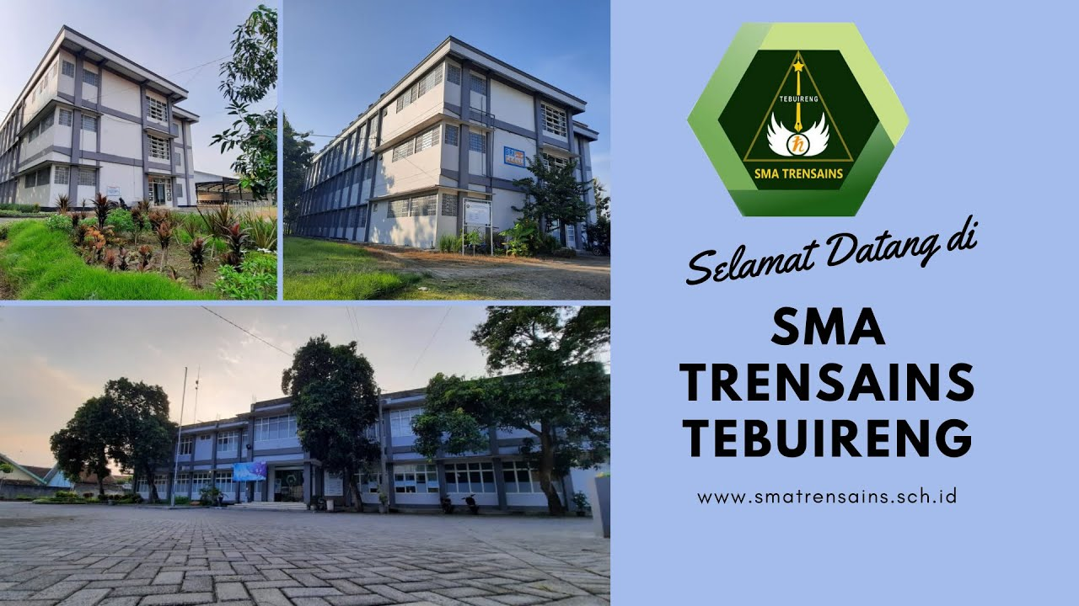
Green sustainability practices :GSP in and
M. Argian Ramadhan & Nesha Khaira Utami
Students of SMA TRENSAINS
https://www.smatrensains.sch.id/
Jl. Raya Jombang-Pare KM 19 Jombok Ngoro Jombang
East Java Province
Indonesia

Slide 2
From literature:
“Sustainability involves becoming aware of the impact of all the little decisions that we make.”

Slide 3
Sustainability at home–my experience and idea to go green!
My Experience
Go #PlasticFree
Be water wise
Turn off the lights when I leave a room
Hand wash my clothes, particularly if I only have a few items to clean.
Turn off my devices at night, including my wifi box
6. Stop buying bottled water!
7. Use my phone, tablet or computer for note-taking
8. Use cloths instead of paper towels.
9. Don’t leave the water running when cleaning my face.
10. Get your devices repaired instead of buying new ones.

Slide 4
Sustainability at home–my experience and idea to go green!
My Idea
Think twice before shopping
Use LED lighting or CFL bulbs instead of incandescent lighting
Start timing your showers
Try a monthly ‘Lights Off Hour’
Donate unneeded goods to charity or a freecycle program with my neighborhood friends

Slide 5
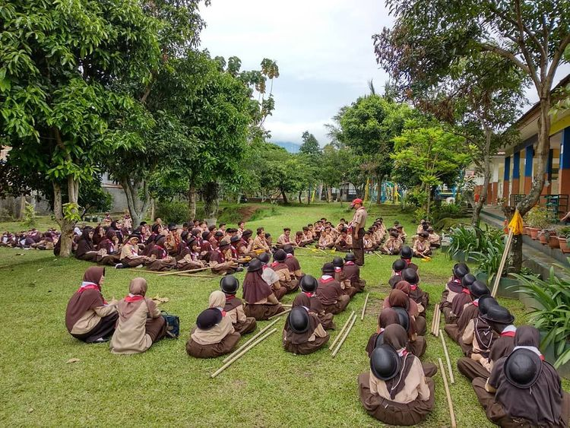
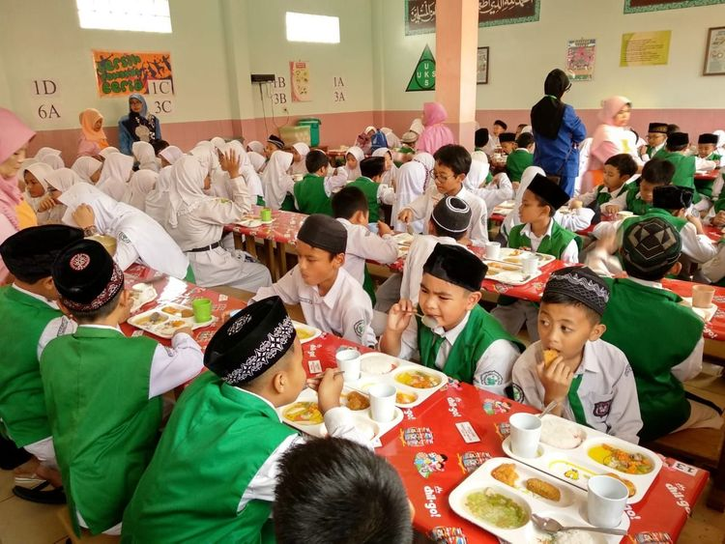
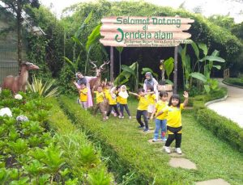
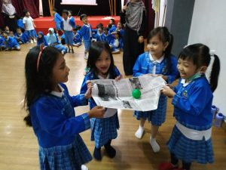
Sustainability at School –my experience and idea to go green!
Get closer to nature through Extracurricular program
Zero food waste program
Field trip, school farming
Recycle as much as possible: creating a ‘recycling center’ for toys
Never heard about term “green sustainability” explicitly;
BUT…
We were introduced to “activities” that actually sounds like green sustainability things at school
FACTS?
Kindergarden
Primary School
Junior
High school

Slide 6
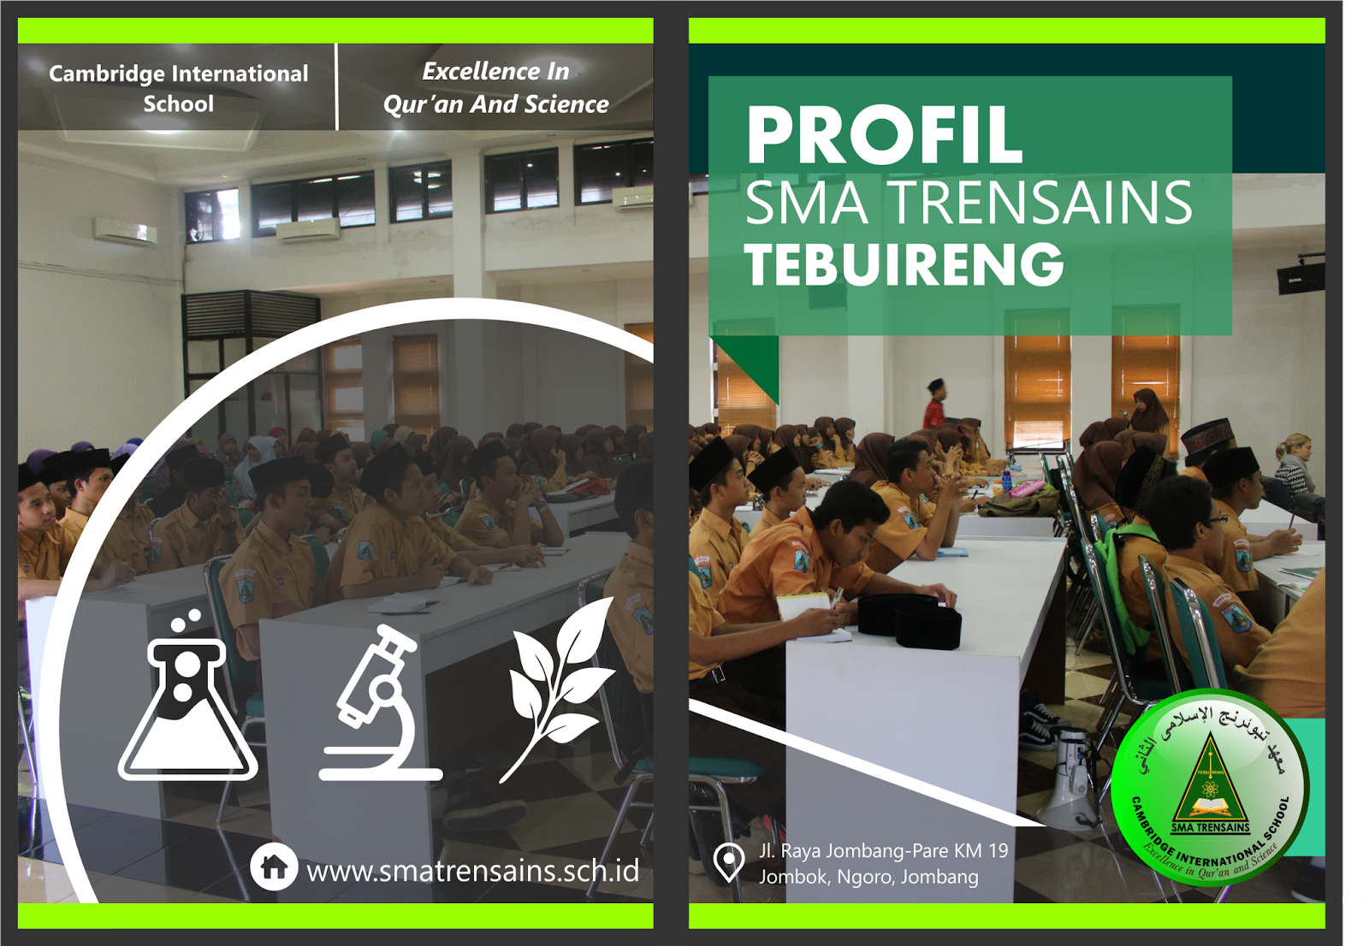
Sustainability in our School –my experience and idea to go green!
Senior High School
School’s subjects
School’s facilities
School’s architecture
School‘s
role

Slide 7
Sustainability in our School –my experience and idea to go green!
School subject
Example: Science
We always reminded by teacher ..
how important environment is
how important water in our daily life
how important electrical in our daily life

Slide 8
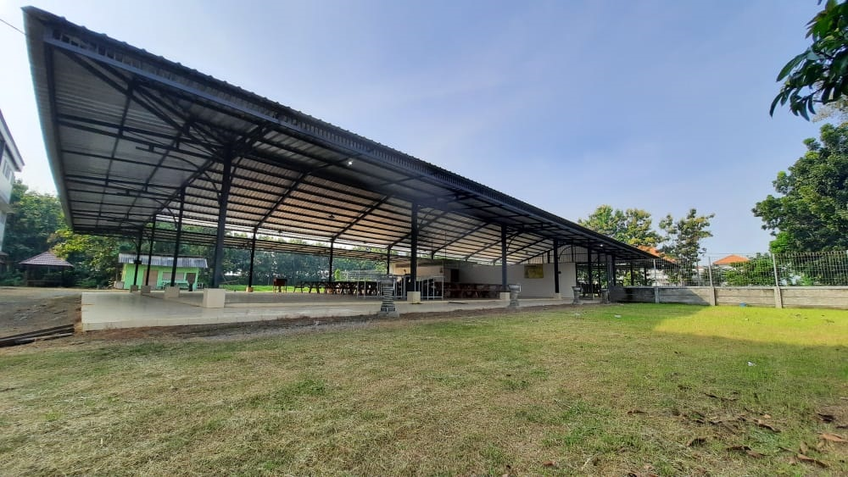
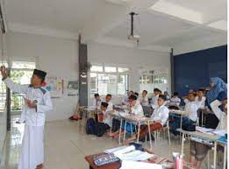
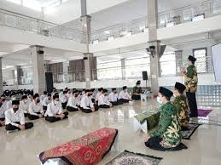
Sustainability in our School –my experience and idea to go green!
School facilities
Example: optimize lighting for each room
Rally for solar panels

Slide 9
Sustainability in our School –my experience and idea to go green!
School roles:
Rally for the use of reusable containers for lunches
Schedule a trash pickup day
Watch Your Water Usage
Zero food waste

Slide 10
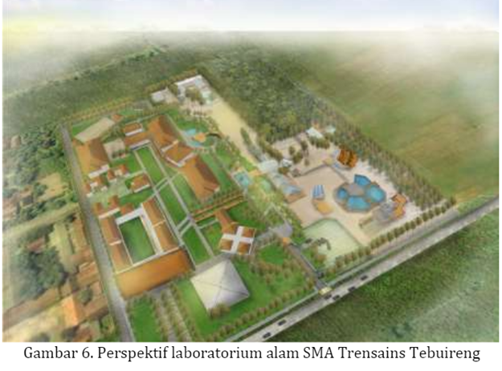
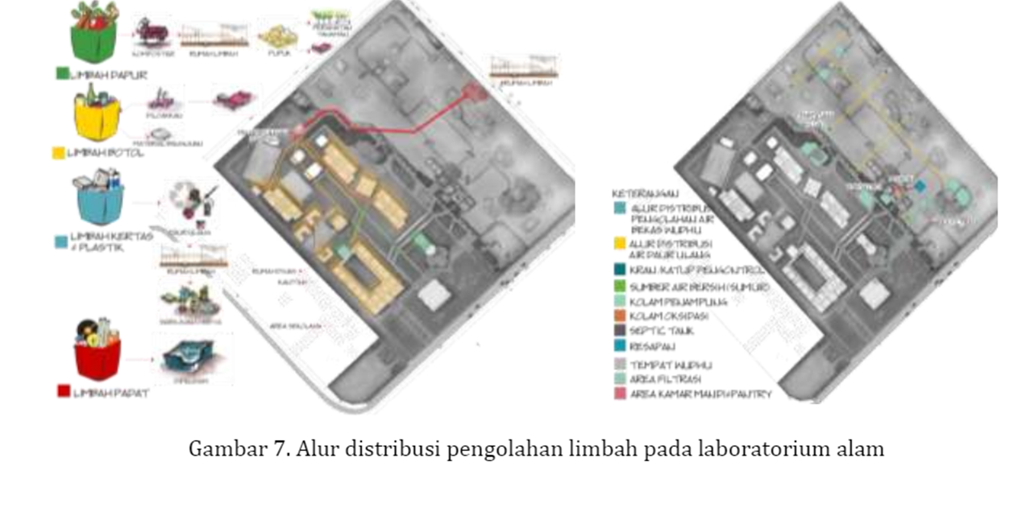
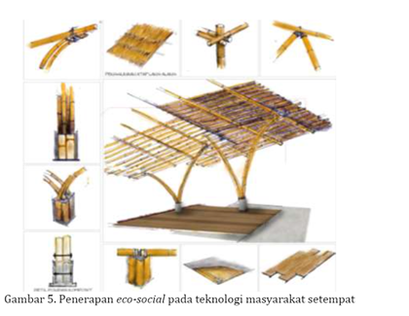
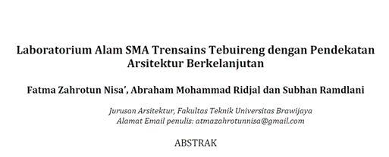
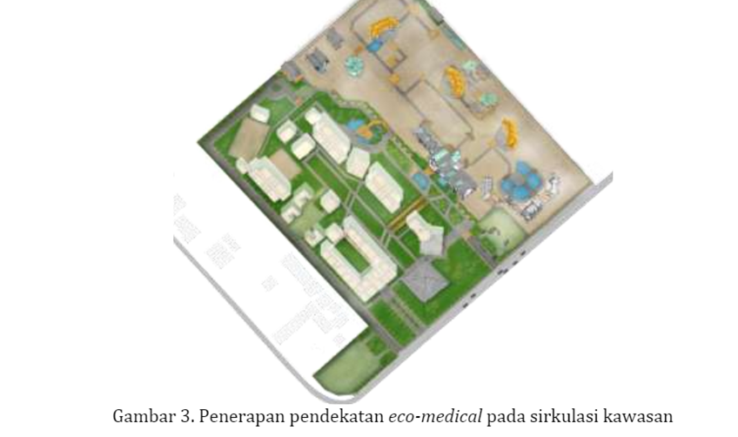
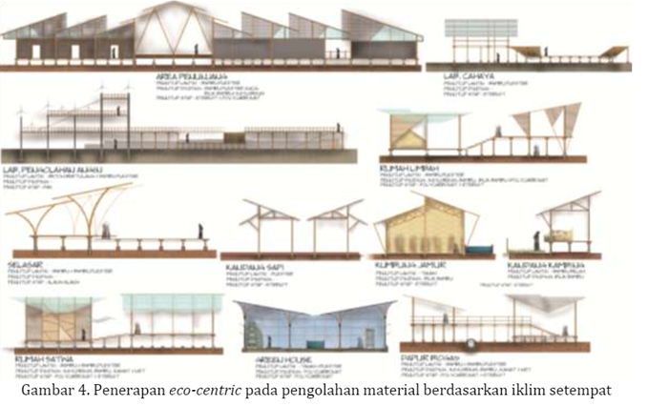
Sustainability in our School –my experience and idea to go green!
Eco-technic
Eco-medical
Eco-centric
Eco-aesthetic
Eco-social
Eco-cultural

