Slide 1
Mangrove Planting and Mudcrab Culture
Sustainable Development through Community Empowerment

Slide 2
Project Description
Mangrove Planting and Mudcrab Culture in Bool District are component projects of the Productivity and Environmental Awareness for Community Empowerment (PEACE) Program implemented jointly by the Regional Center of Expertise-Bohol (RCE-Bohol) through the Bohol Island State University, the Bureau of Fisheries and Aquatic Resources (BFAR), the Department of Environment and Natural Resources (DENR),

Slide 3
Projects Objectives
Educate the local residents on the role of the environment in their well-being and on the need to sustain it for continued utilization;
Provide a sustainable livelihood for local residents to address economic problems;
Empower socially the local residents through active involvement in the project implementation and management; and
Engage the member-institutions of RCE-Bohol in ESD implementation.

Slide 4
Expected or Confirmed Outcomes
Environmental Conservation
Cessation of illegal cutting of fully grown mangroves
Improvement of marine biodiversity
Economic Benefits
Additional income from collection of shells which have grown in abundance in the area
Sale of fattened crabs
Sale of fattened fish collected within the surroundings of the enclosure

Slide 5
Outcomes continued…
Social upliftment/empowerment
Enabled the locals to interact with university faculty and national government personnel by engaging them actively in the planning and implementation of the projects, and thus has boosted their sense of social relevance.
Intensified service delivery
Installation of a solar panel which stores energy for electric bulbs and other power efficient gadgets.

Slide 6
Challenges encountered
Weakening enthusiasm of People’s Organization members who co-managed the project
Differences among members;
Patronage politics in the city;
Red tape in the bureaucracy
Conflict between RCE-Bohol member-institutions own organizational mandate and that of the RCE

Slide 7
Mainstreaming/Scale-up of ESD/SD Practices in the Projects
Put into printed materials the lectures about mangroves and their benefits to the environment. This allows for wider dissemination of information to students in the university at all levels;
Targeted GAP Priority area = Whole Institution
Approaches

Slide 8
Mainstreaming/Scale-up continued…
Adopt co-management technique with partner community in the implementation of programs, projects and activities in all the RCE-Bohol sites.
This strategy not only enables the local people to determine their needs but also to find solution and sustain such solution for their well-being.
Target GAP Priority Area = Local
Communities

Slide 9
Conclusion
Mangrove Planting and Mudcrab Culture Projects in Bool District started off as a response to a felt need to address environmental and livelihood challenges. With the cooperation and collaborative effort of the member institutions of RCE-Bohol and the local community, the projects have initially achieved the goals set forth.
Continued monitoring and assessment of the project revealed that as the strategies employed are sustained, better outcomes are expected that would benefit the local people for their well-being.

Slide 10
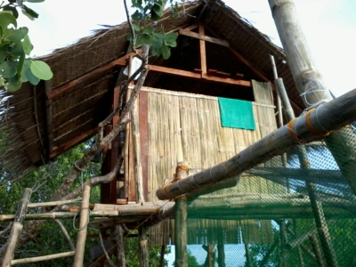
Pictures

Slide 11
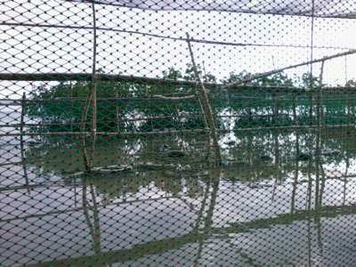
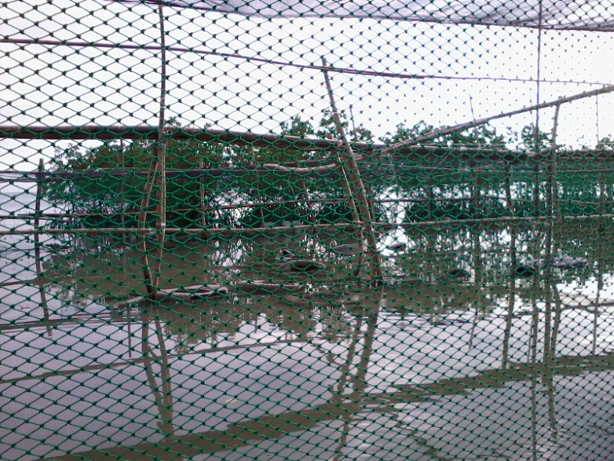
Pictures

Slide 12
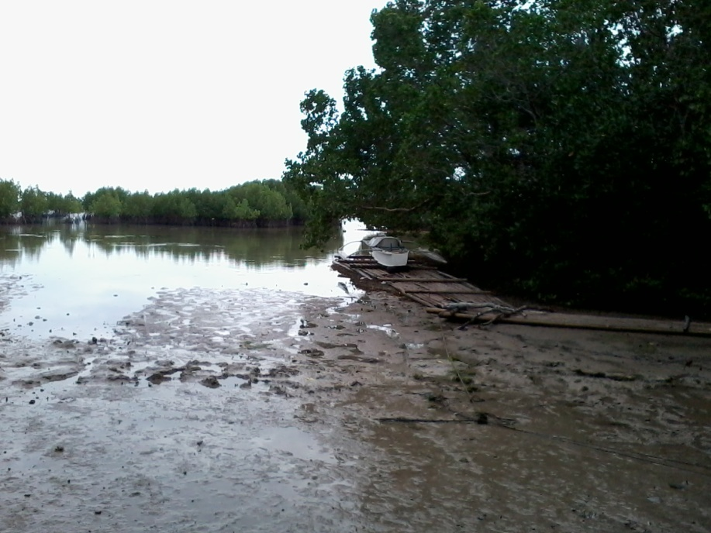
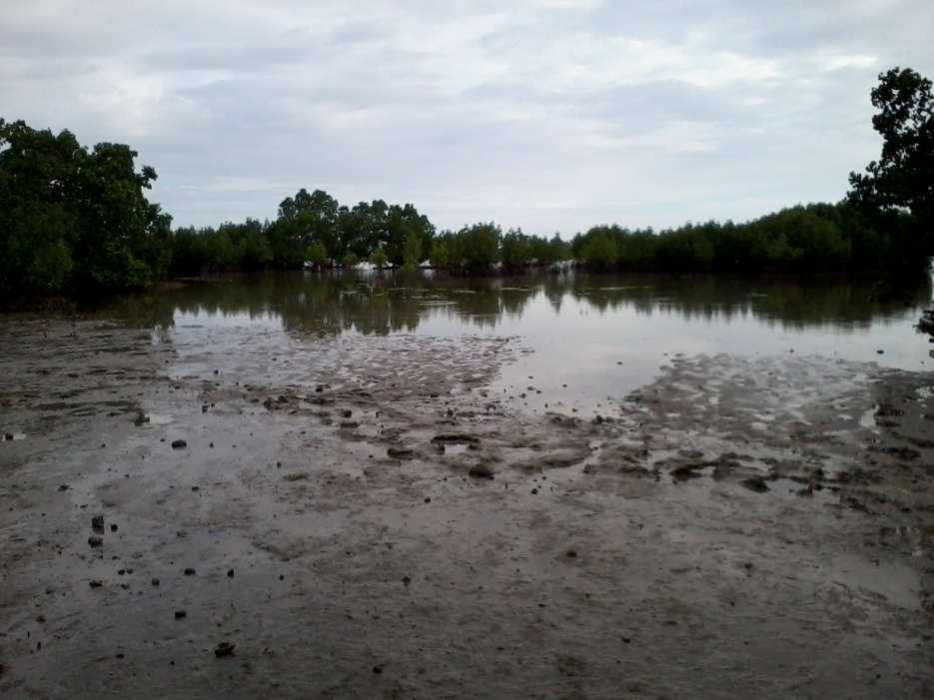
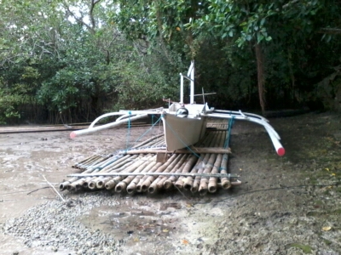
Pictures

