Slide 1
Indian Himalayas Climate Adaptation Programme (IHCAP) PHASE I
CEE Himalaya
Centre for Environment Education
Himalaya Initiative
Contact:
Dr. Abdhesh Kumar Gangwar
Programme Director
CEE Himalaya & CEE North-East
abdhesh.gangwar@ceeindia.org/ceehimalaya@ceeindia.org
Mobile: +919415104125

Slide 2
CEE Himalaya (Centre for Environment Education, Himalaya Initiative) was awarded two mandates by the Swiss Agency for Development and Cooperation (SDC) under its Indian Himalayas Climate Adaptation Programme (IHCAP):
Organizing four Capacity Building Workshops for Media on Climate Change and Development in the Indian Himalayan Region
For the period 15th March 2014 to 14th December 2015
Credit proposal No. 08037.01.01
Contract No. 08037.01.01-012
2. Supporting Science Express - Climate Action Special and Multimedia Mobile Exhibition in the Indian Himalayan Region
For the period 09th October 2015 to 31st December 2015
Credit proposal No. 7F-08037.01.01
Contract No. 81038520

Slide 3
Mandate 1: Organizing four Capacity Building Workshops for Media on Climate Change and Development in the Indian Himalayan Region
Media Workshop Location | Duration | Participants |  | Workshop Themes
 |  | Journalists | Resource Persons & Organizers
Shimla Himachal Pradesh | 30 July to 1 Aug 2014 | 18 | 16 | Impact of CC on Agriculture, Forests, Biodiversity, Food Security, Livelihood
Namchi South Sikkim | 17-19 November 2014 | 25 | 12 | Watershed management and reviving the water streams
Srinagar Jammu & Kashmir | 6-8 April 2015 | 17 | 11 | The devastating J&K Floods
Jorhat & Majuli Islands Assam | 2-5 November 2015 | 14 | 12 | Climate change impacts on agriculture, tea and fish; Floods, soil erosion in Brahmaputra basin and livelihood in Majuli Islands

Slide 4
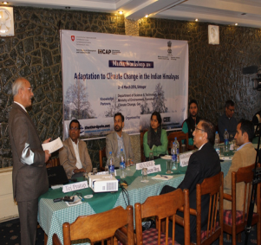
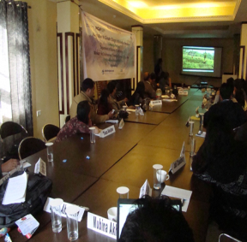
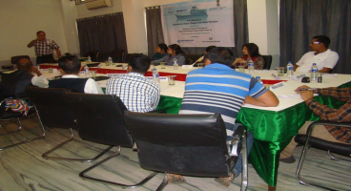
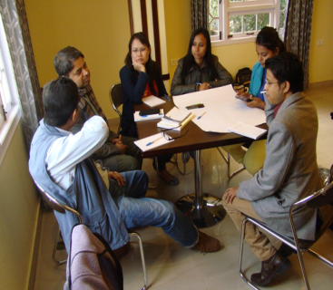
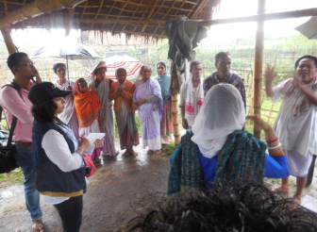
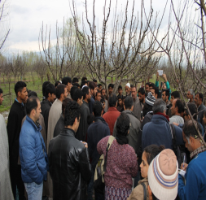
Methodology for Mandate 1
Jyanata Deka presenting the impact of CC on
agriculture in Assam
Presentation by Dr. Tej Pratap, V C, Sher-e-Kashmir
University of Agricultural Sciences and Technology
Short documentary showed to participants on CC
Participants interacting with cattle herder of
Majuli Islands
Interaction with apple cultivators of
Bandipora district, Srinagar, J&K
Group discussion among participants

Slide 5
Commitments & Achievements
S. No | Commitments | Proposed | Achievements
 | Training and capacity building of media personnel on climate change and sustainable development issues, global initiatives on handling these challenges and get oriented on reporting these issues effectively resulting in community awareness, advocacy and policy influence. | 50 media personnel | 74 media personnel were trained through 4 media workshops, which is more than the proposed target.
2. | Training Modules | Reporting Climate Change and Sustainable Development Trainer’s Guide | Delivered
3. | Workshop Reports | 2 reports per workshop-Proceedings : documented the workshops as they ran Journalists : zest of the deliberations made and discussions held. | 8 workshop reports have been prepared and submitted

Slide 6
Commitments & Achievements
S.No. | Commitments | Proposed | Achievements
4. | Press & Electronic reporting/case studies | Press and Electronic reporting/case studies from the journalist participants. | Till present more than 50 press & electronic reporting/case studies appeared in the media.
5. |  |  | Increase in the amount of media coverage given to climate change issues.
6. |  |  | Compiled a database of journalists trained and stories they have published so far.

Slide 7
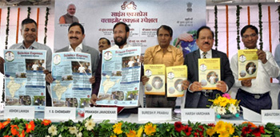
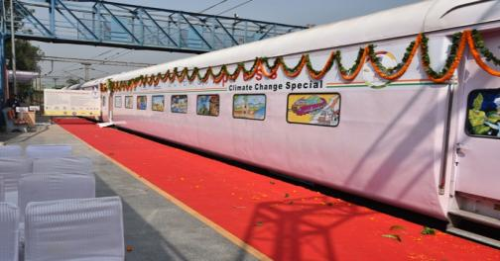
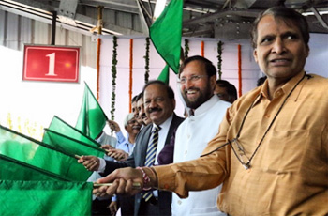
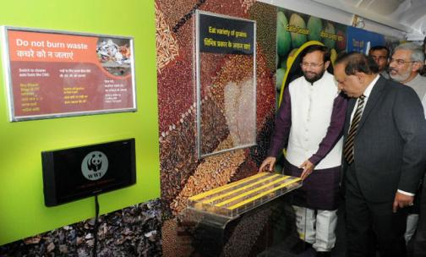
Mandate 2: Supporting Science Express Climate Action Special and Multimedia Mobile Exhibition in the Indian Himalayan Region

Slide 8
Reach out Summary
Location | Activities |  |  | Activities conducted
 | Pre-train | Platform | Post-train | Quiz, Speech, Group Discussion, Mini Science Experiments, Activities on Basic Science and mathematics concepts Display of Standees on Climate Change related messages and discussion based on them, Showing of previous video on Biodiversity Special Train-2012. Drawing, Poster Making, Speech, Discussion, Idea Activity, theme based lectures, meeting, interaction with and address by our resource persons and subject experts, Discussion on water shed management and information about environmental activities, rope & ladder game, Story Telling, Quiz, Speech, Group Discussion, Mini Science Experiments
Amb Andaura | Could not be conducted due to Diwali Holidays in schools | 795 | -
Churarau Takarla |  | 548 | -
Udhampur | 1320 | 2580 | -
Samba | 1293 | No proper platform at Samba Station. | -
Haridwar | 1857 | 2424 | -
Lalkuan | 1277 | 6270
New Jalpaiguri | 3417 | 972 | -
Students’ Science Congress, Rampur, Himachal Pradesh | - | - | 3440 | Equinox Line, Earth Rotation and Revolution, Earth’s Axis & Tilt, Seasons change, Climate change and its Impact on Earth, Information on Science Laws like- Bernoulli’s Law, Centre of Mass, Centre of Gravity etc., Display of Standees and Discussion on them.
Jammu | - | - | 100 | Equipped educators on climate change
 | - | - | 25 | Orientation of media for climate change reporting
Total | 9,164 | 13,589 | 3565 | 26,318 including students, teachers, Sadhus, street vendors, pilgrims ,farmers and general public

Slide 9
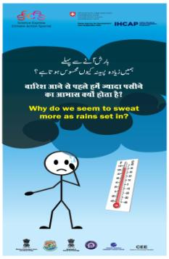
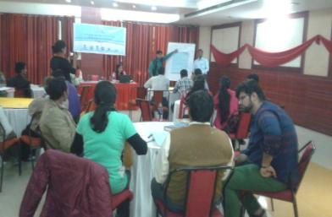
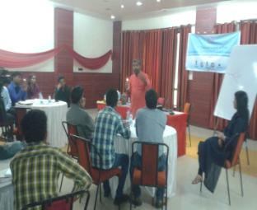
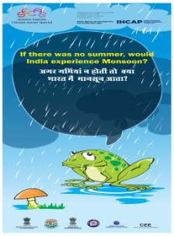
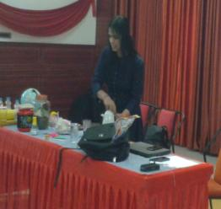
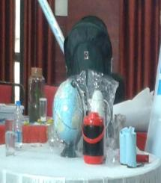
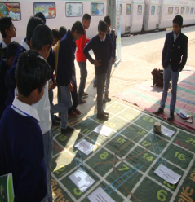
Methodology for Mandate 2
Volunteers trained for SECAS Activities
Facilitators’ Workshop
Trilingual standees
Material in Science kit provided to the volunteers
Ropes and ladder game for
handprint action
Bilingual standees

Slide 10
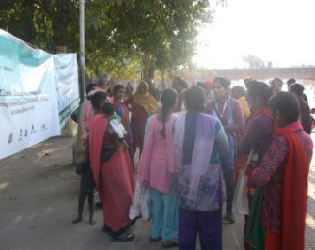
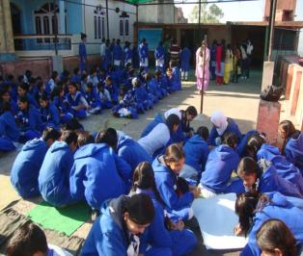
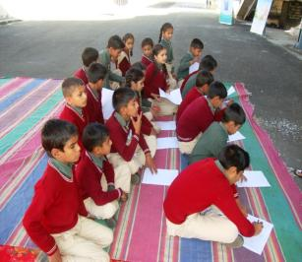
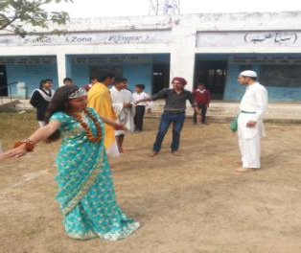
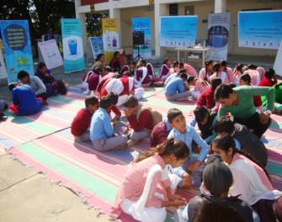
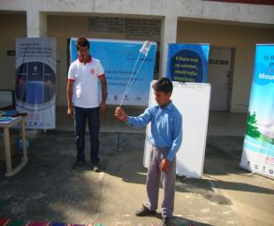
Pre-train Activities
Discussion with pilgrims at
Ganga Ghats
Poster making & slogan writing
Quiz competition
Multiple group activities
Students performing skit
Mini science experiment

Slide 11
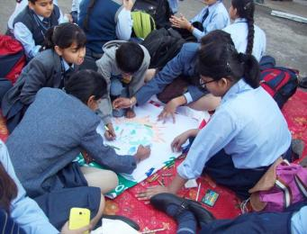
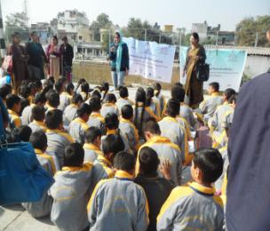
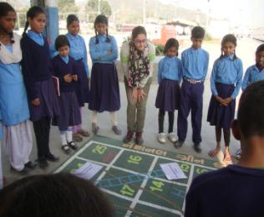
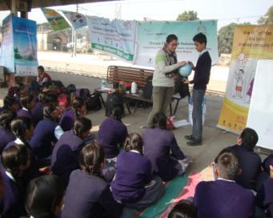
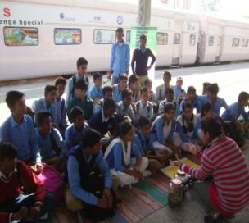
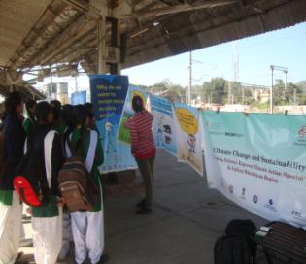
Platform Activities
Poster making and Drawing
Discussions
Ropes and ladder game
Globe Activity
Mini Science Experiment
Discussion based on standees

Slide 12
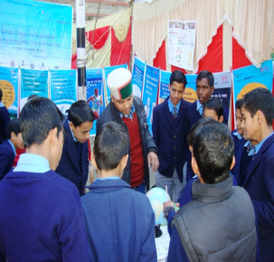
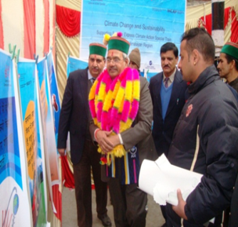
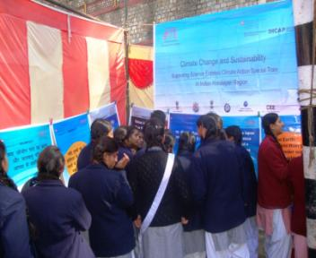
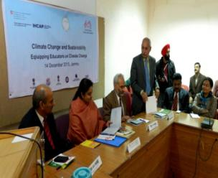
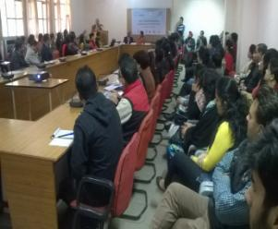
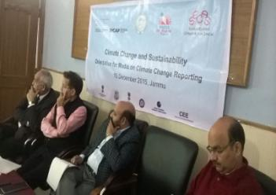
Post-Train Activities
CEE Team conducting activities with students
at Students Science Congress, Shimla
Hon'ble Chief Secretary Mr. P.C Dhiman
observing CEE Exhibition at
Students Science Congress
Students observing standees displayed
by CEE at Students Science Congress, Shimla
Shrimati Priya Sethi, State Minister for
Education, Culture and Information as the
chief guest at educators workshop
Workshop on equipping educators on
climate change
Shri Bali Bhagat, State Minister for Social Welfare,
Forest, Ecology and Environment, the chief guest
at media orientation workshop

Slide 13
Commitments under Mandate 2
At least 10 facilitators trained in basics of climate science and communicating raising awareness on climate issues in local language and local context.
Two-day facilitators’ orientation programme
10 facilitators kits assembled and distributed to volunteers
Platform activities at Churaru Takarla and Amb Andura in Himachal Pradesh (HP), Udhampur and Samba in Jammu & Kashmir (J&K).
Conducting activities in cities of Himachal Pradesh, J&K.
Development of portable standees for facilitators
Conducting activities in Churaru Takarla, Amb Andura and Shimla in HP and Udhampur, Samba and Jammu J&K post Science Express Climate Action Special.

Slide 14
Achievements under Mandate 2
2 volunteers from each of the cities of ChuraruTakarla, Amb Andura, Udhampur, Samba, Lalkaun and Haridwar were trained in the workshop.
Two-day workshop conducted on 19th and 20th November 2015 by two resource persons from CEE Ahmedabad to prepare volunteers for the activities and also provide them with necessary literature and a science kit.
Each volunteer was given 1 science kit consisting of several tools and gadgets like glasses, thermometers, globe, maps, discs, etc.
14,000 students, teachers and general public were addressed at platforms Churaru Takarla, Amb Andura, Udhampur, Samba, Lalkaun, Haridwar and New Jalpaiguri.
10,000 students, teachers and general public addressed in cities of Churaru Takarla, Amb Andura, Udhampur, Samba, Lalkaun, Haridwar and New Jalpaiguri.

Slide 15
Achievements under Mandate 2
Developed 20 standees, tri-lingual (Hindi, English and Urdu)
3,565 students, media persons, teachers were addressed in Shimla and Jammu
Integration of concerned authorities e.g. State Education Department Jammu, Department of Environmental Sciences of the University of Jammu, and the Press Club of Jammu, HP State Council for Science, Technology & Environment, Climate Change Cell, Tourism, Municipal Corporation etc.

Slide 16
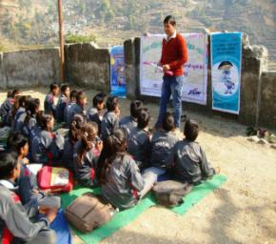
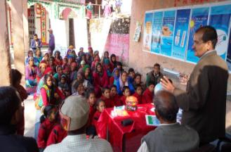
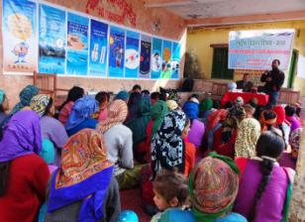
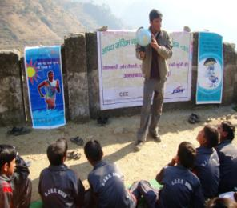
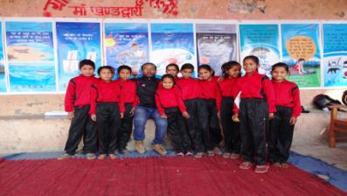
Sustainability Beyond Project
Through its Offices and several programmes being run across IHR, CEE has been able to carry forward the activities started under both the mandates.
National Science Day Celebration at
Kuroli Village and
Govt. Primary School, Kuroli,
using standees and science kit
DRR and CC awareness programme in
school using standees and science kit

Slide 17
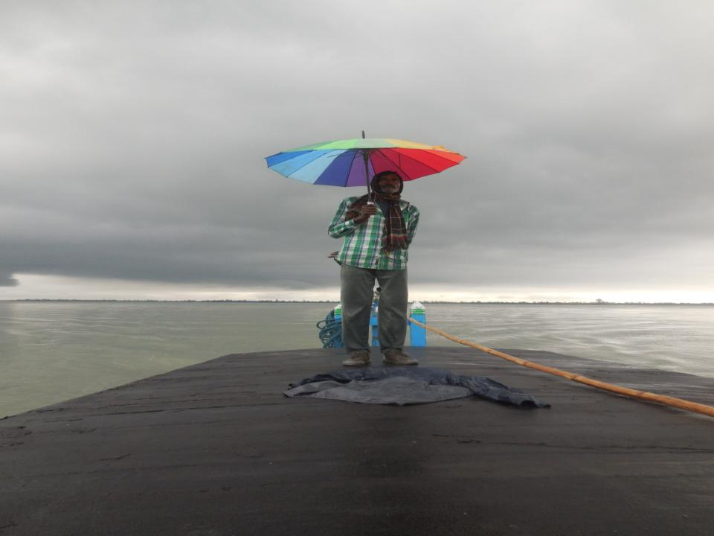
THANK you
THANK yOU

