Slide 1

measurement impossible ?!
Presentation for
International Conference of Latvian NationalCommission for UNESCO
December 2015, Daugavpils
Detlev Lindau-Bank,
University of Vechta RCE Oldenburger Münsterland

Slide 2

ACEWild
Alternative Curriculum – Education out of the Wild !
EVALUATION METHODOLOGIES
Detlev Lindau-Bank; Lukas Scherak, (RCE OM e.V.)
Bogdan Bosoanca and Sina Wolter (Christian-Hülsmeyer Schule)

Slide 3
What is Outdoor Education?
Outdoor Education is an experiential method with the use of all senses in which most of the learning takes place in the outdoors. Outdoor education programs often involve residential or journey based experiences in which students participate in a variety of adventurous challenges.
Outdoor Education is education in, about, and for the out of doors.
  In – tells us that outdoor education can occur in any outdoor setting from a school yard to a remote wilderness setting.
  About – explains that the topic is the outdoors itself and the cultural aspects related to the natural environment.
  For – tells us that the purpose of outdoor education is related to implementing the cognitive, psychomotor, and affective domains of learning for the sake of the ecosystem itself.

Slide 4
Philosophy/Aims of Outdoor Education
The aim of outdoor education is usually not the activity per se, but rather to learn how to overcome adversity, work alongside others, and to develop a deeper relationship with nature. The three domains of self, others, and the natural world are commonly understood as the main aims in outdoor education.
Some specific outdoor education programs aims are to:
  Reduce recidivism (crime)
  Enhance teamwork
  Teach outdoor survival skills
  Promote spirituality
  Understand natural environments
  Develop leadership skills
  Improve problem solving skills

Slide 5
Components of Outdoor Education
Adventure Education
  Interpersonal relationships – refer to how people get along in a group of two or more people.
  Intrapersonal relationships – refer to how an individual gets along with self, self-concept, spirituality, confidence, self-efficacy, etc.
Environmental Education
  Ecosystemic relationships – refer to the interdependence of living organisms in ecological microclimate.
  Ekistic relationships – refer to the interactions between human society and the natural resources of an environment.

Slide 6
Aims of ACE Wild
Due to the nature of the learners, the main focus of the project was to develop personal, social and emotional skills – which are vital in day to day life and to raise achievement. The two main Learning Objectives were:
To improve emotional wellbeing and increase confidence of learners
To develop inter-personal and intra-personal skills of learners.

Slide 7
Outdoor-learning – from sensation to learning
Attraction | Risk | Individuals | Doing
Experience | Reflection | Group | Interaction
Learning | Life long learning | Community | Transition

Slide 8
Cultural differences?
Classroom Culture
Told the information
Reading about topics
Physical distance from others
Limitations
The expected
Intellectual development
- Physical inactivity
Outdoor Classroom Culture
Discover the information themselves through investigation
Experiencing topics first hand and relating them to real life situations
Working in collaboration with others
Testing one’s own limits and learning what is safe
The unexpected
Multi- Sensory/ Whole child development
- Physical development

Slide 9
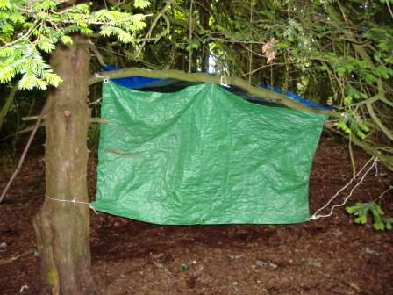
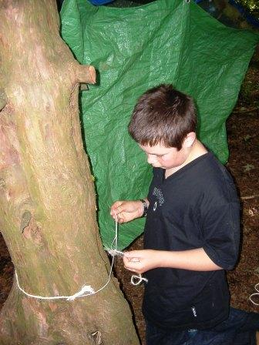
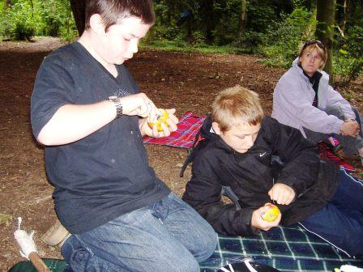
Photographic Evidence
A and N worked together to construct this shelter. A gave N clear instructions on what to do.
N was fascinated by knots and enjoyed developing his skills.
Making Apple Cups as a snack, sitting together.

Slide 10
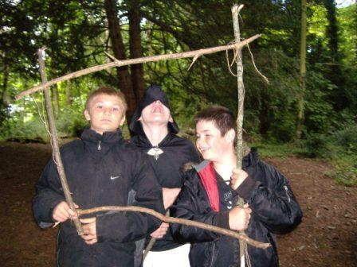
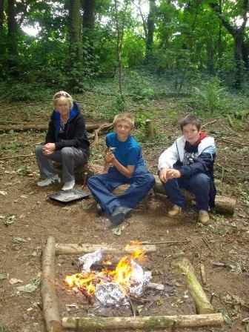
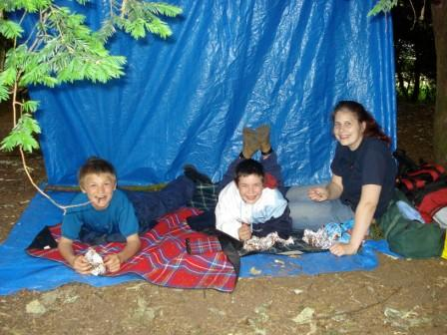
The boys constructed a picture frame using square lashings
Boys constructed fire area , working out how to de-mark the fire area and distances for seating. Cooking chocolate bananas were popular.

Slide 11
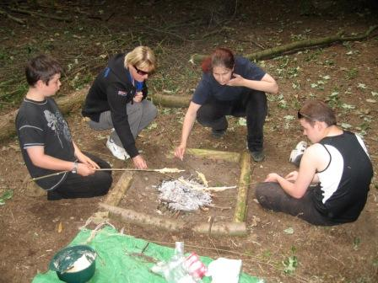
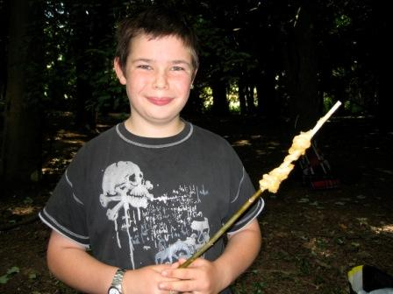
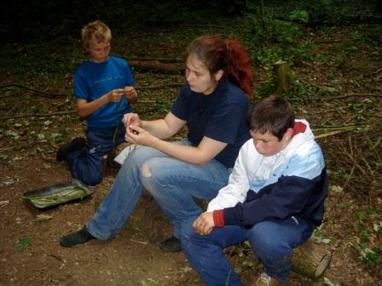
We made and cooked cheesy damper bread on the fire. N particularly enjoyed cooking!
Boys were interested in how to make string from nettle fibres – so we had a go, whilst waiting for the kettle to boil.

Slide 12
Results (Period 1)
There were some very clear and positive themes and results which emerged from the initial trial of Forest School:
Confidence and Self Esteem
The boys grew in confidence and self esteem. From being reserved and unsure at the first session the boys, developed as they became more familiar with the site and sessions. During the first session in the woods, N was obviously frightened and uneasy in the ‘unknown’ environment. At the final ‘celebration’ session he was happy to show invited adults what to do, how to use tools safely and gave them clear instructions in how to light a safe cooking fire.
Speaking and Listening Skills
There was a marked improvement in communication skills within the focus of the sessions. Particularly in the case of A, who is severely dyslexic and has poor memory and descriptive language skills. He was observed giving clear instructions when shelter building to N, describing where to tie knots and the shape of the shelter.
Attendance
Forest School motivated the boys to attend, even if they were finding a traditional education challenging. The attendance records of M show interesting trends. Despite a number of unauthorised absences in the classroom during the 7 week trial period , he only missed 1 Forest School session.
Behaviour
There were no occurrences of physical management during any of the Forest School sessions, which is of note particularly for M who had a growing number of occurrences at Avocet House during the June (14 incidents) & July (6 incidents) period (the time during the Forest School pilot). Also, N was physically managed twice at Avocet House in April and May (before the Forest School pilot) and not at all during and afterwards.

Slide 13
Feedback from supporting Teacher
How do you feel the Forest Schools experience supported raising pupil’s achievement?
The woodland environment and the opportunities that it presented had a highly motivating effect on the boys, thus they were more likely to engage in the learning and want to extend their understanding. Also, they were presented with choices, in what and how they learned , thereby giving them a degree of independence and opportunities to improve their own learning. The boys developed; practical skills such as knot tying, safe tool use, safe fire lighting, cooking and extinguishing; social skills such as communication, negotiation and team work and also knowledge and understanding about the natural world, tools and tasks undertaken.
In what ways do you feel that the Forest Schools approach supports/promotes personal, social and emotional skills?
Personal Skills – It was clear that the boys grew in confidence within the woodland environment. N in particular was quite nervous initially in the new environment but soon was confident enough to support others with tasks. M also demonstrated large amounts of determination and perseverance when he wanted to carve his spoon from a log using an axe (the others received a template already roughly carved), which he did safely.
Social Skills – Certain tasks within the woodland required cooperation and interaction for them to be achieved, so it gave the boys a context and motivation for working together (often in the classroom the boys receive 1 to 1 lessons). Also, the use of fire and outdoor cooking created a community feeling within the group . All the boys chose to be involved with the fire and sitting around the fire, when perhaps they would not have normally chosen to do so.
Emotional Skills – It became apparent that the woodland space helped the boys manage their behaviour. The ‘elastic boundaries’ allowed individuals to move away from a situation to calm down, but because the space was unfamiliar they had to return to the group afterwards (unlike at Avocet House where they would perhaps retreat to their room).
In what ways do you think the experience affected pupil’s health?
There is much current research on the health benefits of being in the natural environment, to both physical and mental health.
There are physical benefits of being active and in the fresh air – essential for healthy brain development and learning, as well as developing muscle control and coordination through various tasks such as shelter building, tree climbing. M was most adept with his fine motor control and coordination so he was encouraged to extend these skills through providing a progression of tasks and tools e.g. using an axe.
There are mental and emotional benefits also to being in the outdoors. The colour green is proven to have a calming effect on the brain, a particularly appropriate space to use with learners who struggle with controlling their emotions. Also connecting with the natural world, is connecting to something larger than the self, an almost spiritual experience, and hence conducive to self-reflection and contemplation.

Slide 14
Feedback from supporting Teacher continued
Is supporting the Young People in Forest School something you felt comfortable and confident with?
Having undertaken the level 1 Forest School skills training I had a degree of understanding of the Forest School ethos. It has motivated me into wanting to undertake my Level 3 Leadership training, as I can see the great benefits of working offsite with boys.
Are there any areas of the Forest school experience that you felt less comfortable with?
It was hard at times to step back and allow the boys to take control, due to the unpredictable behaviour I know they can show, especially in the context of using tools and fire, where inappropriate behaviour could cause serious harm.
How could Forest Schools approaches support the five ‘Every Child Matters’ priorities?
Forest School supports all 5 areas of the Every Child Matters agenda:
Stay Safe – The process of risk awareness was shared with the boys and appropriate actions negotiated. The safe use of tools and fire is clearly defined and procedures were followed sucessfully.
Be Healthy – The health benefits of Forest School have been previously discussed
Enjoy and Achieve – Forest School is a highly motivational context for achievement, the boys engaged with their learning and evidence suggests they enjoy using skills learnt.
Make a Positive Contribution – The knowledge and understanding developed at Forest Schools encourages environmental and social citizenship.
Achieve economic wellbeing – The skills learnt within a Forest School are transferable to the rest of the boys life. A , as a result of Forest School has displayed an interest in the natural world and we are now looking at vocational training opportunities for him at Easton College. We also plan to pilot how vocational qualifications can be gained through future Forest School work.

Slide 15
Results of Questionnaire (no items open questions)
How do you feel the Forest Schools experience supported pupil’s learning?
The experience was on the whole a good one, the boys needed time to get used to being outside to adjust in what was initially quite a daunting environment.
Did you notice any changes in pupils’ behaviour during the Forest Schools experience?
As the boys became more familiar with the surroundings they began to relax and be more confident using tools, building the fires and shelters. The boys seemed to be more aware of each other although the environment is so much more open.
Is supporting the young people in Forest Schools something you felt comfortable and confident with?
Yes I thought it was fine I thought that the sessions engaged the children well and they responded well to the challenges.
Any other comments?
I enjoyed the sessions, I was impressed by the engagement of the boys, although there was a relaxed feeling to time, the boys listened to the rules of the session and the reason for them.

Slide 16
Observations and implications – lessons learnt
Benefits of an offsite woodland location – behaviour strategies
The offsite location worked very well as a context for managing behaviour for the boys. The boys had the space to avoid confrontations, but had to return to the group – as there was no where to go. There is also the benefit of the therapeutic nature of the outdoors - less constraints, more freedom of movement and the ability to use different learning styles.
Session Times
The sessions would be more meaningful if they could be longer. The boys need a transition time to settle and would often just be getting into something when it would be time to leave. Longer sessions would also allow more time for reflection and discussion at the end.
Programme length
We were undertaking a 7 session pilot, so looking at a short space of time, however some interesting results still were apparent. For the boys to gain the full benefits of Forest School the programme should be at least a full year.
Measuring emotional /social development
Measuring development of ‘soft skills’ can be quite difficult and for a long term programme an appropriate system should be adopted. Leaders are looking into the Leuven scales of involvement and wellbeing as a possible tool for this.

Slide 17
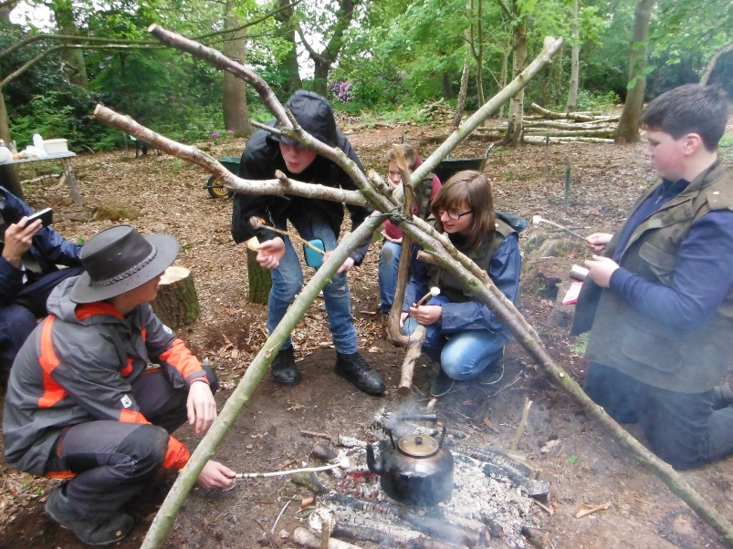
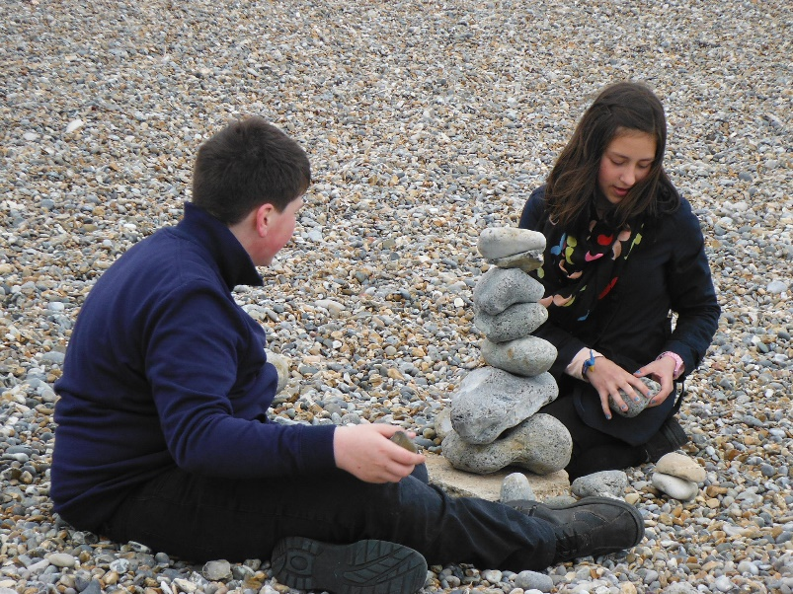
What do we measure? (Period 2)
1) To measure the impact of the programme on the:
attitudes and behaviours
and mindset of the participants
2) To provide evidence that the programme works
Notes:
We had three reasons to evaluate the OL programme at AHS in the first research period.
Firstly, to measure the impact it at had on the pupils’ mental well-being, their attitudes to learning and general behaviour (both on the course but also back inside the classroom) and their mindset (there is a concern that the low aspirations that some of these vulnerable young people have is partly due to a fixed, rather than growth, mindset).
Secondly, using the lessons learnt form our research to help plan the next half-term’s programme in finer detail
And, thirdly, to show other institutions and potential funders that OL can make a valuable difference to the future of the young people in their care.

Slide 18
Overview of Evaluation Tools
Bush Telegraph
Tool | Type | Who | When
Well-Being | Qual & Quan | Self | Start End
SDQ | Qual & Quan | Self | Start End
PEMS+ | Qual &Quan | Researcher | Daily
Bush Telegraph | Qual | Self | Daily
FLCAS | Qual | Self | Weekly
Foreign Language Classroom Anxiety Scale (FLCAS)
Evaluation Tools
Strengths & Difficulties Questionnaire (SDQ)
PEMS+
Notes:
We used a mix of tools to measure change during the research period between Jan and end of March (12 weeks).
1) NPC: We asked the students to complete a Well-Being survey at the beginning and end of the research period. This was an online tool hosted and managed by a UK organisation called New Philanthropy Capital and measures 8 aspects of the group’s well-being against a national (UK) baseline.
2) SDQ: We asked the form tutors to complete a Strength and Difficulties Questionnaire (SDQ) about each of the students, retrospectively from Sept 2014 and again in March 2015. Tool is used by clinicians and psychologists around the world to diagnose mental health disorders in young people.
3) PEMS: Once a week during the 12 week action research period we assessed the students Personal, Environmental, Motivational and Social skills (PEMS) using a 5 point scoring system devised by Jon Cree, a specialist in working with vulnerable young people outdoors.
4) Puppet tree: to provide a quick snapshot of how pupils are feeling, pupils place themselves on the tree depending on their experience of a particular activity
5)Diamond Ranking: at the end of the research period pupils rated why they enjoyed the OL course by ranking a series of possible answers
All but the puppet tree provided qualitative and quantitative data. Whilst time consuming, gathering a range of information from a range of sources, proved very helpful in providing an all-round measure of impacts.

Slide 19
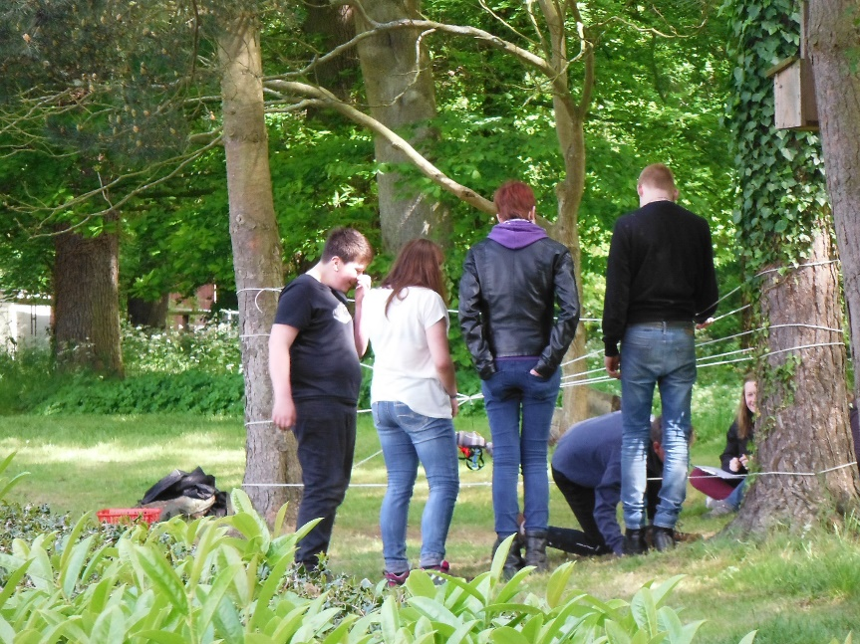
*Strengths & Difficulties Questionnaire (SDQ)
emotional problems
conduct problems
hyperactivity problems
peer problems
prosocial difficulties
Can be completed by teachers, students and/or parents to show change in classroom and / or at home
Paper survey, 25 questions
Generates a score which is compared against a national average
Pros: flexible user group; used internationally; robust; updated (in spite of 2005 date); free
Cons: needs explaining as easy to complete wrong way round; lots of questions; reasonable literacy level required
www.sdqinfo.org

Slide 20
*Personal, Environmental, Motivational, Social, Enterprise & Initiative score (PEMS+)
Developed by Jon Cree, specialist in working with young people who display challenging behaviour in a classroom.
Allocate a score 1 – 5 for each pupil based on their Personal, Environmental, Motivational, Social, Enterprise & Initiative (PEMS+) skills, plus practical skills, eg. use of tools
Pros: Very flexible - on-going assessment tool to measure change over time, or evaluate behaviours and attitudes during certain activities; provides degree of reflection, allowing you to identify trends or behaviours that may otherwise go unnoticed; easy to use; skills element designed to match own qualification
Cons: extra half-day each week needed to input and interpret scores; not validated elsewhere (Jon + forest school leaders)
Notes:
The graph:
Horizontal axis shows weeks, vertical shows PEMS score (max score 20 when all four aspects combined).
Individual skill sets can be displayed, plus overall score.
Personal 5 = quietly confident, positive , respectful, realistic, has demonstrated self-development (ie, high level of self-reflection)
Environmental 5 = organised workplace, trustworthy with tools, cares for immediate env – includes property and tools as well as habitat
Motivational 5 - not juts enthusiastic but includes perseverance, trying new tactics and adapting (resilience)
Social 5 = friendly, caring, encouraging others, positive role-model
This graph (Dan W) shows pupil with mid-level scores, displaying widely fluctuating behaviour (mostly related to indoor activities eg. portfolio work), but overall an upward (positive trend)

Slide 21
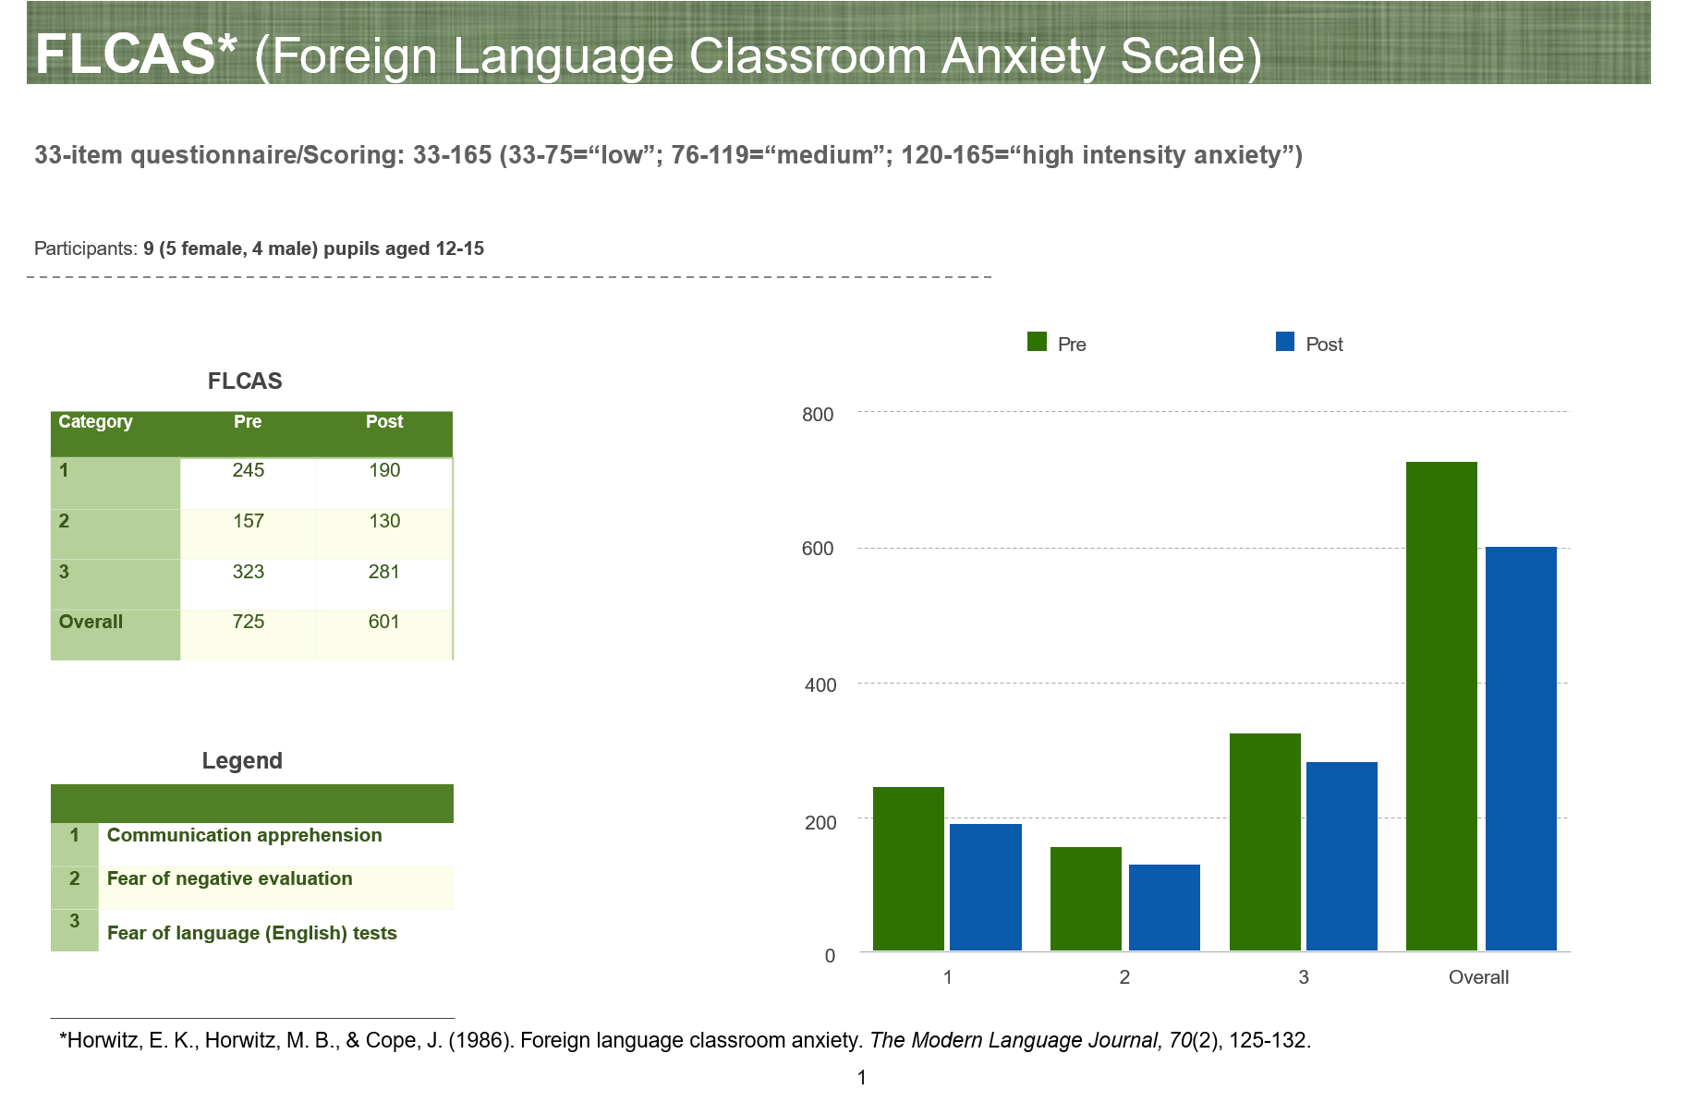
Foreign Language Classroom Anxiety Scale (FLCAS)
The Foreign Language Classroom Anxiety Scale (FLCAS) is a 33 question, 5 point Likert scale survey which is widely used in research studies. The measure investigates participants' communication apprehension, test-anxiety and fear of negative evaluation; and focuses on speaking in a classroom context.

Slide 22
Bush Telegraph
Self-reflective videos taken by the students themselves, where they can open up their hearts and speak freely. This was guaranteed to the students that these videos are solely for their own purposes and shall not be shared with the public.
Notes:
Statements developed from student’s own comments made to Em C either in general conversation or during surveys.
4 main categories:
1) The relationship with the outdoor learning tutor: needs well understood and catered for; trusted to get on with things; given responsibility for own learning
2) Development of “soft skills” – gain confidence, not being laughed at
3) Organisation of programme and activities: choice as part of Spring project, small groups (9 max), targeted to career ( handful of school leavers approaching end of Year 11, though mostly Year 9s)
4) The outdoor element.

Slide 23
Were some activities “better” than others?
Mix of on-site and off-site activities, with local partners worked well to broaden opportunity and ensure everyone felt successful. It also introduced new activities to students and brought them into contact with expert practitioners working in the outdoor sector :
Bushcraft (fire, shelter building, campfire cooking, knife craft)
Outdoor sport (archery, karate, camping craft)
Group challenges (orienteering, team-building)
Environmental & field studies (Norfolk Coast Experience, science in the outdoors)
Providing a broad mix of opportunities enabled all students to develop BUT further investigation required - no notable correlation between needs of students, PEMS+ scores and activities but very small sample size (number of opportunities per activity type)

Slide 24
Recommendations for evaluation tools:
To measure long-term change and impact use of a “before and after” tool is reasonable that is: proven, robust for your purposes and can be understood by all level of participants, eg SDQ or another tool
Undertake self-evaluation (student) eg. SDQ, diamond ranking or bush telegraph. Teacher / parent evaluation to gain broader picture of impacts
To inform short-term planning and teaching strategies, PEMS+ highlights immediate needs of vulnerable young people that should be addressed; also allows you to view long term change to corroborate “before and after”; and allows you to assess the impact of different interventions / activities.

Slide 25
Summary
To be continued
1) Have the evaluation tools allowed to show that the outdoor learning course has had an impact on the well-being, attitudes and behaviours, and mindset of the pupils?
Yes, yes, don’t know
2) Has evaluating the programme helped inform the planning and design of the future programme?
Yes
3) Has evaluating the programme provided evidence that the programme works for young people with challenging behaviour?
Yes!
Notes:
The well-being of the group has improved in nearly all areas (not satisfaction with school and friends), with marked improvement in self-esteem. The PEMS data indicates that even in this short research period, their social and personal skills have also improved. If monitored from the start of the course in Sept 2014, changes would probably be even more significant.
It is hoped that the opportunities the course offers working with external partners such as National Trust and Redwings can raise aspirations and alter mindset from fixed to growth, but not actually measured.
2. Planning for future.
Evaluation shows that Aylsham doing lots of things very well - mix of opportunities, on-site and off-site, external partners /experts allows all pupils to make progress. Know that trust and responsibility are key elements.
Also highlighted the need for deeper reflection at times so that pupil-specific needs can be best addressed (either through the outdoor learning course or referral within the wider education system).
3. The impacts even within this short research period are significant – and doesn’t just work for those with challenging behaviour!

Slide 26
Conclusion
The aims of this pilot were:
To improve emotional wellbeing and increase confidence of learners.
To develop inter-personal and intra-personal skills of learners.
The results of this pilot seem positive and definitely worth further evaluation over a longer period of time.
Observational evidence collected suggested that learners did improve in confidence. Emotional wellbeing is hard to measure, however the fact that attendance was good from the boys and that no physical management was required could indicate that emotional wellbeing was good. Observational evidence also suggested that boys were developing their behavioural coping strategies, by using the space and time within a Forest School to help them. Leaders also recorded improved speaking and listening skills and cooperative working.
The limitations to this pilot were:
Session length too short
Programme length too short (due to funding)
A site open to the public – dogs and associated mess, an extra hazard to be aware of. However a public site does offer additional learning opportunities.
‘Soft skills’ hard to measure, however the qualitative evidence provides a starting point for further research.

Slide 28
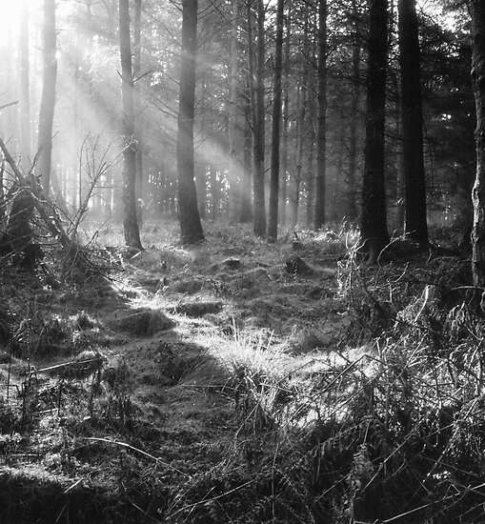
What is the history behind the initiative?
Originally a concept developed in Wisconsin in 1927.
1950s: Introduced in Sweden and Denmark.
International curriculums:
- Reggio Emilia, N. Tuscany
- Hi-Scope, USA
- Te Whariki, New Zealand
1994: Introduced to the UK by Bridgwater
College in Somerset and has seen
unprecedented growth throughout the UK
since.

Slide 29
History
Ancient Greek Civilization – adventurous pursuits such as horse riding to train soldiers
Scouting Movement – 1907 Robert Baden-Powell. Employed non-formal education with an emphasis on practical outdoor activities.
Outward Bound Movement – A movement in the UK often cited as the beginning of the modern outdoor education phenomenon. Later spread to the USA in the 1960s.
Kurt Hahn – A German educator who is credited as the founder of adventure education.

Slide 30
Research on benefits of Outdoor Education
Educational Philosophies
Child-centred education (Froebel)
Learn by doing linked to real life (Dewey)
Natural environment feeds creativity (Steiner)
Importance of space to move (McMillan)
Educational Research
Development of Physical Literacy (Whitehead 2010)
Increased physical activity (Mygind 2007)
Increased motor development (Fjortoft 2004)
Better understanding of risk (Gill 2007)
Improved well being and mental health (Louv 2005)
Counteract ‘toxic childhood’ (Palmer 2006)
Children need to move to learn (Ouvry 2003 )
Sensory integration – food for the brain (Ayres 2005)
All postural behaviour comes from balance (Goddard Blythe 2005)

Slide 31
Why Outdoor learning?
* Builds independence * Increased self esteem
* Curiosity * Exploration of senses
* Spatial awareness * Motor development
* Social skills * Team building
* Risk management * Cross- curricular skills
* Problem solving * Creativity
* Self-discovery * Imagination

Slide 32
Topics Covered
Adventure and Leadership Training
Decision making
Emotional Intelligence
Environment Studies
Geography Studies
History
Leadership
Respect
Responsibility
Resilience
Self Reliance
Inter/Intrapersonal Understanding

Slide 33
Teacher Responsibilities
Technical Skills
Outdoor living
Safety
Environmental skills
Organization
Instruction
Facilitation
Leadership
Environmental ethics
Knowledge

Slide 34
Other Assessments
Scenarios
Journaling
Written tests
Application Essays
Interdisciplinary Techniques
Self Analysis
Group Feedback/Interaction
Teach Backs
Fitness Tests
Group Process
Research

Slide 35
Activities included
Archery
Abseiling
Art and Photography Campcraft (cooking)
Backpacking
Bellboating
Biking
Bushwalking
Camping
Canoeing
Expeditions
Kayaking
Navigation activities (orienteering)
Rafting
Rock climbing
Rope courses
Swimming
Winter sports (ice fishing, snowshoeing, cross country skiing, snowboarding, building snow caves, etc.)

Slide 36
Equipment Needed
Water bottles
Sunscreen
Hat/cap
Waterproof jacket
Insect repellent
Cooking utensils
Extra clothes
Shoes/boots
Swim suits
Towel
Toiletries
Camera
Pillow and sleeping bag
Bike
Rope supplies (ropes, harness, etc.)
Water supplies (canoe, kayak, etc.)
First Aid kit
Back pack that everything should fit in

Slide 37
Benefits
Different outdoor components and models can be easily blended together through the use of camping/adventure trips.
Improved relationships between students and teachers after trips.
Cultural Connections
Health benefits
Positive role models
Leadership opportunities
Personal Growth
Opportunity to make friendships
Learning accountability and independence
Increased inter/intrapersonal skills
Active participation
Decision making skills
Problem solving skills

Slide 38
Limitations
Trips
Equipment
Space requirements
Planning
Complexity
Waviers/Risks
Cost
Experience needed to teach it effectively
Participatory Nature – when one person organizes, plans, and conducts the trips.
Autocratic Leadership – autocratic and the group members do not participate in decisions.
Pecuniary – when a sponsoring institution or club makes money off the trip.

Slide 39
Evidence it works
Student surveys conducted found that it improves self confidence, self knowledge, team work, thoughtfulness, and caring for others.
65% of those who participate in adventure programs are better off than those who do not participate.
Outdoor education participants experience additional growth on returning to their home environments.
Since it has only been around since the 1960’s research is still being conducted to find out how effective outdoor education is and can be.

Slide 40
References
www.isu.edu/outdoor/CADefine.htm
Australian Journal of Outdoor Education – Volume 3 No. 1 1998
http://research2.csci.educ.ubc.ca/indigenation/ketchkie.htm
www.isu.edu/outdoor/model.htm
http://en.wikipedia.org/wiki/Adventure_education
www.eric.ed.gov
http://www.bbc.qld.edu.au/outdoor_ed/files/Parent_Info_Book_2007.pdf
http://www.artsci.gmcc.ab.ca/courses/peds205ml/adventureeducation.html
Standards-Based Physical Education Curriculum Development
Assessment in Outdoor Adventure Physical Education

Slide 42
Outdoor Education
Lecture 1
Definition & Teaching Foundations

Slide 43
Outdoor Education Defined
Education in, for, about, and through the outdoors
3 dimensions: extension, content and teaching method
Extension = beyond the classroom into the community, natural environment and other locations of topics being studied. (Example: Studying Native Americans = Going to an Native American Burial Ground)
Notes:
Education in, for, about, and through the outdoors
3 dimensions: extension, content, teaching method
Extension = beyond the classroom into the community, natural environment ad other locations of topics being studied. (Example: Studying Native Americans = Going to an Native American Burial Ground)
Content= What is being taught. This content can include information about the natural environment and its relationships, specific skills to be used in the outdoors , or our relationship with the environment and how our activities as individuals and as a society affect it.
Teaching method= links the cognitive, affective, and psychomotor demands of learning. It uses activities as a means for developing skills and understanding concepts in a variety of subjects. This method can be used as a means for developing skills and understanding concepts in a variety of subjects. Techniques used with this method can include journaling, reflective discussions and highlighting connections.

Slide 44
Content= What is being taught. This content can include information about the natural environment and its relationships, specific skills to be used in the outdoors, or our relationship with the environment and how our activities as individuals and as a society affect it.

Slide 45
Teaching method= links the cognitive, affective, and psychomotor demands of learning. It uses activities as a means for developing skills and understanding concepts in a variety of subjects. This method can be used as a means for developing skills and understanding concepts in a variety of subjects. Techniques used with this method can include journaling, reflective discussions and highlighting connections.

Slide 46
Teaching Outdoor Education
Methods
Students
Content
Curricular Standards
Class Organization & Management

Slide 47
Methods
Outdoor recreational activities are excellent educational tools for incorporating experiential teaching methods and engaging the student by being physically active, mentally active (thinking and questioning), emotionally active (feeling and engaging the physical and mental processes which bring about an emotional reaction)
Notes:
Outdoor recreational activities are excellent educational tools for incorporating experiential teaching methods and engaging the student by being physically active, mentally active (thinking and questioning), emotionally active (feeling and engaging the physical and mental processes which bring about an emotional reaction)

Slide 48
Experiential Learning Process
APPLYING
EXPERIENCING
GENERALIZING
REFLECTING
Notes:
The process through which the learner constructs knowledge, skills, and values through direct experience.

Slide 49
Experiential teaching Process
ADAPTATION
KNOWLEDGE
EVALUATION
PLANNING
REFLECTION
&
DISCUSSION
IMPLEMENTATION
Notes:
Knowledge
Usually begins with the teacher’s intention to teach experientially using interdisciplinary highlights and with an idea and basic information, such as knowing your class, time frame, facilities, equipment, and what objectives or standards you want to address.
Planning
Involves structuring activities in ways that enhance the opportunity to use each activity to illustrate a concept or skill. Also involves identifying standards from other areas that you can connect to the activity in order to reinforce it.
Implementation
Actively engaging students in the experiences, making observations and comments during the activity and asking leading, challenging questions that are pertinent to the planned objectives.
Reflection & Discussion
Time to talk about what happened. Question types to lead discussions: What? So what? Now what?
Evaluation
Evaluate the success of the lesson and determine if then objectives were accomplished.
Adaptation
How to structure the next experience based on lessons learned

Slide 50
  Knowledge
  Usually begins with the teacher’s intention to teach experientially using interdisciplinary highlights and with an idea and basic information, such as knowing your class, time frame, facilities, equipment, and what objectives or standards you want to address.

Slide 51
  Planning
  Involves structuring activities in ways that enhance the opportunity to use each activity to illustrate a concept or skill. Also involves identifying standards from other areas that you can connect to the activity in order to reinforce it.

Slide 52
  Implementation
  Actively engaging students in the experiences, making observations and comments during the activity and asking leading, challenging questions that are pertinent to the planned objectives.

Slide 53
  Reflection & Discussion
  Time to talk about what happened. Question types to lead discussions: What? So what? Now what?

Slide 54
  Evaluation
  Evaluate the success of the lesson and determine if then objectives were accomplished.
  Adaptation
  How to structure the next experience based on lessons learned

Slide 55
Teachers should consider themselves as “Facilitators” because they encourage an attitude of assistance, encouragement and coaching whereas a “Teacher” is associated with providing facts.
Notes:
Teachers should consider themselves as “Facilitators” because they encourage an attitude of assistance, encouragement and coaching whereas a “Teacher” is associated with providing facts.

Slide 56
Principals of Being an Effective Facilitator
Know why you are doing what you are doing
Put the focus on the participants
Encourage students to explore and discover meaning and understanding from the activities
Notes:
Know why you are doing what you are doing
Put the focus on the participants
Encourage students to explore and discover meaning and understanding from the activities
Design situations that will encourage students to want to learn or figure out something
Look for and be flexible enough to use teachable moments

Slide 57
Design situations that will encourage students to want to learn or figure out something
Look for and be flexible enough to use teachable moments

Slide 58
Use sequenced progressions that move from simple to complex
Anticipate how to use students’ failures as well as their successes to maximize learning
Notes:
Use sequenced progressions that move from simple to complex
Anticipate how to use students’ failures as well as their successes to maximize learning

Slide 59
End an activity on a high note
Follow an activity with opportunities for reflection, discussion, generalization and application. This is when learning occurs
Notes:
End an activity on a high note
Follow an activity with opportunities for reflection, discussion, generalization and application. This is when learning occurs

Slide 60
Effective Teaching Practice
Intention-
Look for ways to connect curriculum areas and then plan how to put your ideas into action. This type of planning means organizing your lessons to make sure you know what you are trying to accomplish beyond simply doing the activities and how you intend to get it done.
Notes:
Intention
Look for ways to connect curriculum areas and then plan how to put your ideas into action. This type of planning means organizing your lessons to make sure you know what you are trying to accomplish beyond simply doing the activities and how you intend to get it done.
Vigilance
This means actively observing the class while it is participating in an activity so you can make comments and ask questions while the activity is happening and after it has ended.

Slide 61
Vigilance-
This means actively observing the class while it is participating in an activity so you can make comments and ask questions while the activity is happening and after it has ended.

Slide 62
Students
Adolescents
1) Be genuine balance b/t professional & personal
2) Take your time
3) Give them responsibilities
4) Create social atmosphere try to prevent clique from forming
5) Motivate and be supportive
Notes:
1) Be genuine - balance b/t professional & personal
2) Take your time with them
3) Teens are confident, give them responsibilities they can competently achieve through hard work
4) Create social atmosphere: allow for fun, quell clique formation
5) Motivate them- be supportive

Slide 63
Content
Recreational skills that are related to curricular concepts
For example:
Recreation skills Curricular concepts
Land navigation Math, reading
Canoeing Geography, Health

Slide 64
Curricular Standards
Social Studies
Health
Language arts
Math
Physical Education
Science
Notes:
K-4 Content Standards
What is Government and What Should It Do?
What is government?
Where do people in government get the authority to make, apply, and enforce rules and laws and manage disputes about them?
Why is government necessary?
What are some of the most important things governments do?
What are the purposes of rules and laws?
How can you evaluate rules and laws?
What are the differences between limited and unlimited governments?
Why is it important to limit the power of government?
What are the Basic Values and Principles of American Democracy?
What are the most important values and principles of American democracy?
What are some important beliefs Americans have about themselves and their government?
Why is it important for americans to share certain values, principles, and beliefs?
What are the benefits of diversity in the United States?
How should conflicts about diversity be prevented or managed?
How can people work together to promote the values and principles of American democracy?
How Does the Government Established by the Constitution Embody the Purposes, Values, and Principles of American Democracy?
What is the United States Constitution and why is it important?
What does the national government do and how does it protect individual rights and promote the common good?
What are the major responsibilities of state governments?
What are the major responsibilities of local governments?
Who represents you in the legislative and executive branches of your local, state, and national governments?
What is the Relationship of the United States to Other Nations and to World Affairs?
How is the world divided into nations?
How do nations interact with one another?
What are the Roles of the Citizen in American Democracy?
What does it mean to be a citizen of the United States?
How does a person become a citizen?
What are important rights in the United States?
What are important responsibilities of Americans?
What dispositions or traits of character are important to the preservation and improvement of American democracy?
How can Americans participate in their government?
What is the importance of political leadership and public service?
How should Americans select leaders?

Slide 65
Curricular Standards
Social Studies themes
Culture
Time, Continuity, and Change
People, Places, and Environment
Individual Development and Identity
Individuals, Groups, and Institutions
Power, Authority, and Governance
Production, Distribution, and Consumption
Science, Technology, and Society
Global Connections
Civic Ideals and Practices
Notes:
Culture
Time, Continuity, and Change
People, Places, and Environment
Individual Development and Identity
Individuals, Groups, and Institutions
Power, Authority, and Governance
Production, Distribution, and Consumption
Science, Technology, and Society
Global Connections
Civic Ideals and Practices

Slide 66
Curricular Standards
Health
Knows availability and use of health services, products and info.
Knows environmental and external factors that affect individual and community health
Understands the relationship of family health to individual health
Knows how to maintain mental and emotional health
Knows essential concepts and practices concerning injury prevention and safety
Notes:
1. Knows the availability and effective use of health services, products, and information
2. Knows environmental and external factors that affect individual and community health
3. Understands the relationship of family health to individual health
4. Knows how to maintain mental and emotional health
5. Knows essential concepts and practices concerning injury prevention and safety
6. Understands essential concepts about nutrition and diet
7. Knows how to maintain and promote personal health
8. Knows essential concepts about the prevention and control of disease
9. Understands aspects of substance use and abuse
10. Understands the fundamental concepts of growth and development

Slide 67
Curricular Standards
Language arts
Notes:
What is Government and What Should it Do?
What are the Basic Values and Principals of American Democracy
How Does the Government Established by the Constitution Embody the Purposes, Values, and Principles of American Democracy?
What is the Relationship of the United States to Other nations and to World Affairs?
What are the Roles of the Citizen in American Democracy?

Slide 68
Curricular Standards
Math
Notes:
1. Uses a variety of strategies in the problem-solving process
2. Understands and applies basic and advanced properties of the concepts of numbers
3. Uses basic and advanced procedures while performing the processes of computation
4. Understands and applies basic and advanced properties of the concepts of measurement
5. Understands and applies basic and advanced properties of the concepts of geometry
6. Understands and applies basic and advanced concepts of statistics and data analysis
7. Understands and applies basic and advanced concepts of probability
8. Understands and applies basic and advanced properties of functions and algebra
9. Understands the general nature and uses of mathematics

Slide 69
Curricular Standards
Physical Education
Notes:
1. Uses a variety of basic and advanced movement forms
2. Uses movement concepts and principles in the development of motor skills
3. Understands the benefits and costs associated with participation in physical activity
4. Understands how to monitor and maintain a health-enhancing level of physical fitness
5. Understands the social and personal responsibility associated with participation in physical activity

Slide 70
Curricular Standards
Science
Notes:
Earth and Space Sciences
1. Understands atmospheric processes and the water cycle
2. Understands Earth's composition and structure
3. Understands the composition and structure of the universe and the Earth's place in it
Life Sciences
4. Understands the principles of heredity and related concepts
5. Understands the structure and function of cells and organisms
6. Understands relationships among organisms and their physical environment
7. Understands biological evolution and the diversity of life
Physical Sciences
8. Understands the structure and properties of matter
9. Understands the sources and properties of energy
10. Understands forces and motion
Nature of Science
11. Understands the nature of scientific knowledge
12. Understands the nature of scientific inquiry
13. Understands the scientific enterprise

Slide 71
Class Organization & Management
Activity Teams
  3, 4, 5 person teams designed to function with indirect supervision
  Team leaders in each group (fully inform the leader and give them directions/instructions before class)
  Change team leaders

Slide 72
Class Organization & Management
Pledge of respect
  Agreement b/t teacher and students to respect themselves and each other so they can make class an enjoyable experience for everyone.
  Example
As a member of this class I pledge to:
Respect the dignity and essential worth of all individuals.
Respect the privacy, property, and freedom of others.
Not tolerate bigotry, discrimination, violence, or intimidation of any kind.
.
Notes:
As a member of this class I pledge to:
Respect the dignity and essential worth of all individuals.
Promote a culture of respect throughout the community.
Respect the privacy, property, and freedom of others.
Not tolerate bigotry, discrimination, violence, or intimidation of any kind.
Practice personal and academic integrity and expect it from others.
Promote the diversity of opinions, ideas and backgrounds which is the lifeblood of the university.

Slide 73
Class Organization & Management
Student Behavior
  Instructions
  Types of instructions
    Organizational Rules:
    Instructional Signals:
Notes:
Student Behavior
Instructions – When they know what to expect they are more likely to comply
Types of instructions
Organizational Rules: Students are instructed to follow at specific times, such as when going from classroom to outdoors or when outside
Instructional Signals: Provide a basic means of communication between teacher and students when the students are doing activities outside in small groups and are not all within easy hearing distance from the teacher. All signals are made overhead, and a designated class meeting place should be designated at the beginning of class.

Slide 74
Class Organization & Management
Teaching formations
  Circle - Ideal for discussions, teachers stand as part of the circle
  Semi-circle - Gives more room for demonstrations
  Small groups - Trying out an activity that was just taught
Notes:
Teaching formations
Circle
Ideal for discussions, teachers stand as part of the circle
Semi-circle
Gives more room for demonstrations
Small groups
Trying out an activity that was just taught

Slide 75
Fundamentals of Outdoor Education
Experiential
Connection with Nature
Encourages reflection, generalization, application
Intentionally interdisciplinary
Notes:
Experiential
Experiences must be structured for the purposes of illustrating, expanding, investigating, practicing, or discovering
Connection with Nature
Can take place in or outside. Could take the form of activities that depend on some type of cooperation with nature (canoeing, fishing, climbing, etc.)
Encourages reflection, generalization, application
1. Introduction-introduce intervention to team members, explain process, set expectations.
2. Fact - To have each participant describe the nature of their participation, from a cognitive perspective.
3. Thought Reaction - To solicit cognitive response to: "What aspect held the most positive/negative impact?" Then, transition from cognitive to emotional processing.
4. Emotional Reaction -Given the response to Stage 3, to solicit emotional reactions or consequences.
5. Reframing -To transition from emotional domain back to cognitive. "What lessons could be learned from this experience?" and, "What is something positive that you will take away from this experience?"
6. Teaching - To educate as to normal reactions and teach basic stress management, if applicable.
7. Re-Entry - To summarize experience with emphasis on positive or learning aspects
Intentionally interdisciplinary
The idea that there is more than one academic discipline being addressed through the experience. (e.g. Social studies and math, Writing and Geography) This concept must be planned for and carried throughout. Teachers and administrators need to know the value of Outdoor Education.

Slide 76
Highlighting Character Qualities
Caring
Citizenship
Courage
Patience
Perseverance
Respect
Responsibility
Trustworthiness

Slide 77
Types of Outdoor Education
Environmental Education: Refers to education about the total environment, including population growth, pollution, resource use and misuse, urban and rural planning, and modern technology with its demands on natural resources.

Slide 78
Conservation education: is the study of the wise use of natural resources. It tends to focus on animals, soil, water, and air as single topics in relation to their use for timber, agriculture, hunting, fishing, and human consumption. It is not usually concerned with preservation, recreation, or human relations and as such is more narrow than outdoor education.

Slide 79
Resident outdoor school: the process of taking children to a residential camp during school time for a period of usually three to five days to extend the curriculum through learning in the outdoors.
Outdoor recreation: refers to a broad spectrum of outdoor activities participated in during leisure time purely for pleasure or some other intrinsic value. When taught or being learned, these can be considered outdoor education activities.

Slide 80
Environmental interpretation: is a term used and associated with museums and visitor centers in public land management agencies. Environmental interpretation is basically a way of explaining natural and cultural scientific terms in non-scientific ways in interesting or exciting ways.
Nature education: Learning or leisure activities related to natural resources.

