Slide 1
IUBAT EARTH CHAPTER
FOUNDER & PRESIDENT
Shanjida Sayed Soha
ID – 18302003
Department : CBA
Collaborated with
RCE Greater Dhaka
Free
PPT Templates
Supported by Bangladesh Youth Environmental Initiative
Insert the Subtitle of Your Presentation
http://www.free-powerpoint-templates-design.com

Slide 2
WORLD ENVIRONMENTAL DAY
5th JUNE, 2021
Ecosystem Restoration
Reimagine. Recreate. Restore
2

Slide 3
BYEI-Bangladesh Youth Environmental Initiative
Developing the next generation of planetary stewards to strive towards a more sustainable, equitable and resilient Planet Earth.
3

Slide 4
Earth Champions Program
ECP takes young people through the process of becoming Planetary Stewards – citizens who are aware and knowledgeable of the world around us and take action to be its custodians, from their respective fields.
3
83
70
program
Fellows
Earth Clubs
4

Slide 5
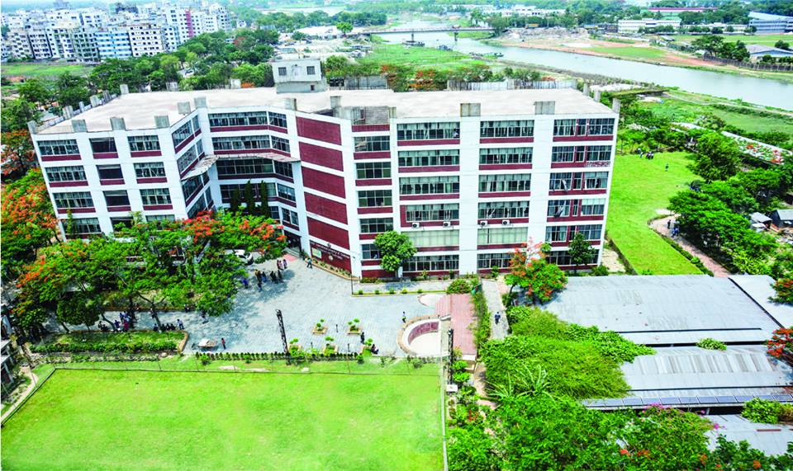
IUBAT Earth Chapter collaborated with RCE Greater Dhaka
Prof.Mohammed Ataur Rahman
PhD Director,
Center for Global Environmental Culture(CGEC) and Program on Education For Sustainability Coordinator.
Dr.Muhammad Rehan Dastagir
Assistant professor,
Soil and Environmental Sustainability College of Agricultural Science – IUBAT University.
5

Slide 6
IUBAT Earth Chapter Members
Executive – General member
Shanjida sayed soha
CBA
11
15
FOUNDER & PRESIDENT
Rakibul Hasan
General Secretary
CBA
Shakil Ahmed
Treasurer
CBA
Abir Hasan
Head of HR
BCSC
Masuma Akter
Head of Branding & promotion
BCSC
Sajda-e-Jannat
Head of Communication
BSAg
Hasibul Islam
Head of visual logistics
CBA
Shadman Sharif
Head of Logistics
CBA
Md. Abir
Head of logistics
BSCE
Tania Akter
Head of Content Creator.
CBA
Mithila
Social Media Management
CBA
2

Slide 7
Orientation programme
Was held on 26th of May 2021
7

Slide 8
IUBAT Earth Chapter
Mission
Vision
To increase awareness to save our environment among our students.
Our vision is to build a strong youth, those will be able to make a step forward to our green future.
To work for keep our green campus more clean and eco-friendly.
8

Slide 9
Earth Chapter’s resolution for this year
Estimated time from june-01,2021 to September30,2021
01
02
03
Indoor plant for air purifying.
04
Make some nest by straw for our birds.
9

Slide 10
Earth Chapter’s resolution for this year
Estimated time from 1st of October 2021 to 31st of January,2022
05
Reduce the usage of plastic as much as possible.
06
07
Recycling plastic by planting tress .
10

Slide 11
Earth Chapter’s resolution for this year
Estimated time from 1st February,2022 to rest of first year.
Trying to minimize pollution by fulfill our upcoming project.
Wind power plant
Fire pit for wastage tissues
Making Organic fertilizer
08
Coming up different ideas, those will help to make conscious about environment of our students.
09
11

Slide 12
Expected Outcome
Campus air will be more safe for us
Indoor and Outdoor Plants will be increase
Usage of plastic will be decrease
Number of Birds will be increase
Student will be aware of environment
Our campus will be more Eco-friendly.
13

Slide 13
THANK YOU

