Slide 1


W
omen
4
or
P
ublic
P
rocurement

Slide 2

Introduction
Women play a vital role in sustainable development. The empowerment of a woman is the empowerment of a household, a community, and the nation at large.
Our goal is to equip women with the basic skills that can enhance their competitiveness in the procurement space, expand their economic horizons, and ultimately improve social and economic conditions of their households.

Slide 3
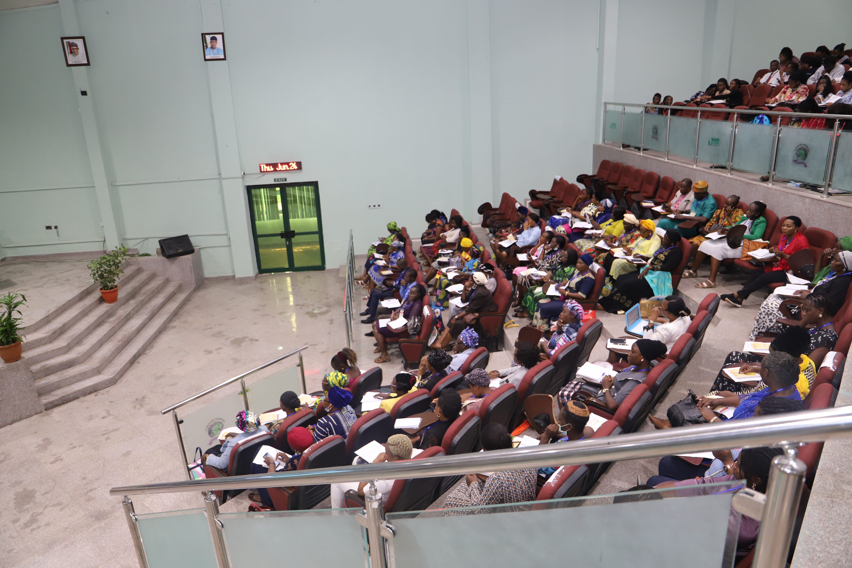
Action Plan

Slide 4

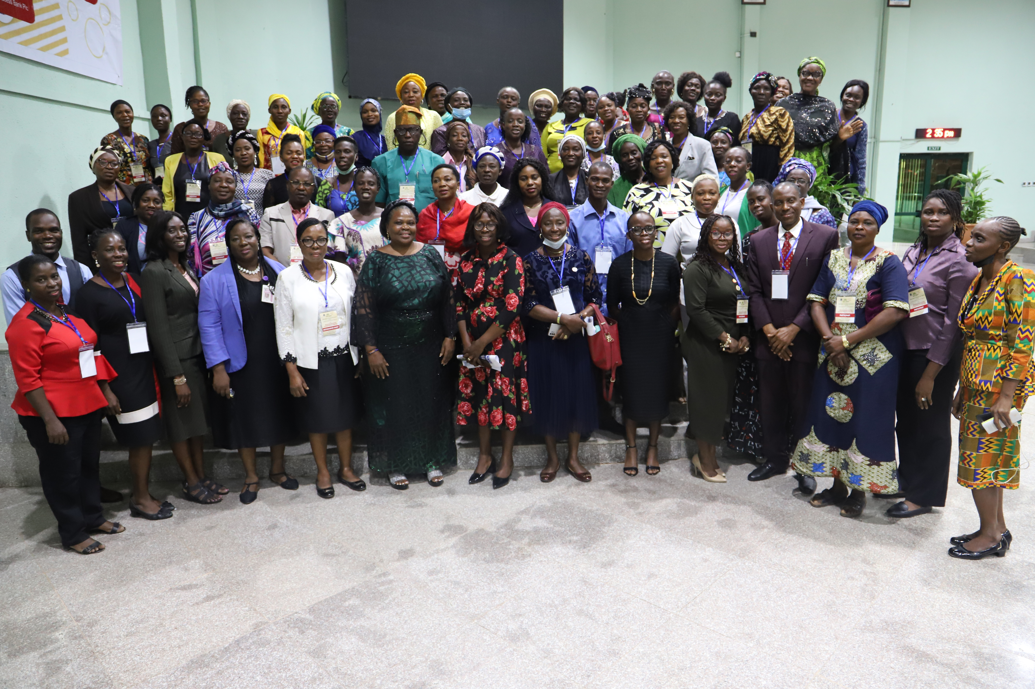
Report of Activities
Opening Ceremony of the W4PP Programme

Slide 5
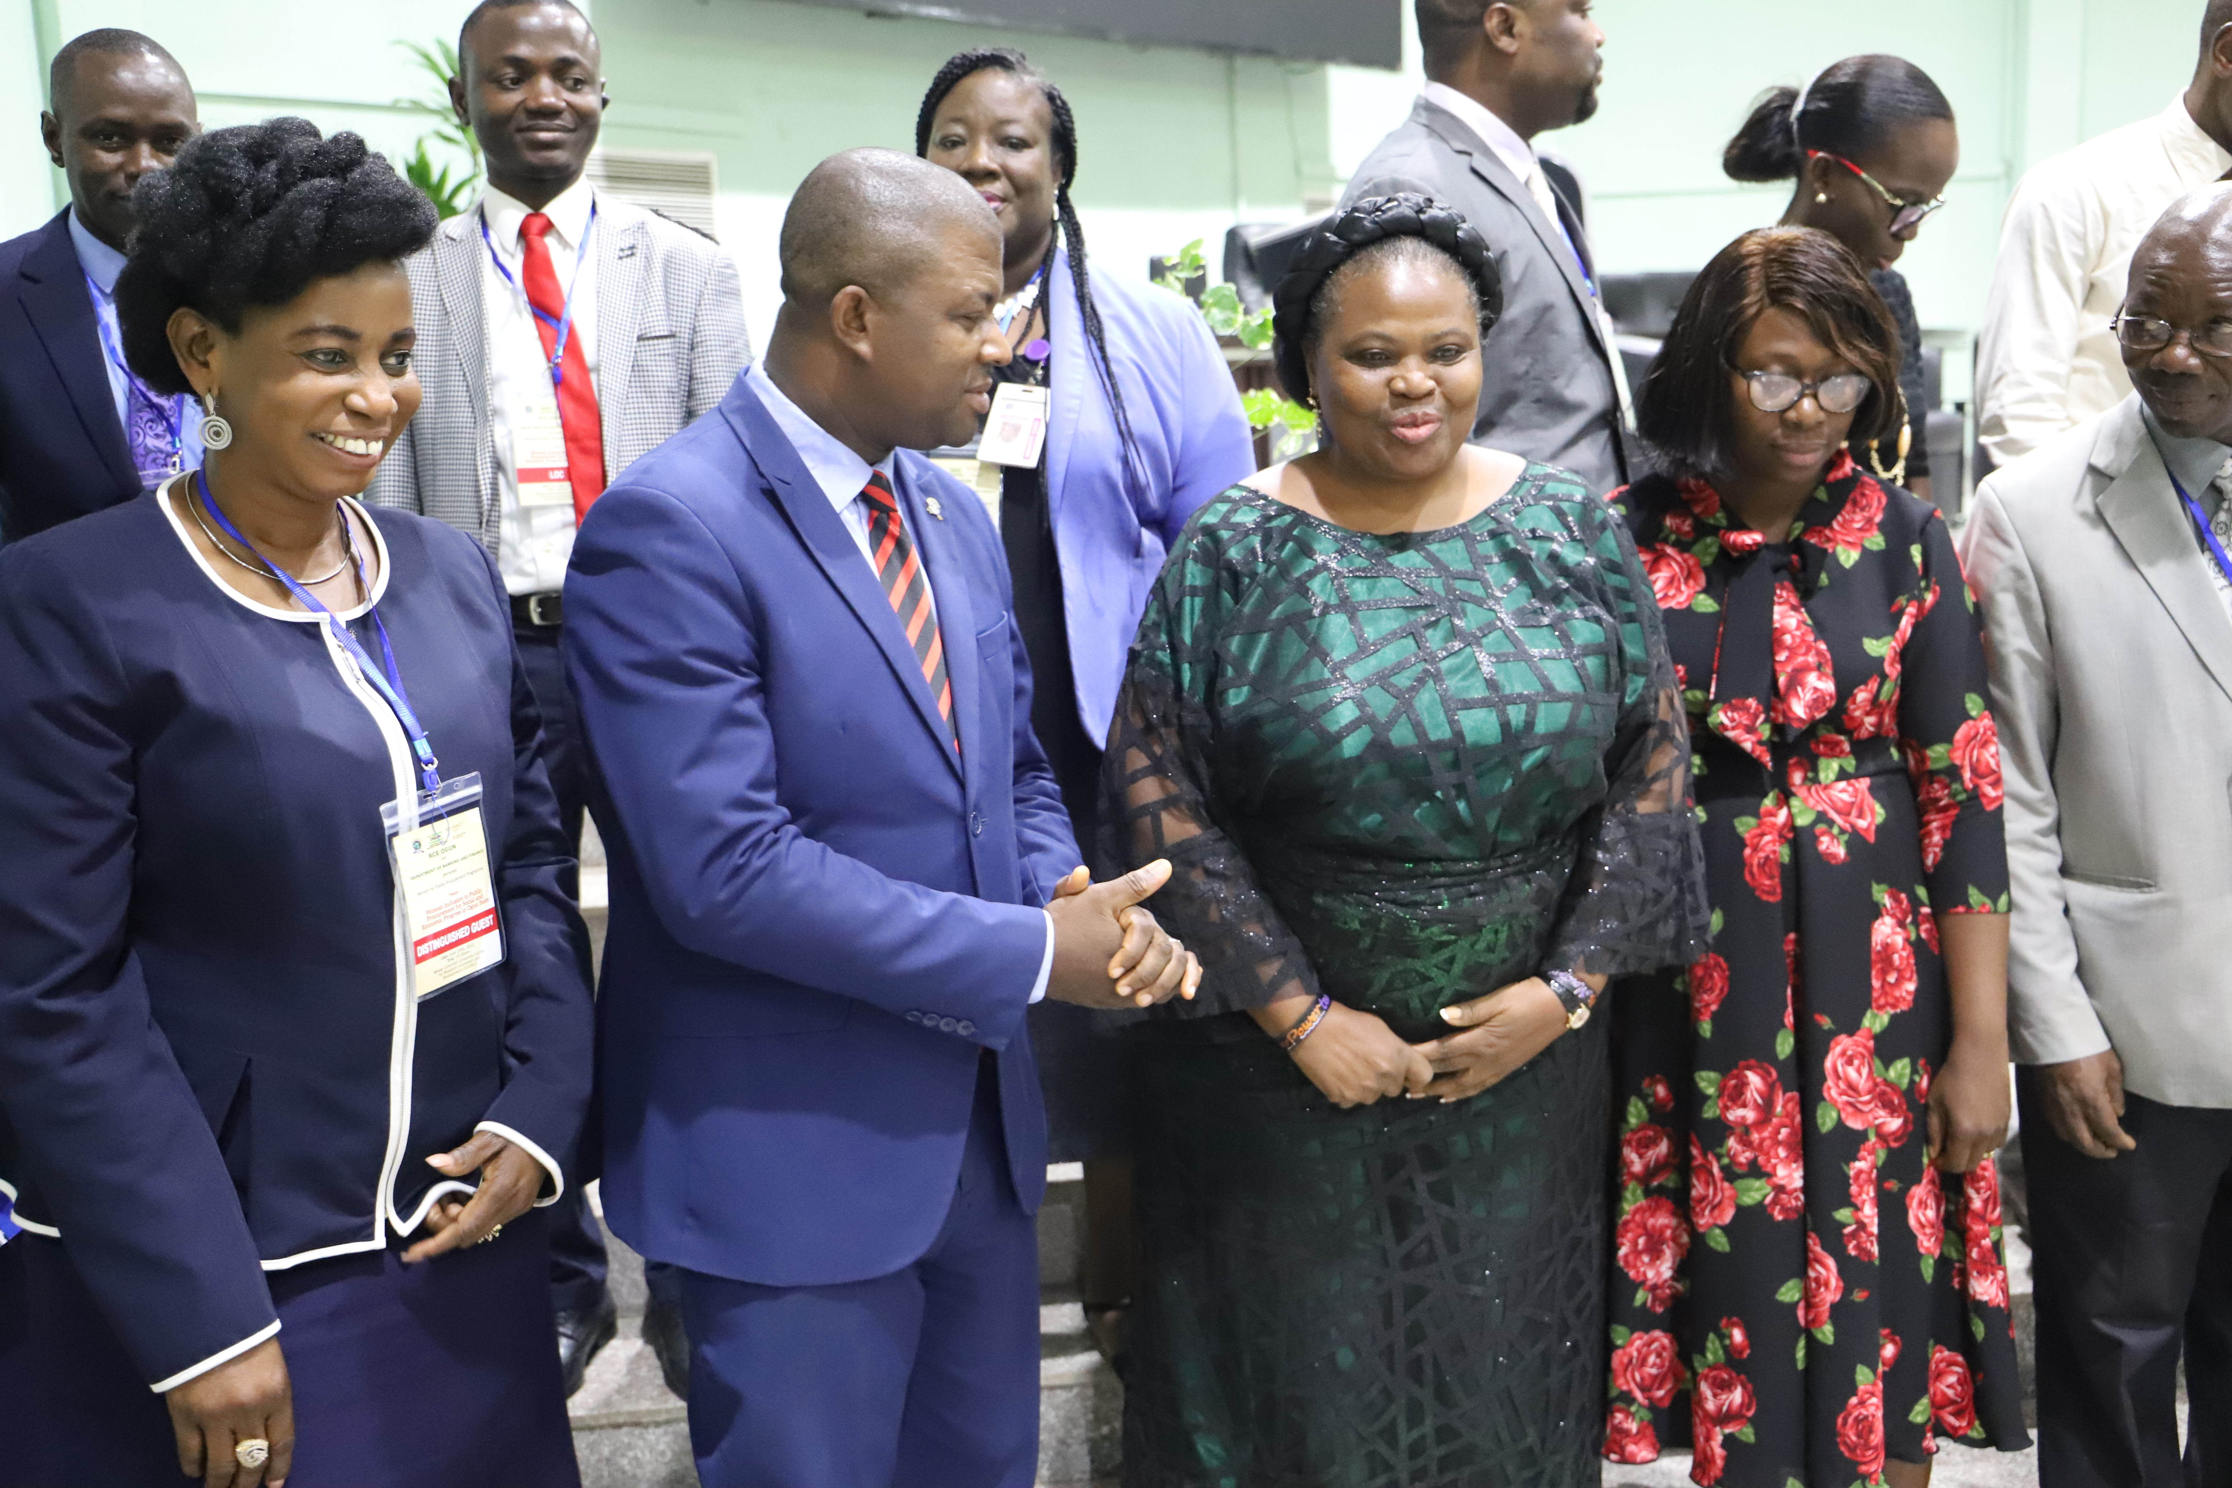
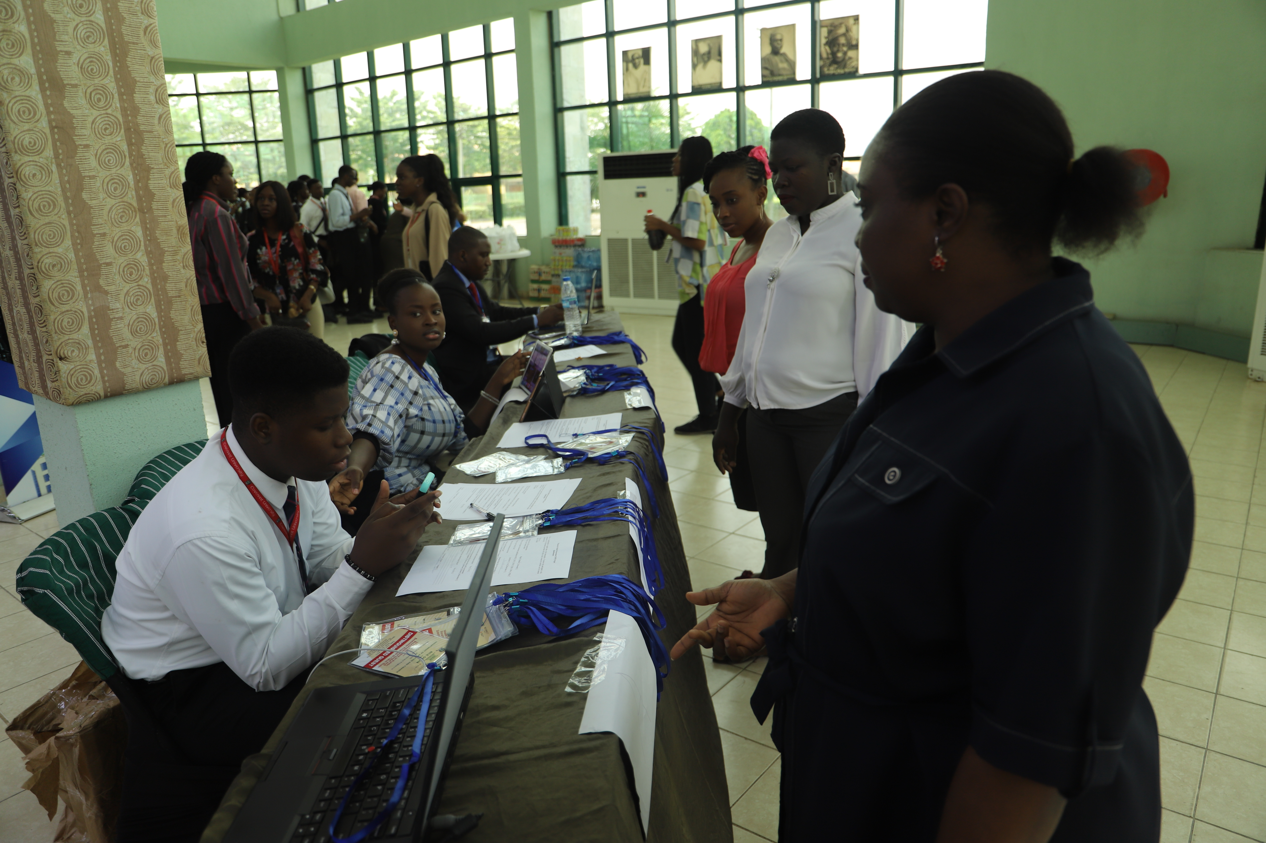
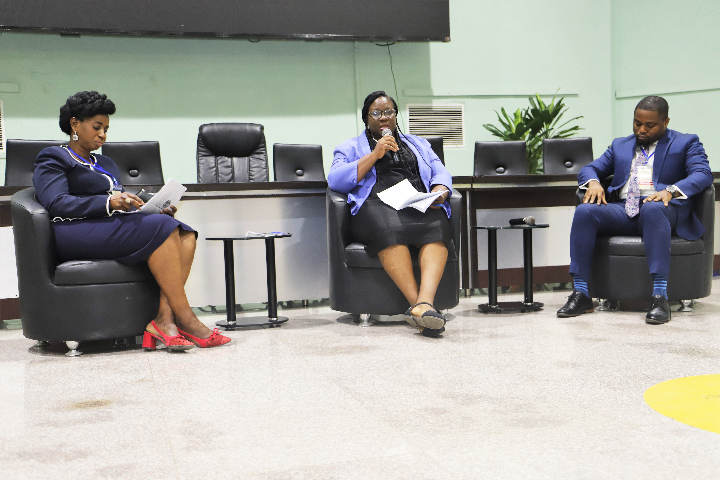
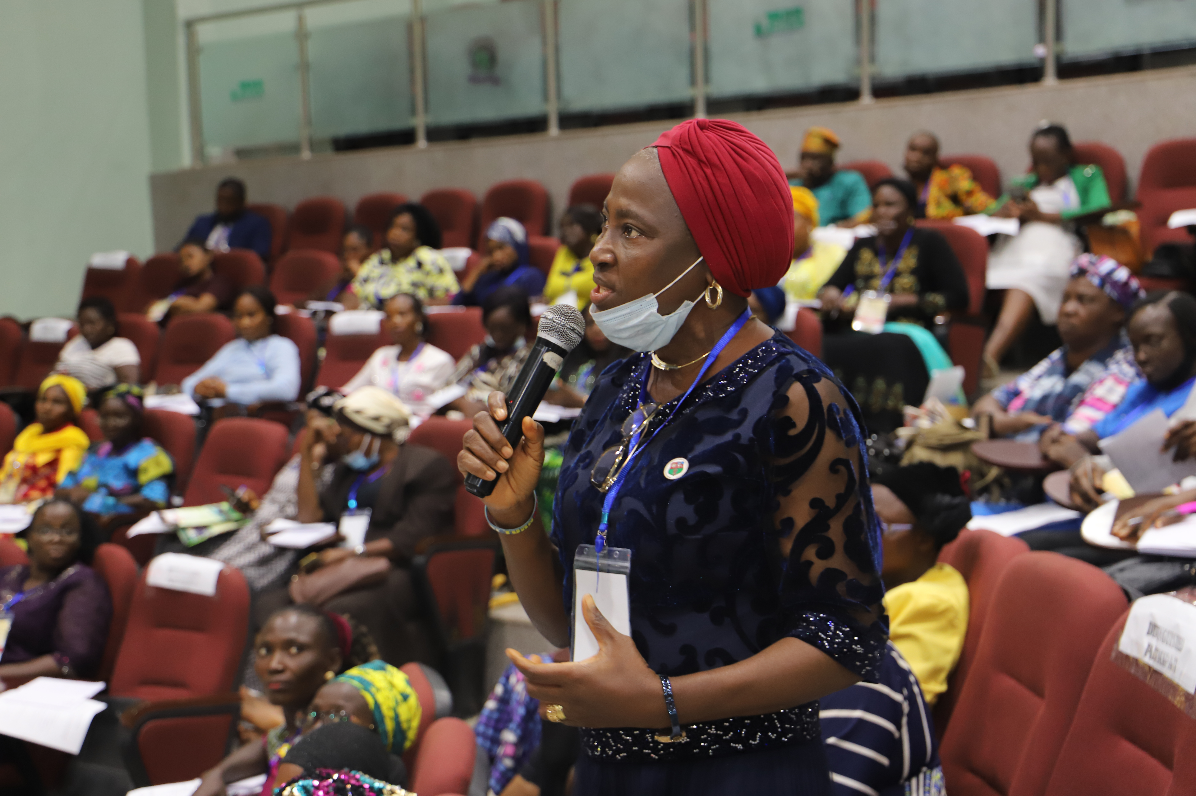
Registration point for the W4PP Opening Ceremony
The VC, Covenant University, Prof. Abiodun H. Adebayo with representative of the Keynote Speaker, Princess Adetutu Omisore and RCE Chair Dr. Patience Tunji Olayeni to his left and Panelist, Mrs. Favour Femi- Oyewole to his right.
Panel Session led by Mrs. Aderonke Asaolu with Mr. Damlare Mesimo and Mrs. Favour Femi-Oyewole.
Mrs. Cynthia Saka with other participants of the W4PP Opening Ceremony

Slide 6
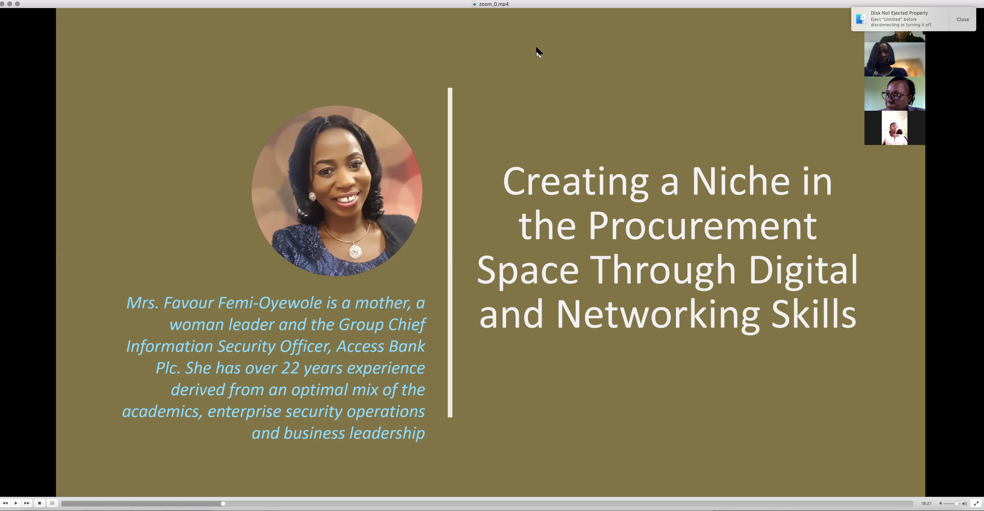
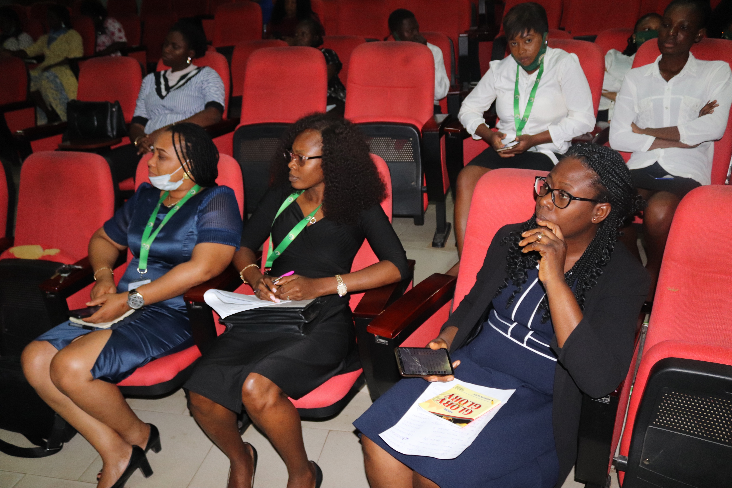
Report of Activities
W4PP Webinar Series
Creating a Niche in the Procurement space Through Digital and Networking Skills (23rd July,2021)
Legal Options for SMEs
Auditing for SMEs
Financing options for SMEs by the Team from Covenant Micro Finance Bank.
(19th August,2021)

Slide 7
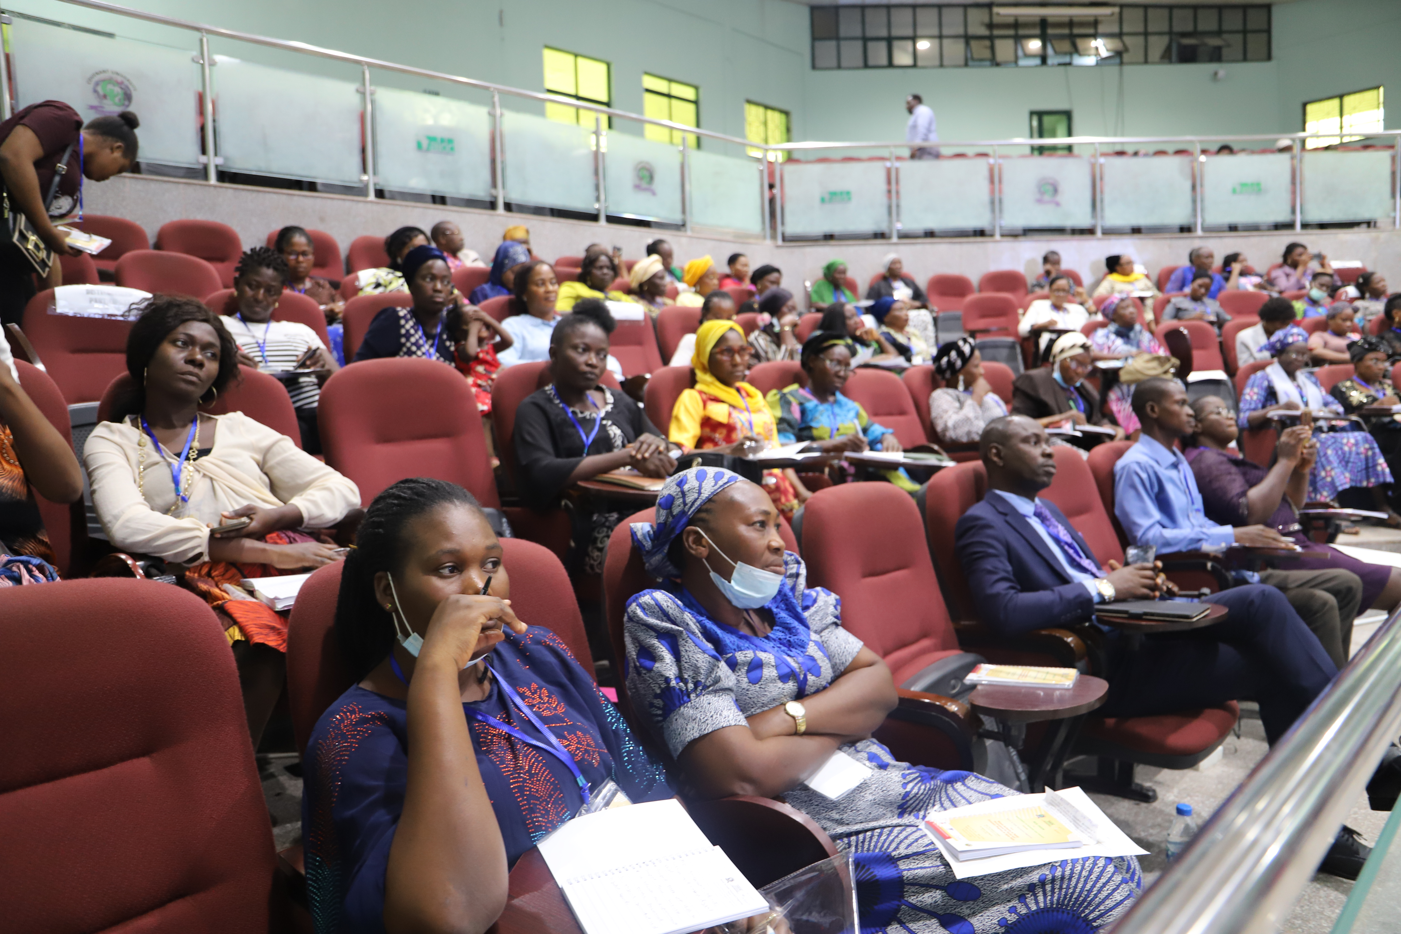
OUTCOMES
Increased awareness of the benefits of women inclusion in public procurement ,
Acquisition of requisite skills for women inclusion in public procurement.
A platform for lifelong learning and capacity building has been created for the women through monthly webinars and in person trainings .
A policy brief on women inclusion in public procurement has been designed and it is awaiting public hearing.

Slide 8
Key Partners
Ota-Agbara Chamber of Commerce Industry, Mines and Agriculture.
OTAGCCIMA
Ota Economic Summit Group
OESG
Zenith Bank Plc.
Hebron F.M

Slide 9

Conclusion
Advocacy for Women inclusion and gender equality is not about women supremacy. It is simply profiling the social and economic implications of women exclusion in processes such as public procurement. RCE Ogun is committed to the course of women inclusion in public procurement and we are open to ideas and partnerships in realizing these goals, both on regional and national scales. rceogun@covenantuniversity.edu.ng
https://rceogun.covenantuniversity.edu.ng/
www.facebook.com/ogunrce

