Slide 1
Prospect of Sustainability Course for Student’s Engagement in ESD
Dr. Ferdous Ahmed*, Dr. Rehan Dastagir, Prof. Dr. Ataur Rahman, Prof. Selina Nargis
IUBAT Institute of SDG Studies (IISS)
IUBAT-International University of Business Agriculture and Technology
4 Embankment Drive Road, Sector-10, Uttara Model Town, Dhaka-1230
ferdous.ahmed@iubat.edu*
6th International (Virtual) Workshop
UI GreenMetric World University Rankings (IWGM 2020)
15 October, 2020

Slide 2
Introduction
The demand of the sustainable education emerging due to global acceptance.
Producing young graduates with an action-oriented education program is the prime requirement for any country.

Slide 3
Objectives
To disseminate the knowledge sharing that IUBAT leads introducing sustainability education in undergraduate level.
To know how IUBAT students are dedicated to participate and practicing for sustainable education for their lifelong learning.
To highlight the Sustainability Course which is ‘Environmental Science and Sustainability’ introduced for undergraduate students.

Slide 4
Literature Review
[1] Wamsler, C. (2020). Education for sustainability. International Journal of Sustainability in Higher Education.
[2] Cheang, C. C., So, W. M. W., Zhan, Y., & Tsoi, K. H. (2017). Education for sustainability using a campus eco-garden as a learning environment. International Journal of Sustainability in Higher Education.
[3] Tangwanichagapong, S., Nitivattananon, V., Mohanty, B., & Visvanathan, C. (2017). Greening of a campus through waste management initiatives. International Journal of Sustainability in Higher Education.
[4] Farinha, C., Caeiro, S., & Azeiteiro, U. (2019). Sustainability strategies in Portuguese higher education institutions: Commitments and practices from internal insights. Sustainability, 11(11), 3227.

Slide 5
[5] Findler, F., Schönherr, N., Lozano, R., & Stacherl, B. (2019). Assessing the impacts of higher education institutions on sustainable development—an analysis of tools and indicators. Sustainability, 11(1), 59.
[12] Eppinga, M. B., Lozano-Cosme, J., de Scisciolo, T., Arens, P., Santos, M. J., & Mijts, E. N. (2020). Putting sustainability research into practice on the university campus. International Journal of Sustainability in Higher Education.
[6] Purcell, W. M., Henriksen, H., & Spengler, J. D. (2019). Universities as the engine of transformational sustainability toward delivering the sustainable development goals. International Journal of Sustainability in Higher Education.

Slide 6
Method
This study not following any particular method instead its emphasizing IUBAT’s own sustainability practices among students and other communities based on sustainability course which is ENV-101: Environmental Science and Sustainability.
This course “Environmental Science & Sustainability” which is a mandatory for all the disciplines which taught programs in IUBAT in the undergraduate levels.
Therefore, it is a case study (research) which tries to highlight the insights of ESD among the students through this sustainability course.

Slide 7
Discussion
Figure 1. Sustainability Course Taught in Different Disciplines

Slide 8
Figure 2. Semester Wise Enrolled for Sustainability Course for Different Disciplines

Slide 9
Figure 3. Topics Covered for this Sustainability Course in 21 Class Lectures

Slide 10
Figure 4. Student’s Engagements in Different Environmental Activities

Slide 11
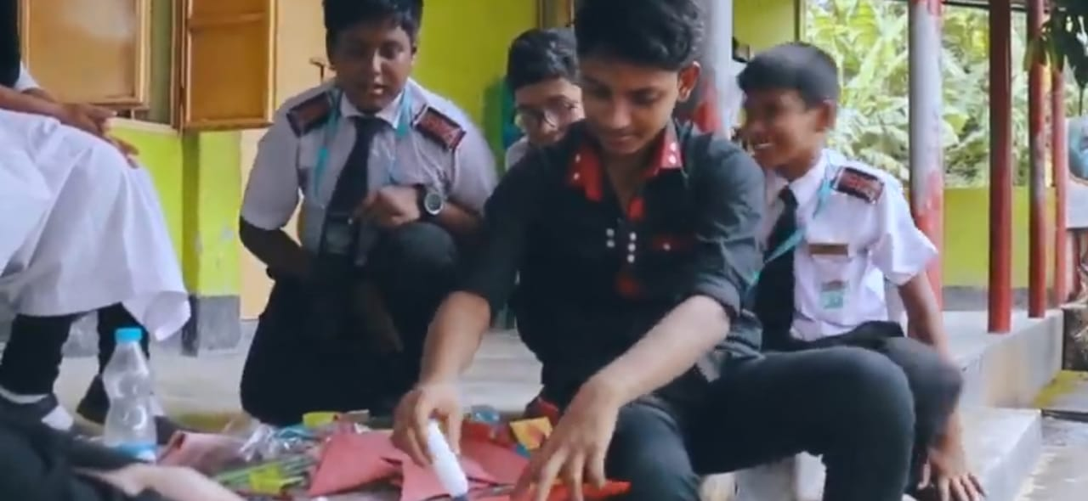
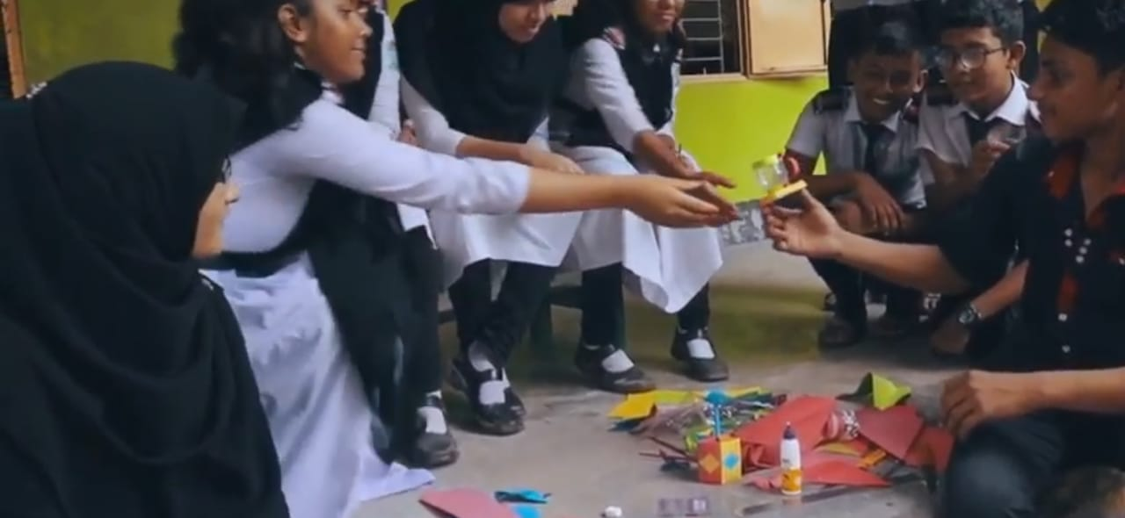
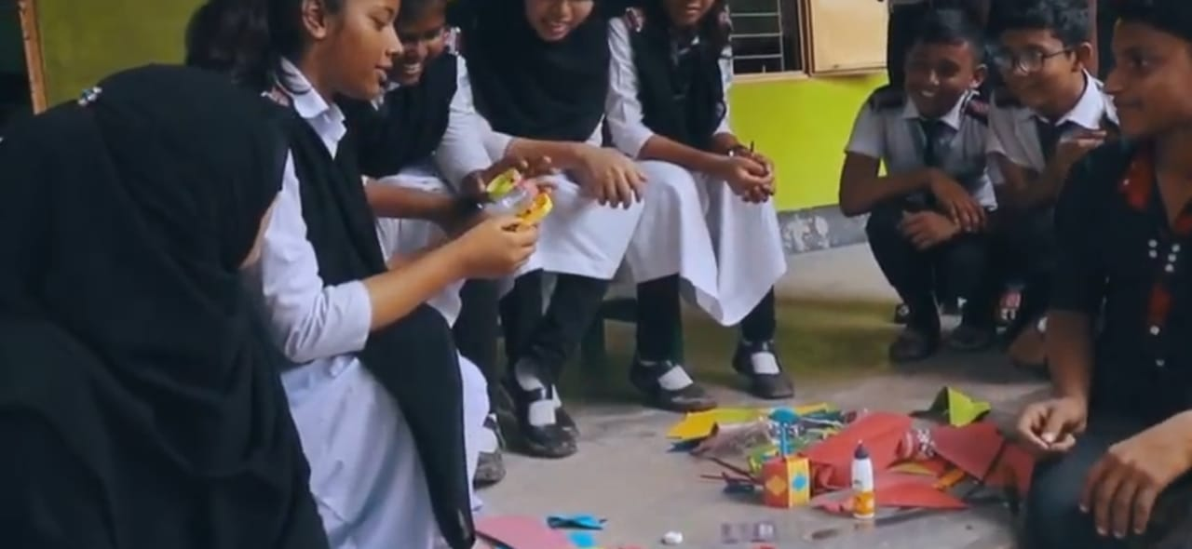
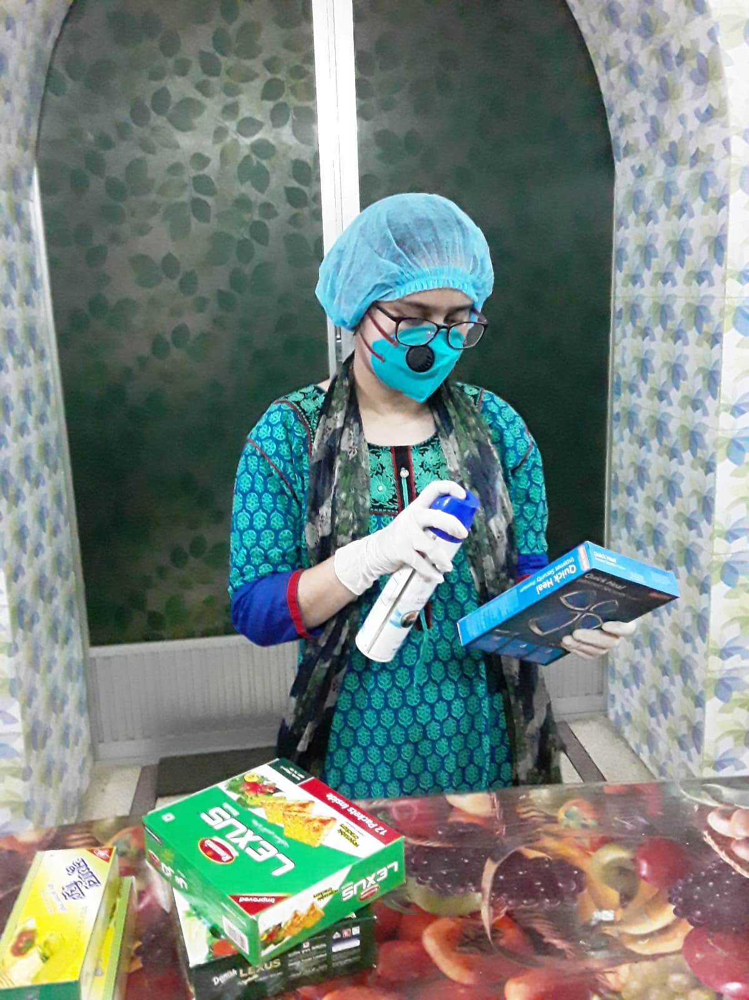
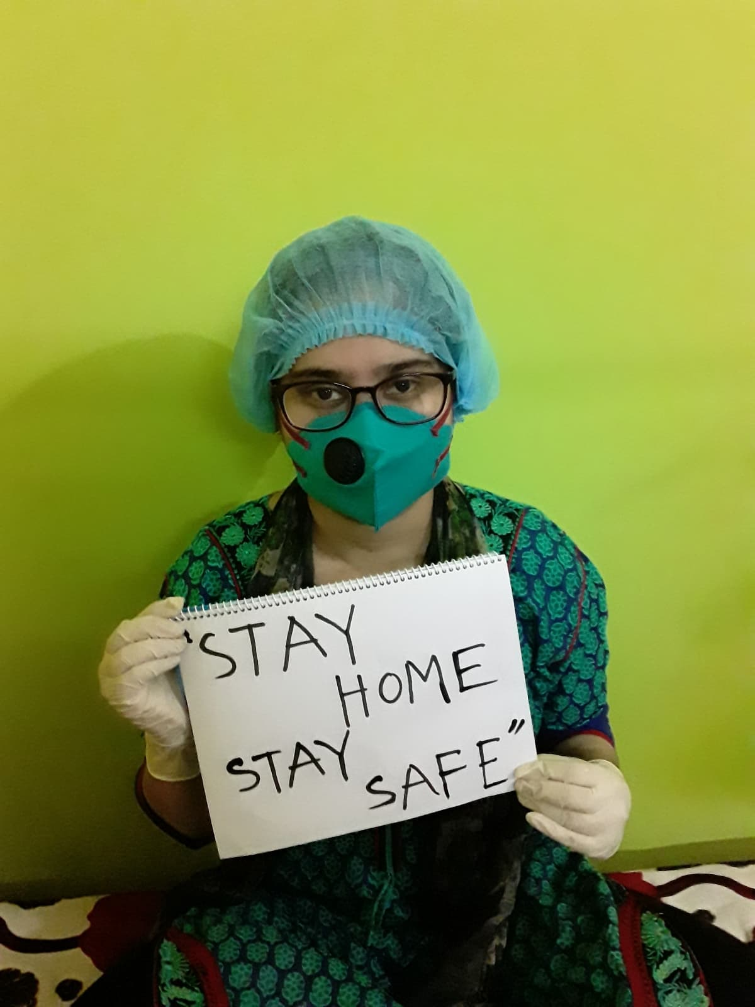
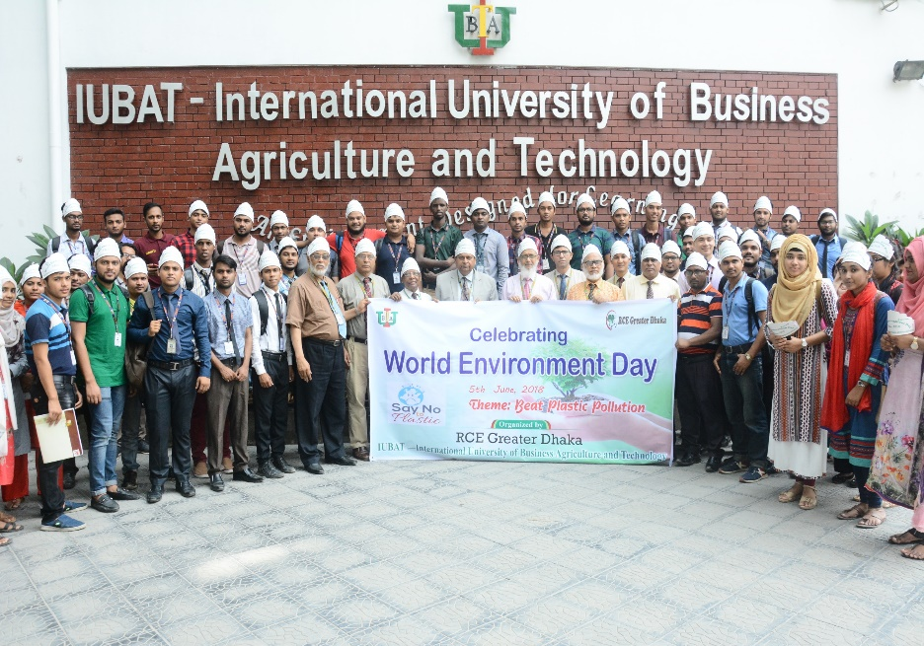
Students Activities for Sustainability

Slide 12
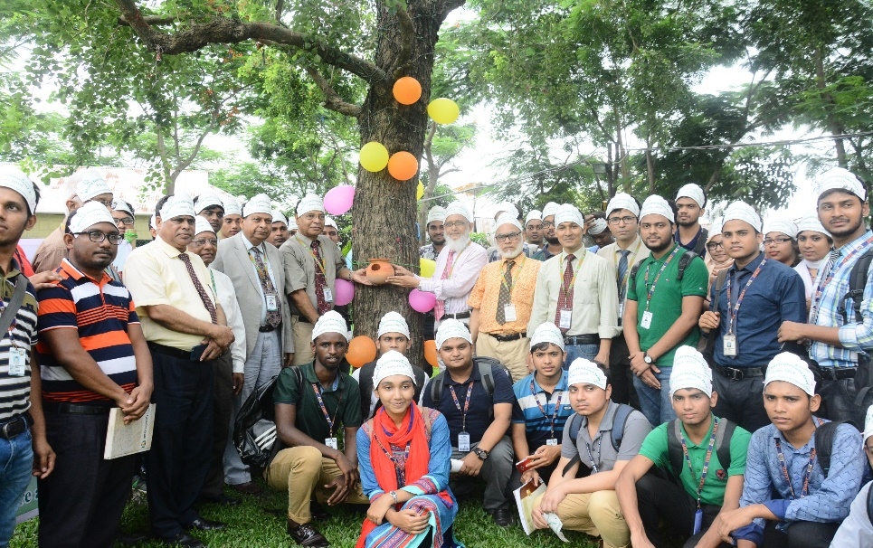
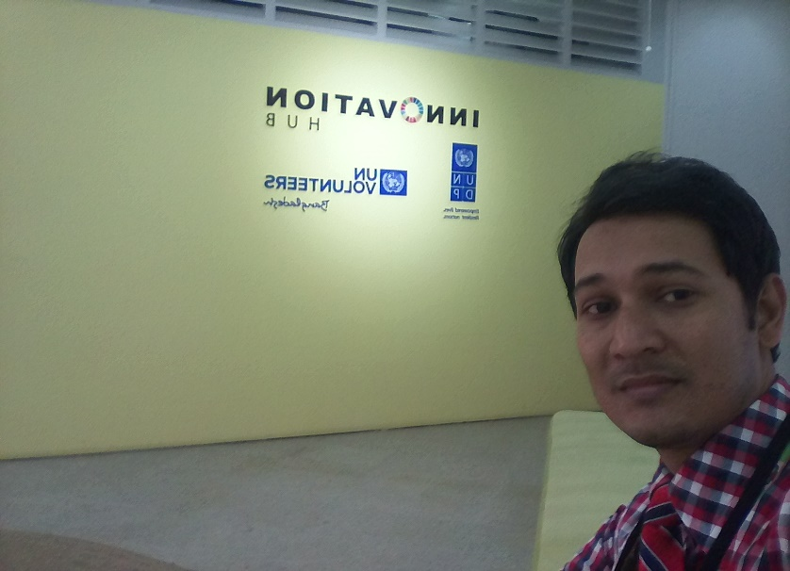
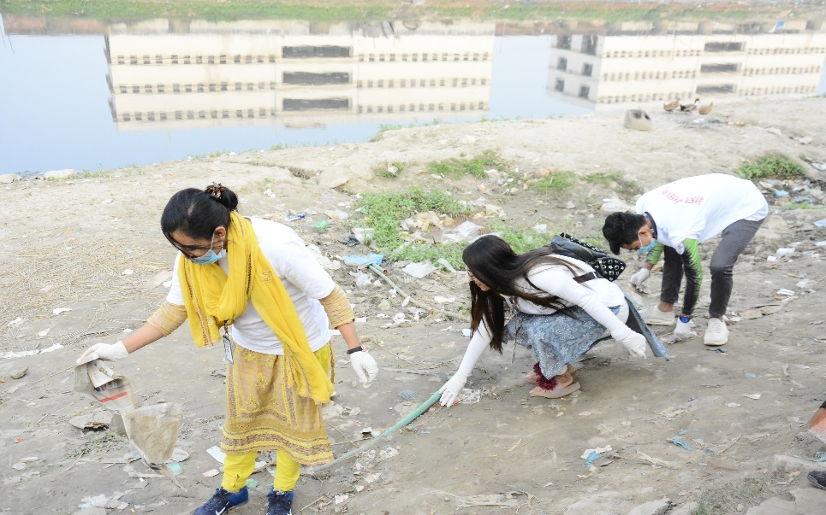
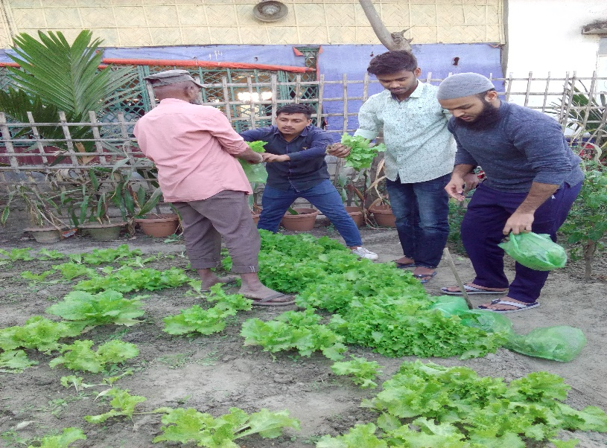
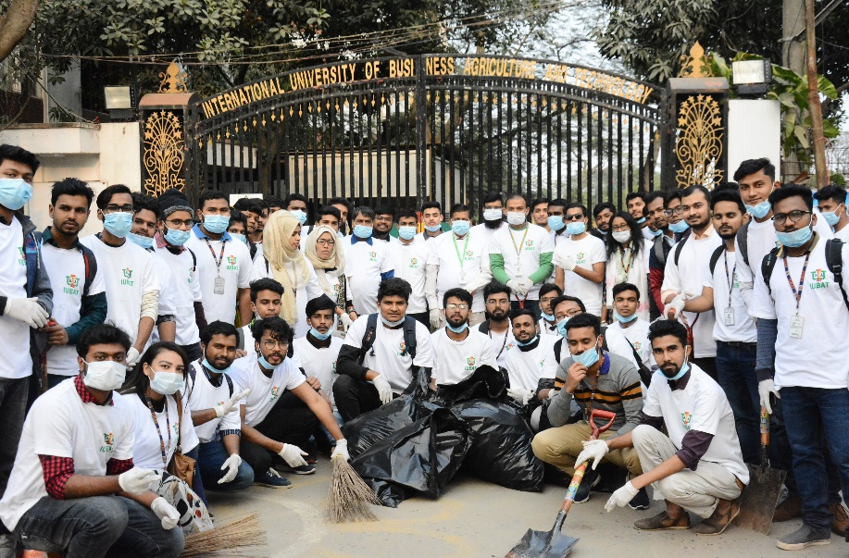
Students Activities for Sustainability

Slide 13
Figure 5. Different Discipline Students Taught Sustainability Course (ENV-101) in IUBAT

Slide 14
Figure 6. Green IUBAT Campus Enriched with Different Plant Species

Slide 15
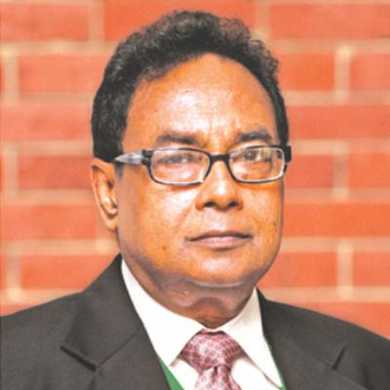
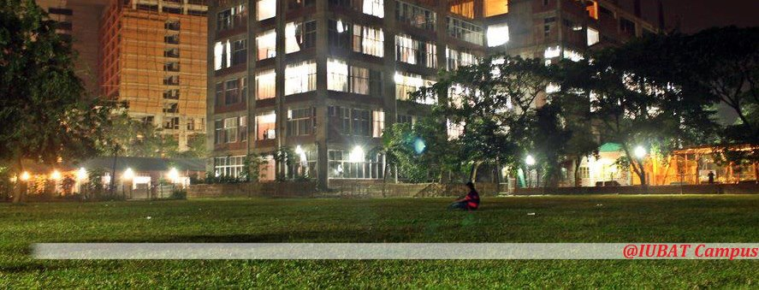
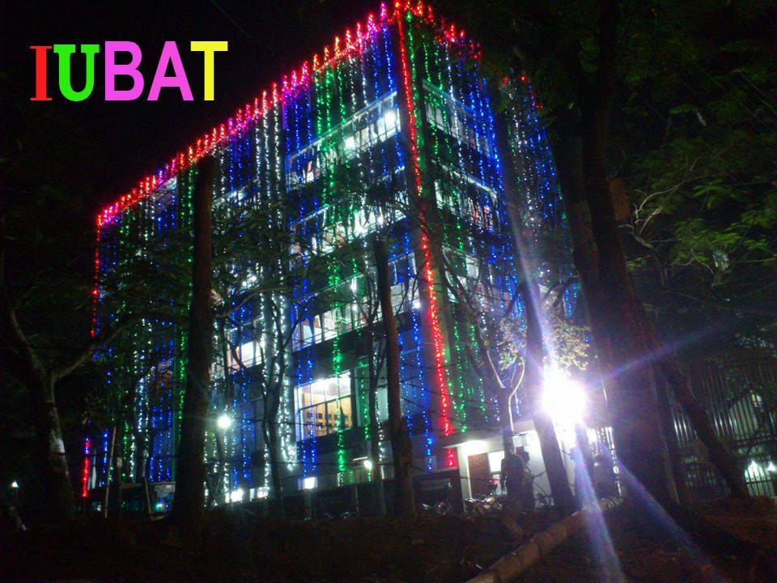
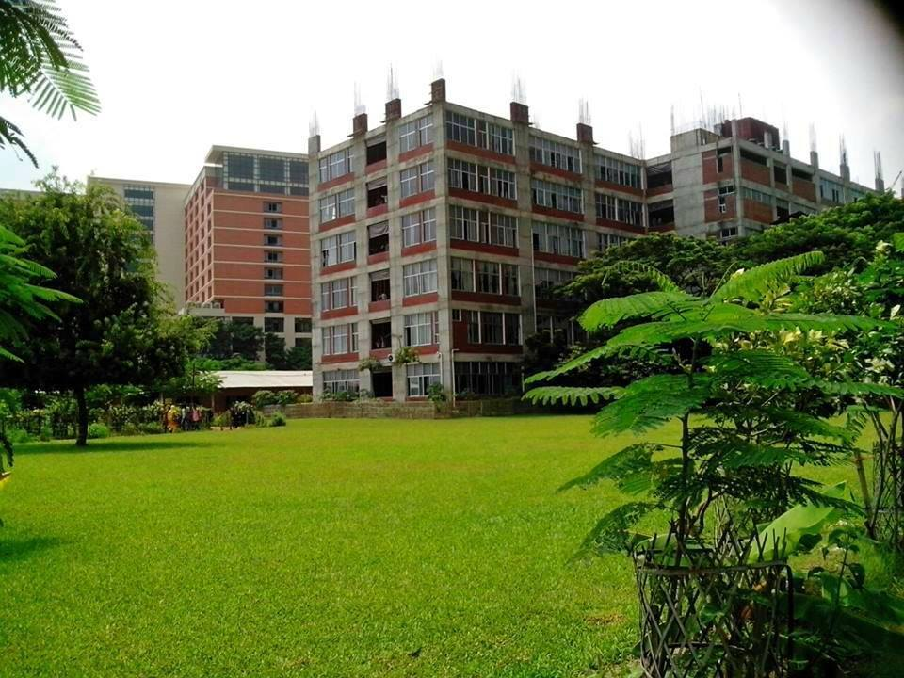
Founder Vice Chancellor Prof Alimullah Miyan

Slide 16
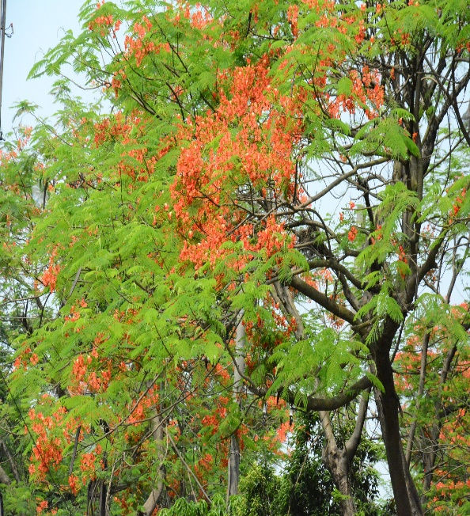
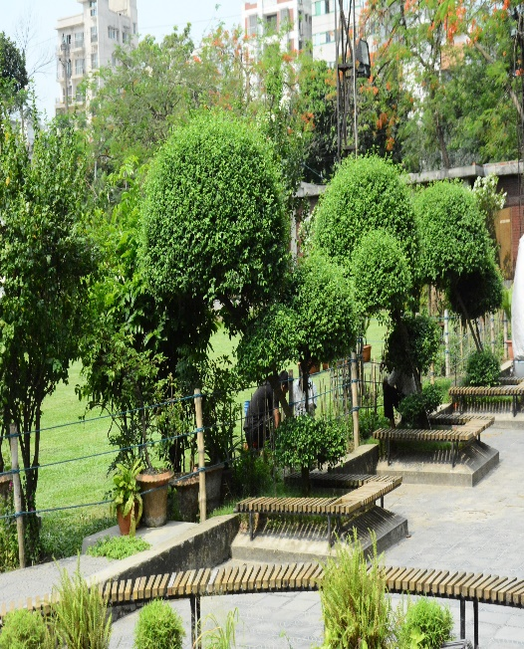
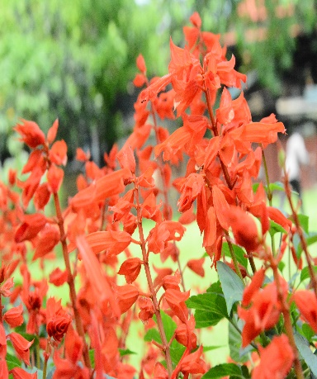
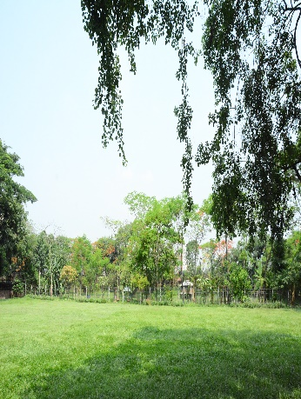
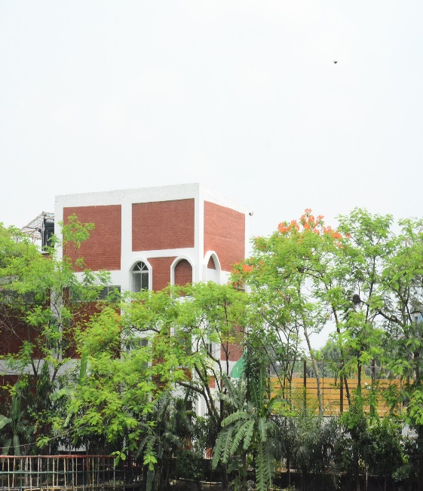
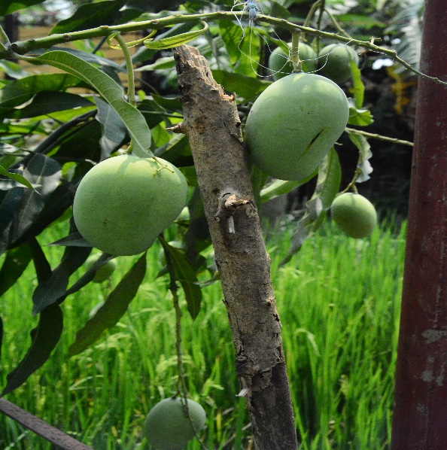
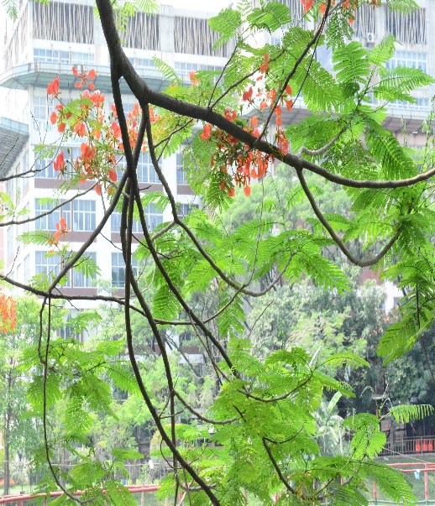
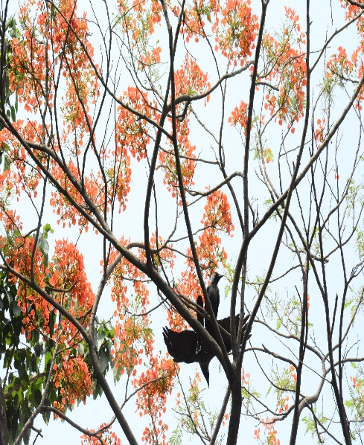
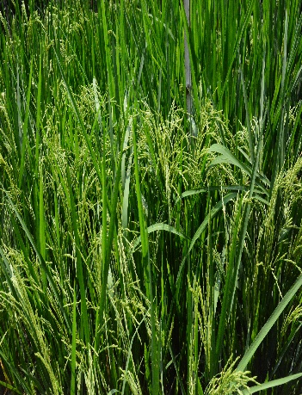
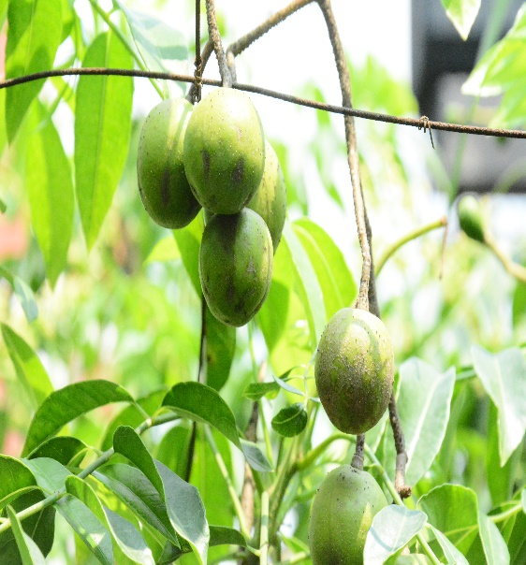
IUBAT Green Campus

Slide 17
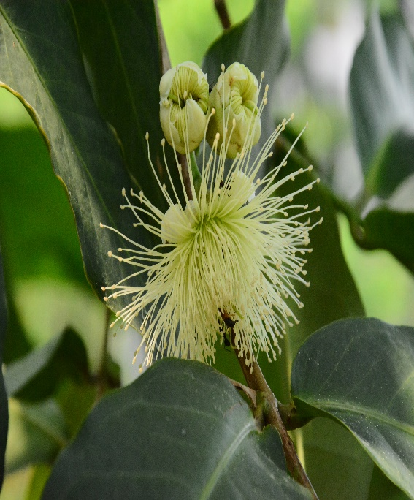
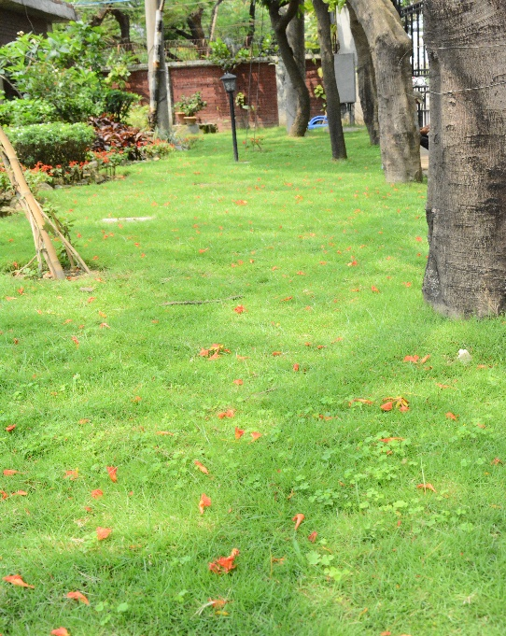
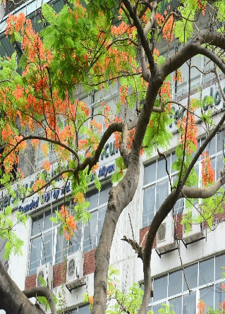
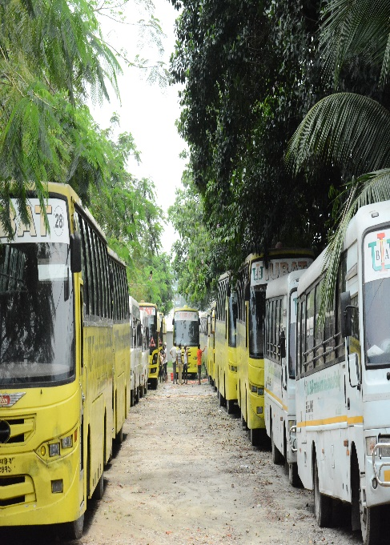
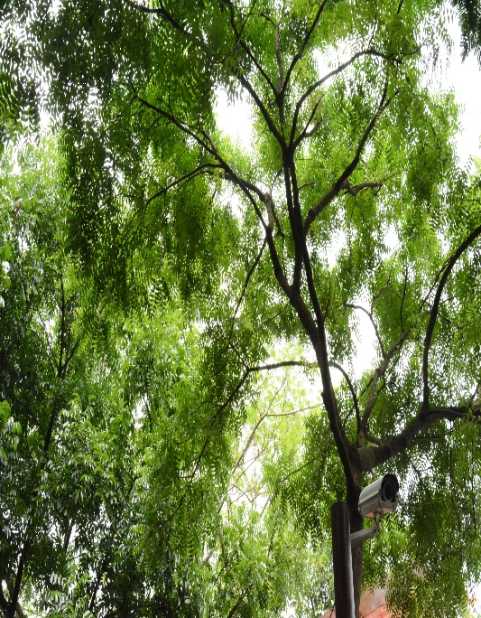
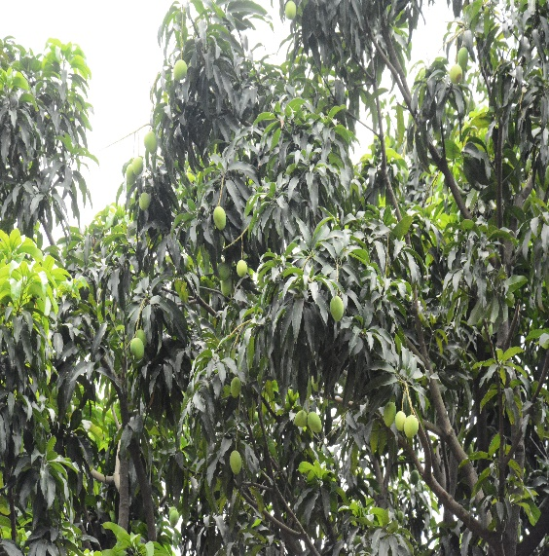
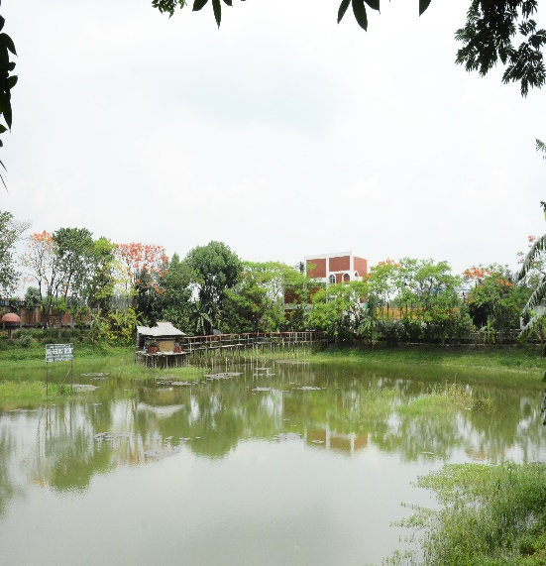
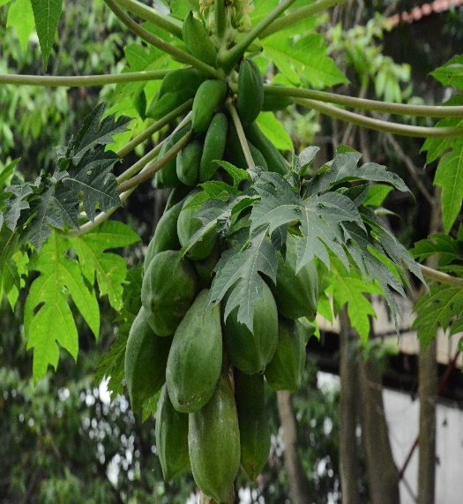
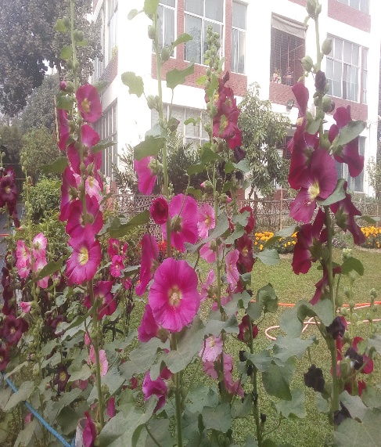
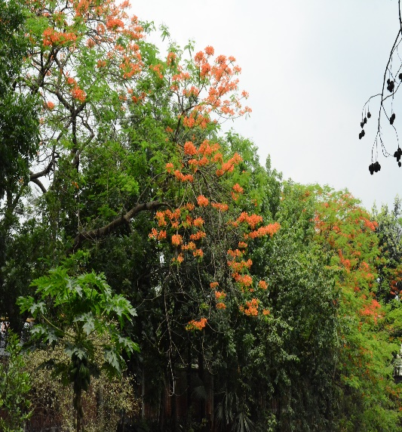
IUBAT Green Campus

Slide 18
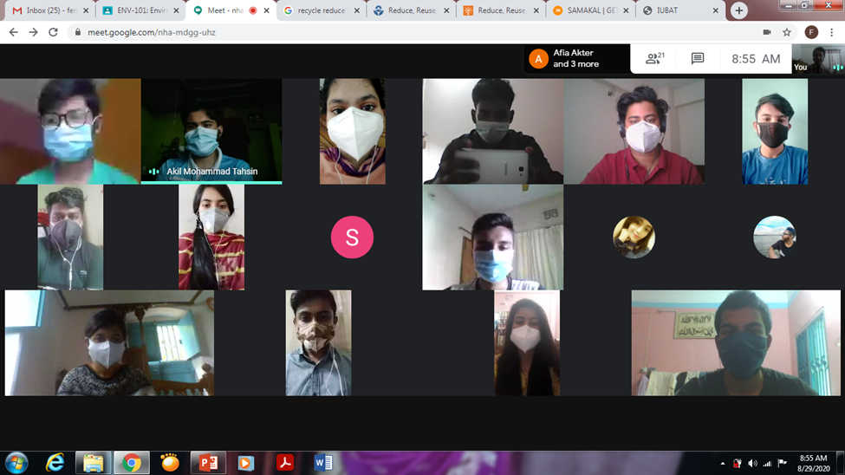
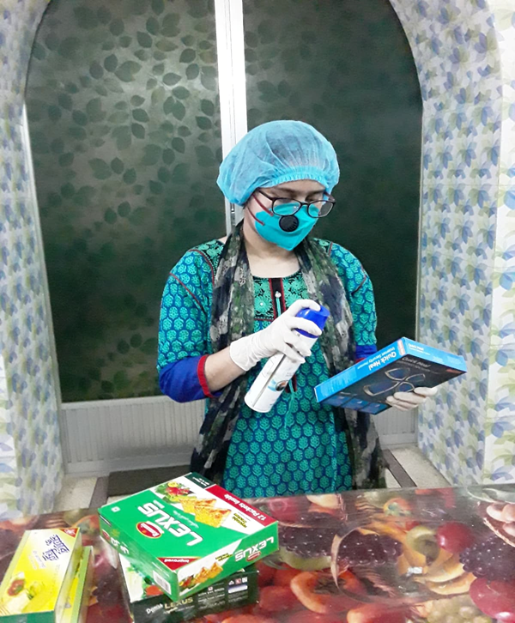
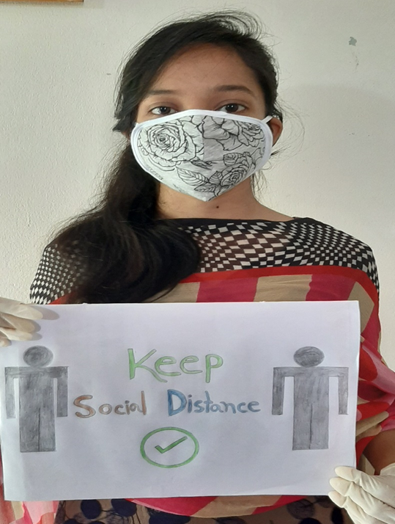
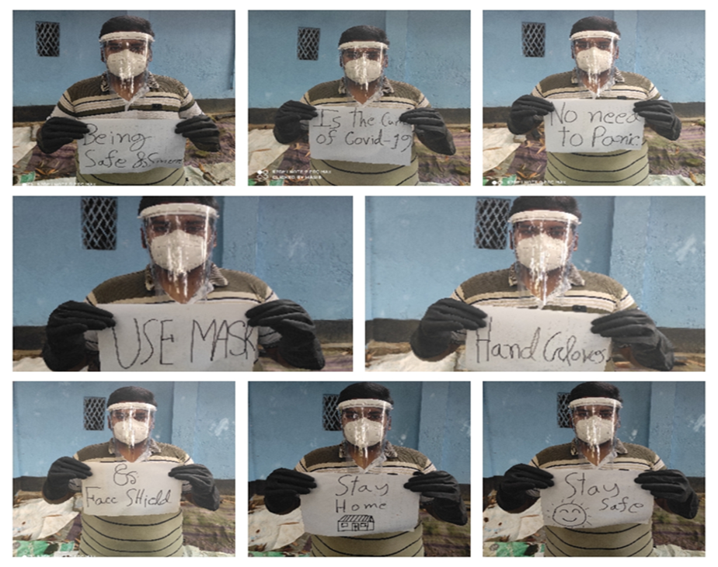
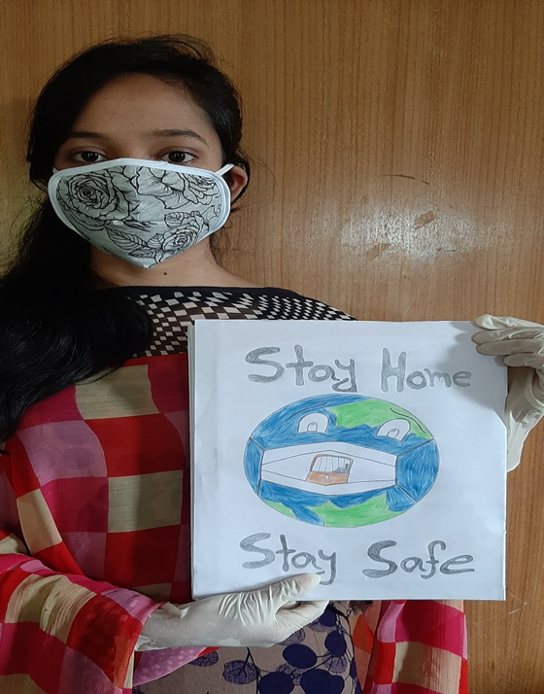
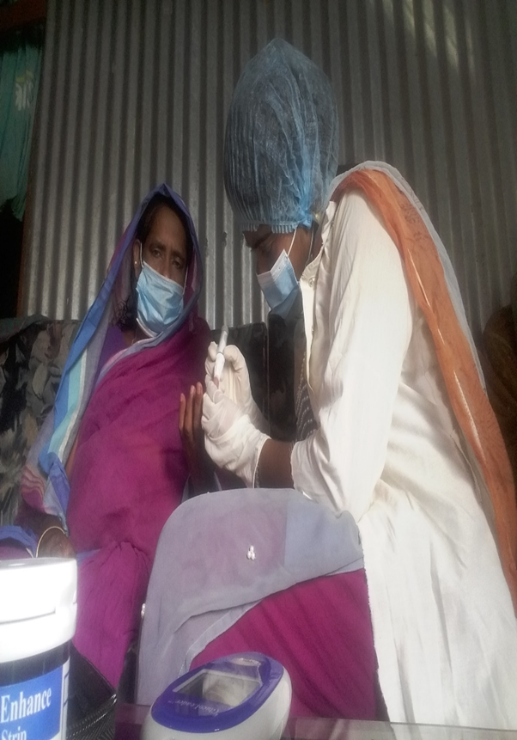
Leave No One Behind

Slide 19
Conclusion
Achieving SDG is a great challenge for the developing countries like Bangladesh. But ESD could be the baseline to achieve all other SDGs.
Therefore ESD (SDG 4.4) is the very effective approach which able to bring positive sign way to sustainable development.
That is why IUBAT has already implemented sustainability course where students are very much engaged into different environmental programs which lead to sustainability issue of the country’s ambition to become developed country by 2041.

Slide 20
Acknowledgements
Prof. Alimullah Myan, Founder Vice Chancellor
GreenMetric /IWGM 2020 Committee
https://www.youtube.com/watch?v=Ds7NbF8zUPw

