Slide 1
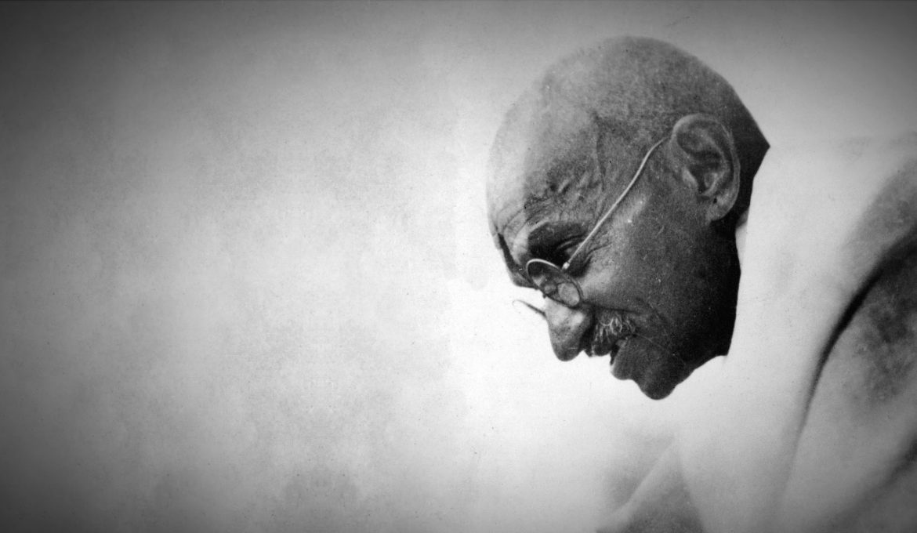
Nonviolence Theory and the Gandhian Philosophy
Dr. Brittany Foutz
Patrick Bernardo
Matthew Bernor
Andrew Hurley
Noah Karengo
Christopher Knier
Joshua Moore
Isaiah Neal
Tyler Norwood
Caroline Strohmeyer
Moustapha Thiam
Kara Williams
Alison Wright

Slide 2
The Designers
This presentation was designed by a graduate course in Theories of Conflict Resolution (CADR 540) in the Spring 2021 Semester with the Department of Conflict Analysis and Dispute Resolution (CADR) at Salisbury University.
For more information about the CADR M.A. Program, check out here: https://www.salisbury.edu/explore-academics/programs/graduate-degree-programs/cadr-masters/.
Salisbury University: https://www.salisbury.edu.

Slide 3
Overview
Introduction to Theory and its Importance
Introduction to Nonviolence
Distinctions Made by Devotees of “Nonviolence”
Generic Nonviolence
Non-Violent Resistance and Direct Action
Pacifism
Value of Nonviolence
Gandhi: Who he is
Bosserman Center for Conflict Resolution

Slide 4
Introduction to Theory and its Importance
An explanation of the relationship between elements or variables.
Theories explain the workings of a phenomenon by operating within the confines of a perspective or common set of assumptions.
Poole Folger and Randall Stutman, “The Inner Experience of Conflict” Chapter 2 of Working Through Conflict, 40.

Slide 5
Nonviolence: An intro.
Is a philosophy, theory, and practice.
Provides us with the right tools.

Slide 6
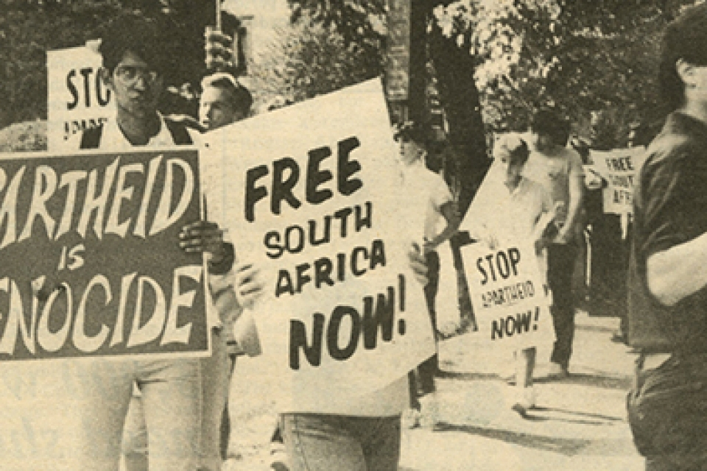
Distinctions Made by Devotees of “Nonviolence”
According to Guy Hershberger,
non-resistance describes the faith and life of those “who cannot have any part in warfare because they believe the Bible forbids it, and who renounce all coercion, even non-violent coercion” (42).
Mahatma Gandhi called his South African protest movements as “passive resistance”, then discarded the term and adopted “Satyagraha”.
“I found that the term passive resistance was too narrowly construed, that it was supposed to be a weapon of the weak, that it could be characterized by hatred, and that it could finally manifest itself as violence. It was clear that a new word must be coined by the Indians to designate their struggle” (43).
Content from: Gene Sharp, The Meanings of Nonviolence: A Typology. The Journal of Conflict Resolution. Vol. 3(1), No. 1 (Mar. 1959), pp. 41-66.
Visual from: https://gwtoday.gwu.edu/looking-back-washington-dc-activists-campaigned-end-apartheid.

Slide 7
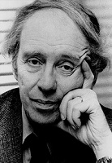
More Systematic Distinctions
Political scientist Dr. Mulford Sibley has distinguished three types of Nonviolence:
Hindu pacifism - Satyagraha
Christian pacifism
Revolutionary sector pacifism
This does not encompass the field of Nonviolence and was limited to those modern types of pacifism containing political theory (43).
Content from: Gene Sharp, The Meanings of Nonviolence: A Typology. The Journal of Conflict Resolution. Vol. 3(1), No. 1 (Mar. 1959), pp. 41-66.
Visual from: http://www2.mnhs.org/library/findaids/index_S.htm.

Slide 8
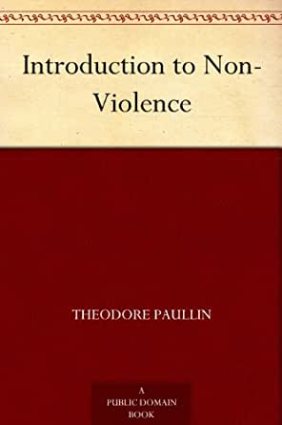
Paullin’s Typology of Nonviolence
Theodore Paullin comes close to developing a typology of “Nonviolence”.
He structured his discussion on the basis of six types resulting from a continuum, “at one end of which we place violence coupled with hatred, and at the other, dependence only upon the application of positive love and good will. In the intermediate positions we face”:
Violence without hatred
Nonviolence practiced by necessity rather than because of principle
Non-violent coercion
Satyagraha and non-violent direct action
Non-resistance
The Nonviolence extremity of his continuum, “active goodwill and reconciliation” is the sixth type (43).
Content from: Gene Sharp, The Meanings of Nonviolence: A Typology. The Journal of Conflict Resolution. Vol. 3(1), No. 1 (Mar. 1959), pp. 41-66.
Visual from: https://www.amazon.com/Introduction-Non-Violence-Theodore-Paullin-ebook/dp/B00847HY14.

Slide 9
Generic Nonviolence
Generic Nonviolence is the whole gamut of behavior and belief characterized by an abstention from physical violence.
This is the sense in which the term “Nonviolence” has been used in this paper.
Not included in this classification are hermits, cases of cowardice involving a de facto withdrawal, legislation and state decrees (44).
Gene Sharp, The Meanings of Nonviolence: A Typology. The Journal of Conflict Resolution. Vol. 3(1), No. 1 (Mar. 1959), pp. 41-66.

Slide 10
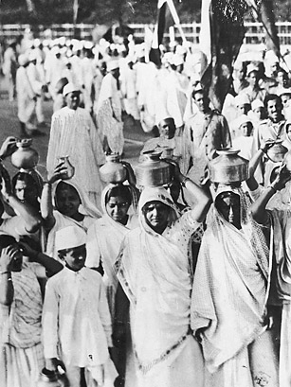
The Types of Generic Nonviolence
Non-resistance, active reconciliation, moral resistance, selective Nonviolence, passive resistance, peaceful resistance, non-violent direct action, Satyagraha, and non-violent revolution (56).
Salt Satyagraha: “True force”: Gandhi embarked on a 24-day march from the city of Ahmedabad to the small seaside town of Dandi, attracting followers along the way.
Visual from: http://content.time.com/time/specials/packages/article/0,28804,2080036_2080037_2080220,00.html.
Content from: Gene Sharp, The Meanings of Nonviolence: A Typology. The Journal of Conflict Resolution. Vol. 3(1), No. 1 (Mar. 1959), pp. 41-66.

Slide 11
Non-Violent Resistance and Direct Action
“Non-violent resistance and direct action” is another intermediary classification, being narrower than “generic Nonviolence” and broader than specific types.
It refers to those methods of resistance and direct action without physical violence in which the members of the non-violent group commit either:
Acts of omission: they refuse to perform acts which they usually perform and are expected by law or regulation to perform (44)
Or acts of Commission: they insist on performing acts which they usually do not perform, are not expected by custom to perform, or are forbidden by law or regulation from performing (44)
Or both (45).
In this, the primary intent is to change attitudes and values as a preliminary to changing policies.
When the behavior of the non-violent group is primarily intervention, usually
acts of commission, it can be described as “non-violent direct action” (45).
Gene Sharp, The Meanings of Nonviolence: A Typology. The Journal of Conflict Resolution. Vol. 3(1), No. 1 (Mar. 1959), pp. 41-66.

Slide 12
Pacifism
Pacifism: includes the belief systems of those persons and groups who, as a minimum, refuse participation in all international or civil wars or violent revolutions
and base this refusal on moral, ethical, or religious principle.
Pacifism is a narrower term than “generic Nonviolence” (44).
Gene Sharp, The Meanings of Nonviolence: A Typology. The Journal of Conflict Resolution. Vol. 3(1), No. 1 (Mar. 1959), pp. 41-66.

Slide 13
Pacifism and Generic Nonviolence
Of these nine types of generic Nonviolence, five fall within the definition of “pacifism”,
that is their adherents refuse, on grounds on principle, participation in all international and civil wars and violent revolutions.
These are non-resistance, active reconciliation, moral resistance, Satyagraha, and non-violent revolution (63).
Six of the nine types of generic Nonviolence emphasize the value of non-violent behavior as a method for achieving desired social objectives
and these are moral resistance, passive resistance, peaceful resistance, non-violent direct action, Satyagraha, and non-violent revolution (63).
There is overlapping of the groups: peaceful resistance, Satyagraha, and non-violent revolution.
This emphasizes the intrinsic value of both Nonviolence and non-violent behavior as a method (63).
Of the nine types, the following are within the area of non-violent resistance and direct action: passive resistance, peaceful resistance, and non-violent direct action (63).
Often included also would be moral resistance, Satyagraha, and non-violent revolution (63).
Gene Sharp, The Meanings of Nonviolence: A Typology. The Journal of Conflict Resolution. Vol. 3(1), No. 1 (Mar. 1959), pp. 41-66.

Slide 14
The Value of Nonviolence
Vehicle for social change.
Promotion of positive peace.
Gives the voiceless a voice.
“Defeats injustice and not people” (MLK).

Slide 15
Mahatma Gandhi: Who he is and his experiences with violence
Mahatma Gandhi:
Anti-colonial nationalist that lead the campaign of India’s Independence from the British Empire in 1947.
Inspired civil rights and freedom movements throughout the world.
Experiences With Violence:
Civil rights activism in South Africa (1893 - 1914).
Experienced discrimination and violence based on his heritage.
Used to recruit Indian troops for the WWI war effort to fight for the British.
Gandhi participated in the South African war against the Boers, on the British side in 1899. He served as a stretcher-bearer.
Orwell, G. “Reflections on Gandhi.” Partisan Review. (1949): 5. Accessed April 6, 2021 https://arvindguptatoys.com/arvindgupta/gandhi-orwell.pdf.

Slide 16
What is the Gandhian philosophy of nonviolence?
Gandhian philosophy and ways of life is to always do the right thing and practice nonviolent movement.
They believe that it is possible to pursue truth without being non-violent.
“To know what is right and not to do it is cowardice”. Mahatma Gandhi often used this quote from Confucius.``
https://www.nobelprize.org/prizes/themes/mahatma-gandhi-the-missing-laureate/.

Slide 17
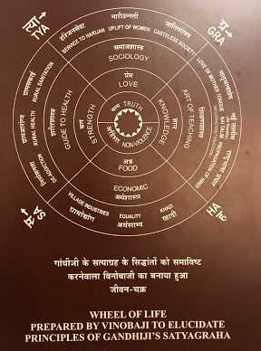
Gandhi’s Principle Wheel
Gandhi’s principles go beyond the movements and the changes that he was able to create.
Gandhian philosophy can be applied to our world now from how we treat our environment to how certain social movements can be successful with the help of Gandhian philosophy.
Picture taken by Alison Wright
January 10th, 2020.

Slide 18
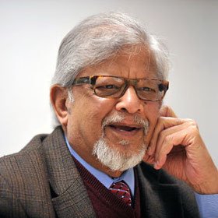
Bosserman Center for Conflict Resolution
Executive Director Dr. Brian Polkinghorn.
Promotes peace and conflict resolution.
Offers the United Nations Educational, Scientific and Cultural Organization (UNESCO) Fellowship Program.
Is known as RCE Salisbury through UN University and UNESCO.
Conducts research of peace and conflict issues.
Attracts and implements grant funded projects, contracts, and consultancies.
Disseminates findings and educates the public through conferences, training, and workshops.
Dr. Arun Gandhi Senior Practitioner / Spiritual Guide.
For more information: http://bossermancenter.com/people/arun-gandhi/.

Slide 19
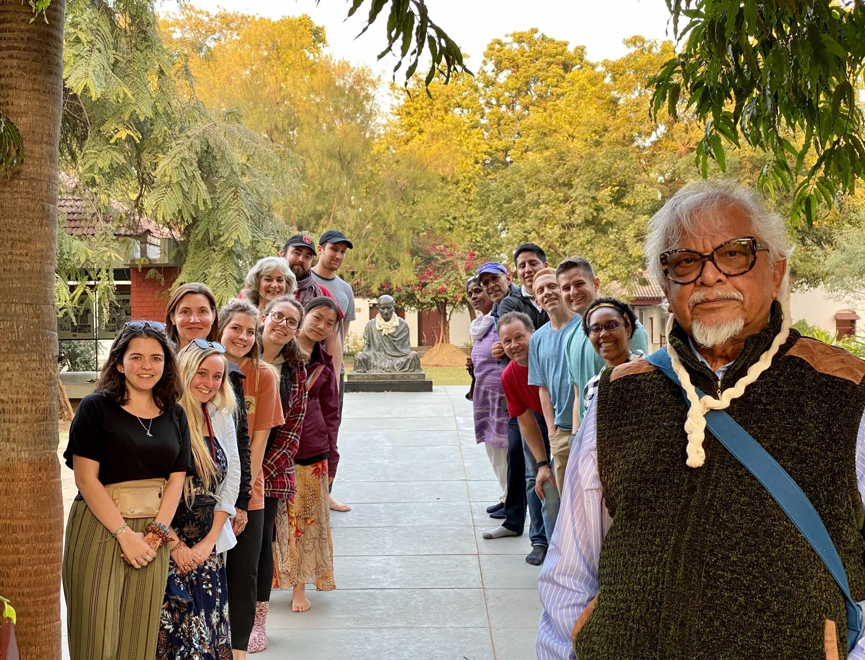
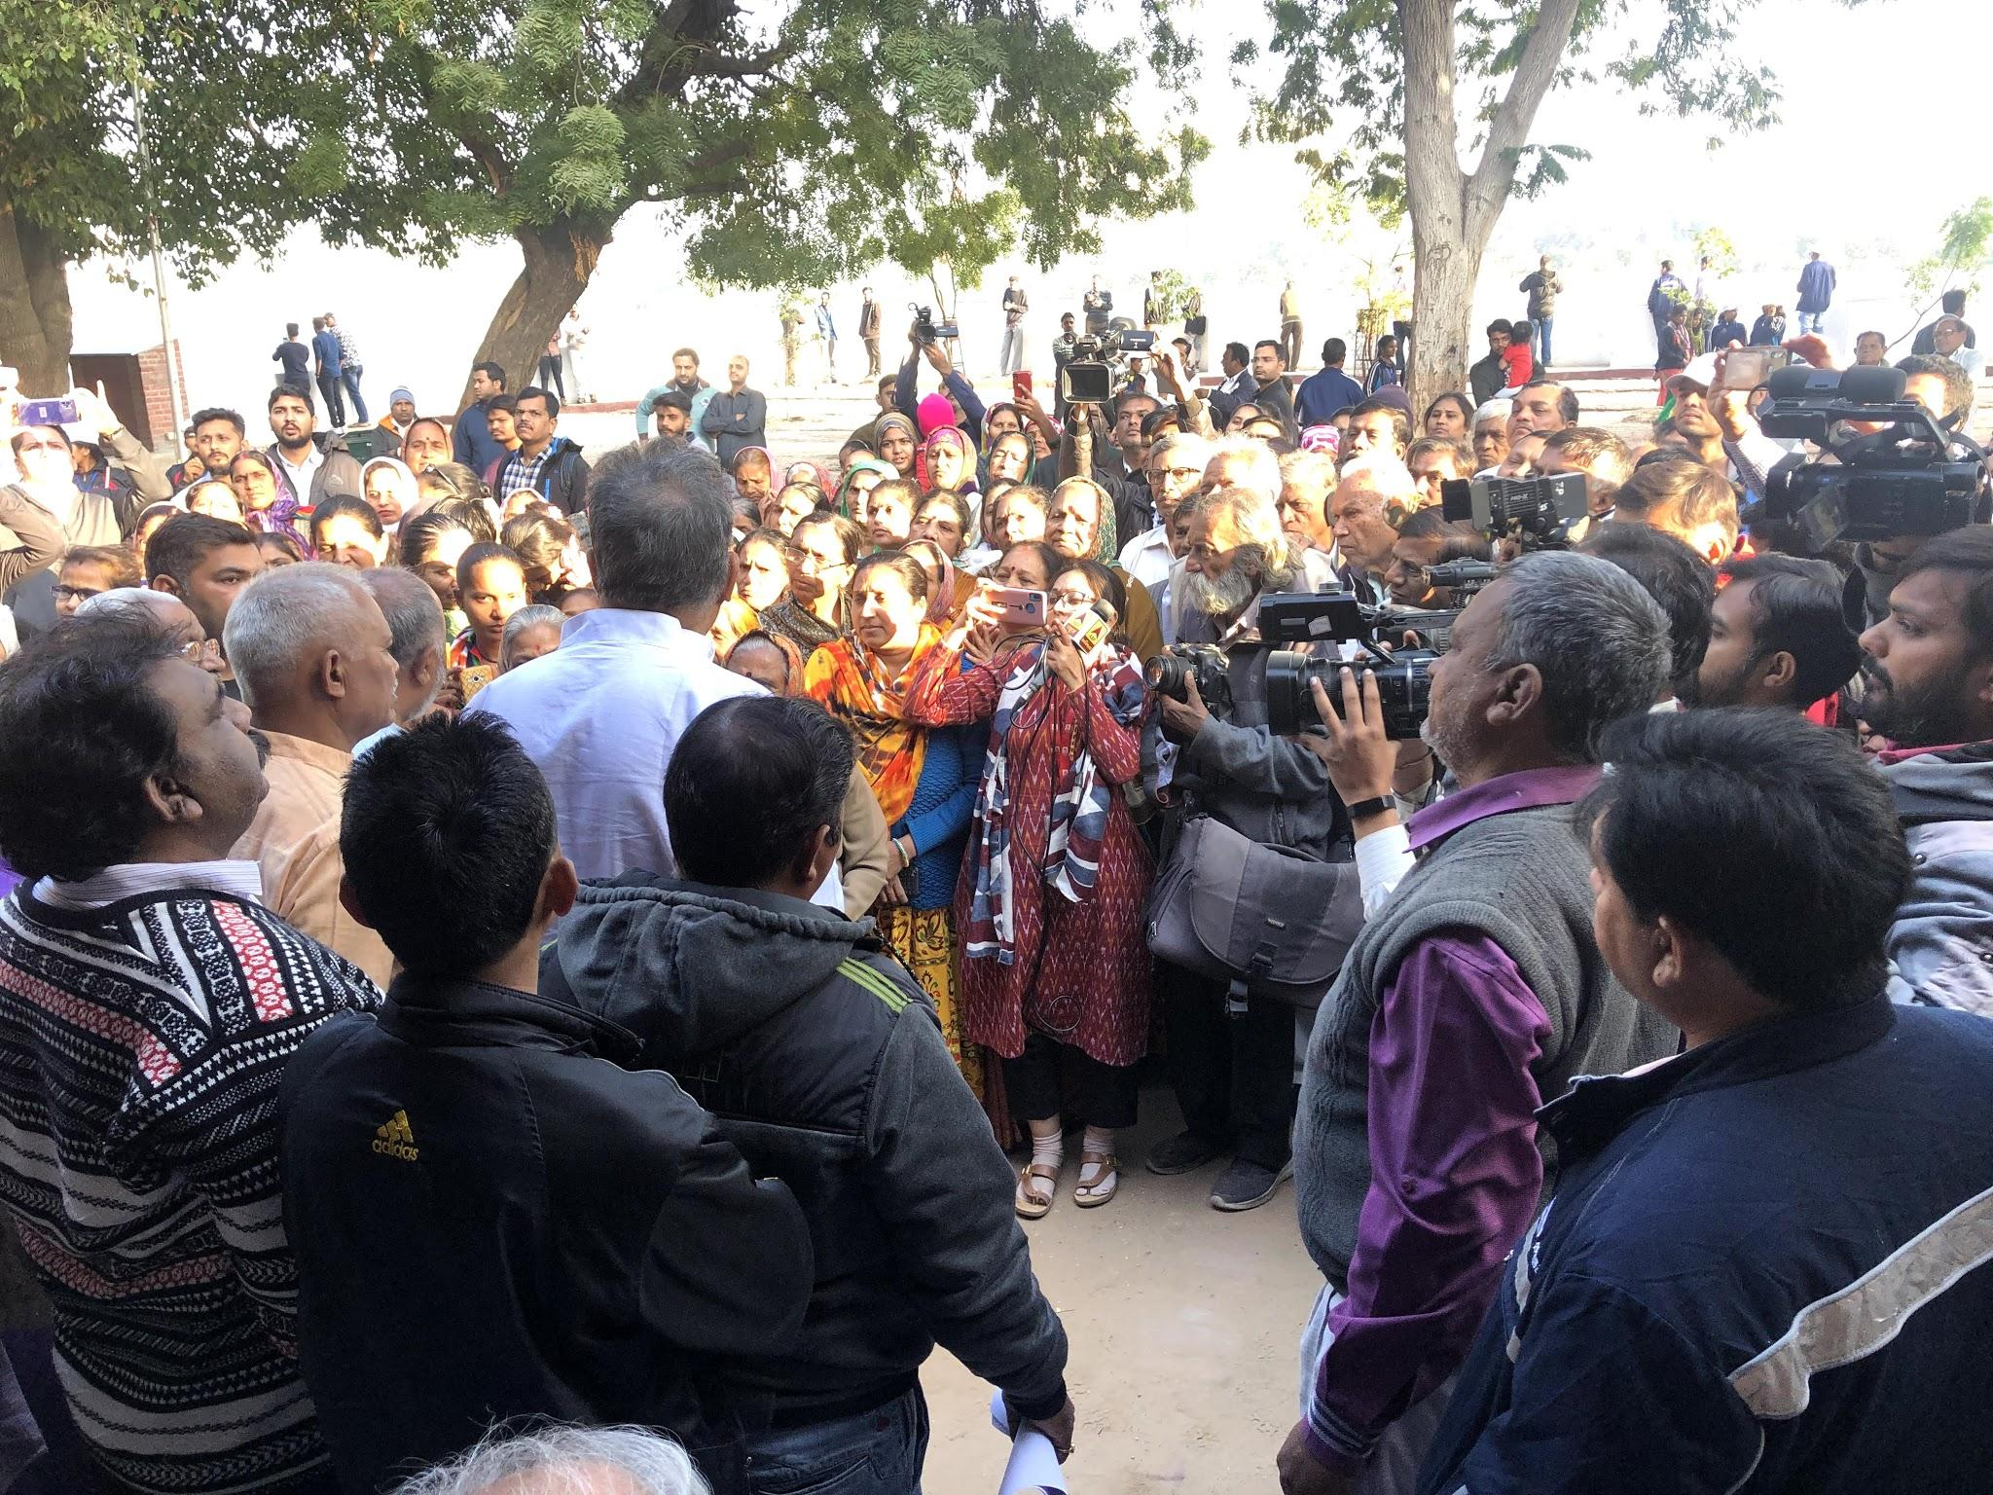
Arun and Tushar Gandhi
Gandhi’s grandson and great-grandson have carried on the Gandhian philosophy.
Arun has focused his life on continuing the work that his grandfather has set forth.
In recent times, Arun has published his book, “The Gift of Anger: And Other Lessons I Learned from My Grandfather Mahatma Gandhi”
Tushar has also released several books about his great-grandfather's past and is leading the movement to have a Nonviolent India.
Both Arun and Tushar lead the Gandhi legacy tour in India and South Africa that shows Gandhi’s legacy at first hand.
Both Photos taken from: Alison Wright on January 10, 2020.

