Slide 1
Estimation of Carbon Footprint in Schools & Creation of Low Carbon Campus Plans Kerala, India
Prof. (Dr.) C.K. Peethambaran
Director
Centre for Innovation in Science and Social Action (CISSA)
Headquarters of RCE Thiruvananthapuram
Kerala, India
http://www.cissa.co.in/

Slide 2
Multiple Stakeholder Participation
Implemented by
Supported by
13 Schools
(11 Government schools & 2 Private schools from Rural and Urban area)

Slide 3
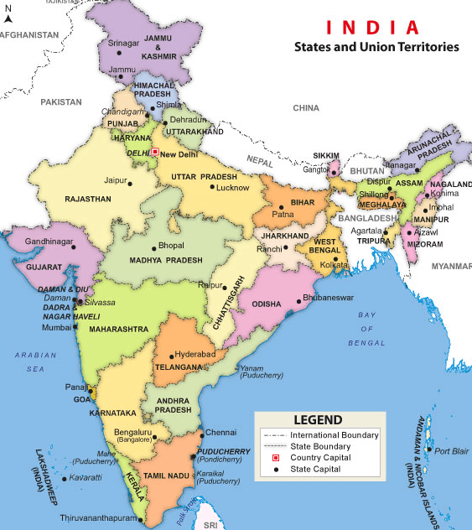
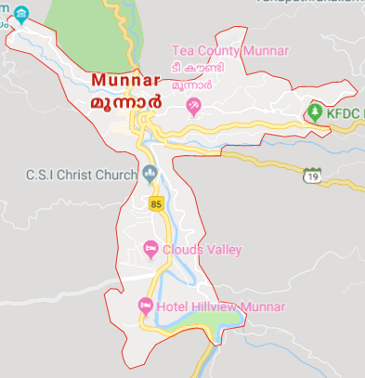
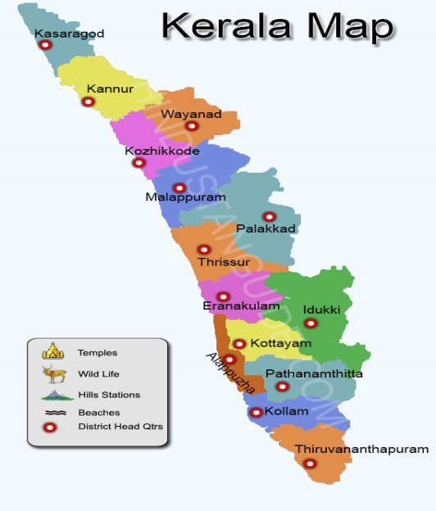
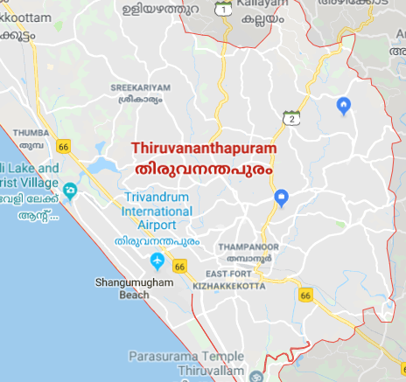
Munnar, Idukki, Kerala
Thiruvananthapuram, Kerala

Slide 4
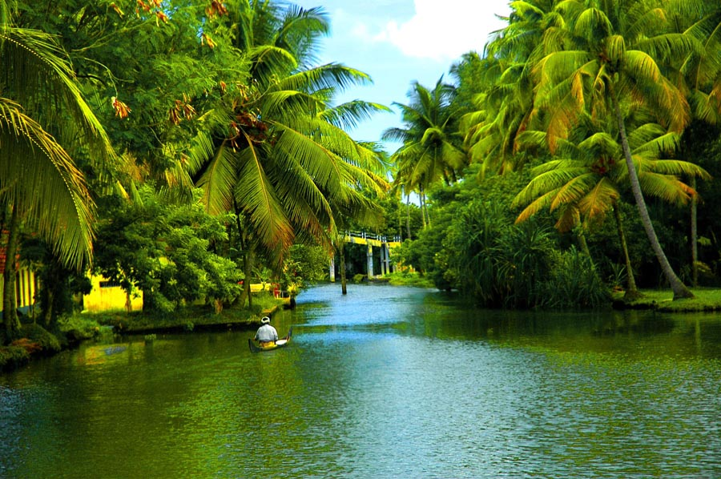
KERALA : A MODEL STATE
First state to achieve 100% primary education
93.91% Literacy rate (2011 census)
Girls outnumber boys in educational institutions
Wealth and resource redistribution programmes
52.3 % of total land area is forest area.
CRITICAL ISSUES: Rapid Urbanisation, Pollution, High density of population

Slide 5
RELEVANCE
NATIONAL SCENARIO
India- the fourth largest GHG emitter (5.8% of total emission)*
LOCAL SCENARIO
Ecologically fragile area and sensitive to micro level climate change.
Highest Population Density
Has faced worst flood havoc during August 2018, resulting in death and displacement of several thousands of citizens
Kerala has favorable environment to achieve Carbon Neutral
High pace of infrastructure development
High demand of energy consequent to high urbanisation
*http://energyatlas.iea.org/#!/tellmap/1378539487

Slide 6
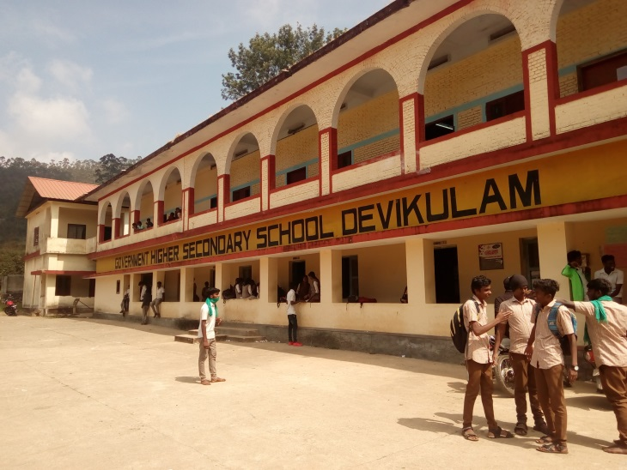
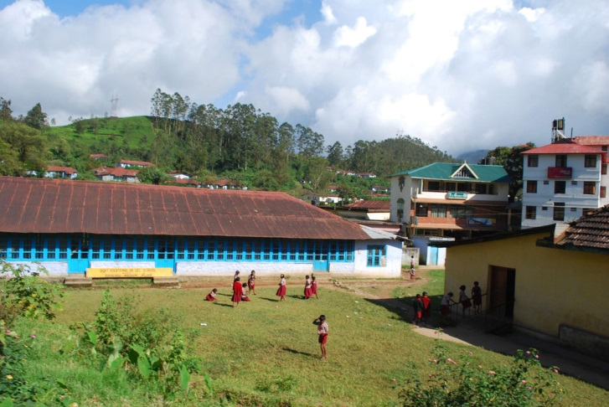
OBJECTIVES
To educate students and teachers on carbon footprint.
To train students to collect data on carbon emissions and carbon sequestration in the campus in a participatory mode.
To calculate the specific carbon footprint of the campus and classify them as Carbon Negative, Neutral or Positive
To create individual plans for schools to reduce their carbon footprint based on the data generated.
Popularize the concept among the society through the involvement of students

Slide 7
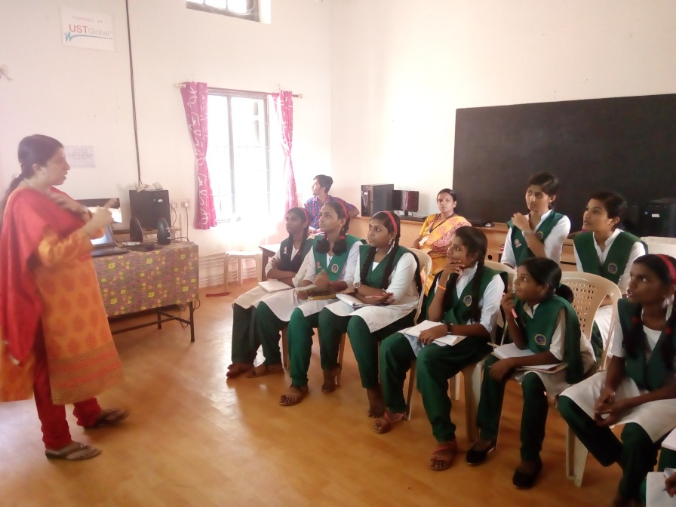
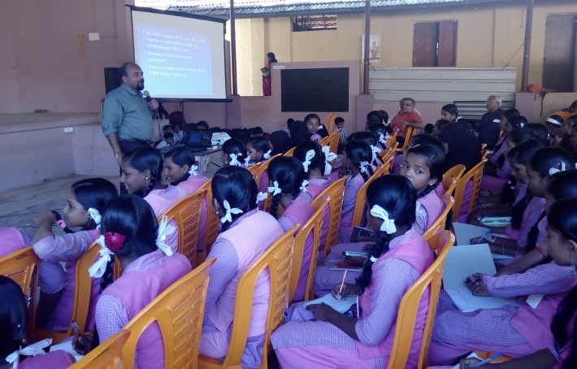
ACTIVITIES & PRACTICES
1. SENSITISING THE TARGET GROUP
Introductory classes on different carbon literacy knowledge, low carbon attitudes and practices in a participatory mode involving students and teachers.
Data collection methodologies were explained to the project team for field studies.

Slide 8
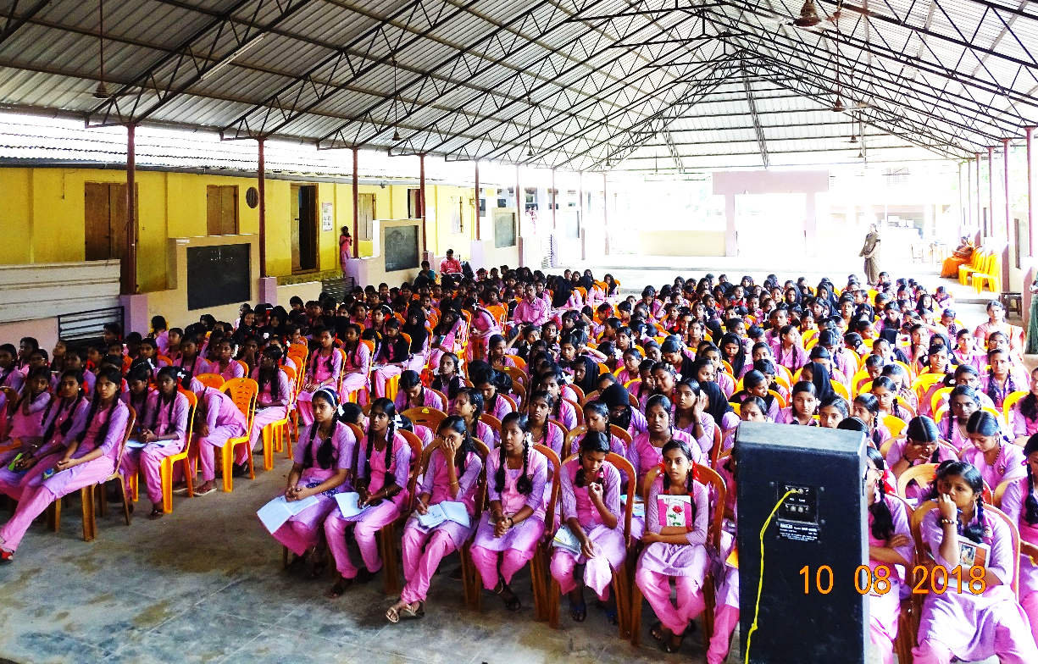
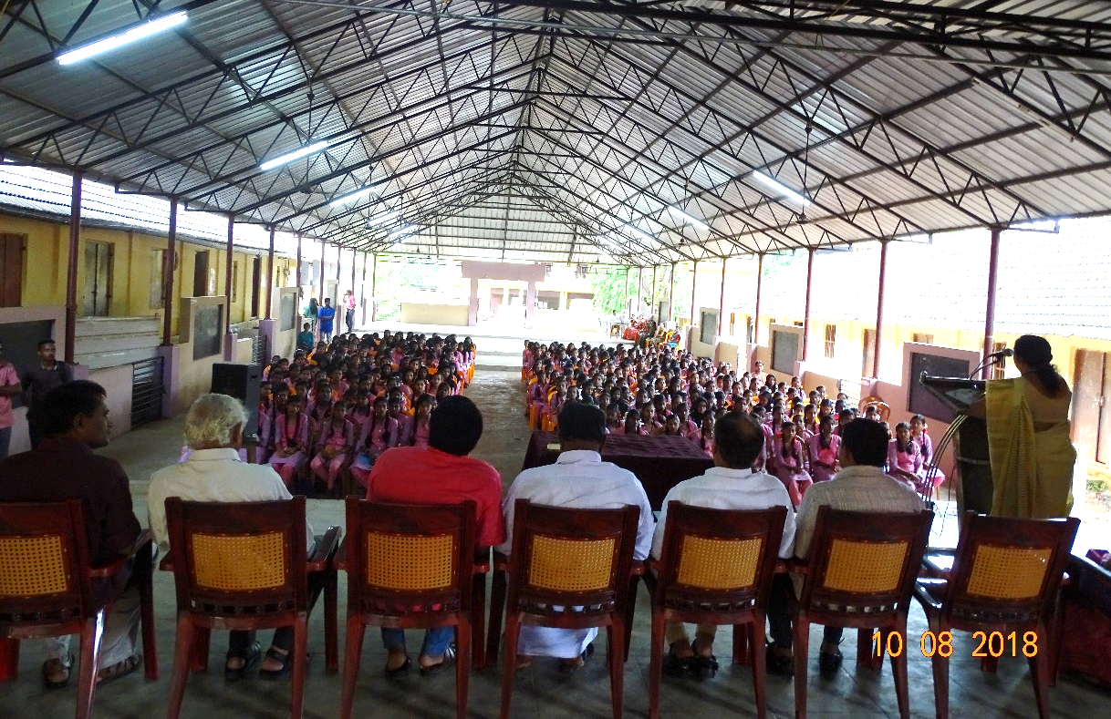
ACTIVITIES & PRACTICES
SENSITISING THE TARGET GROUP
The members of legislative assembly, local self governments and experts were invited to the sensitization programs to assure multiple stakeholder participation.

Slide 9
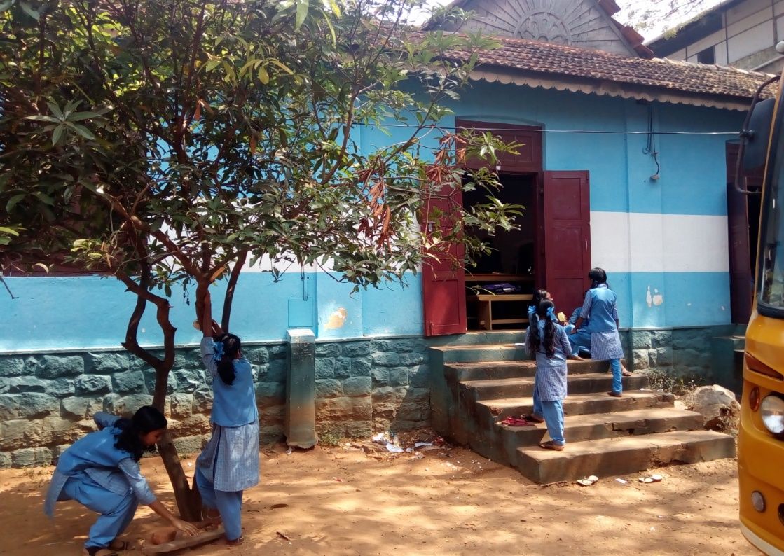
ACTIVITIES & PRACTICES
2. DATA COLLECTION
Activity groups were formed for field studies.
The team comprising of students, teachers and experts from CISSA
The studies were conducted on following
Electricity usage
Fuels for cooking
Transportation
Waste management
Carbon sequestration

Slide 10
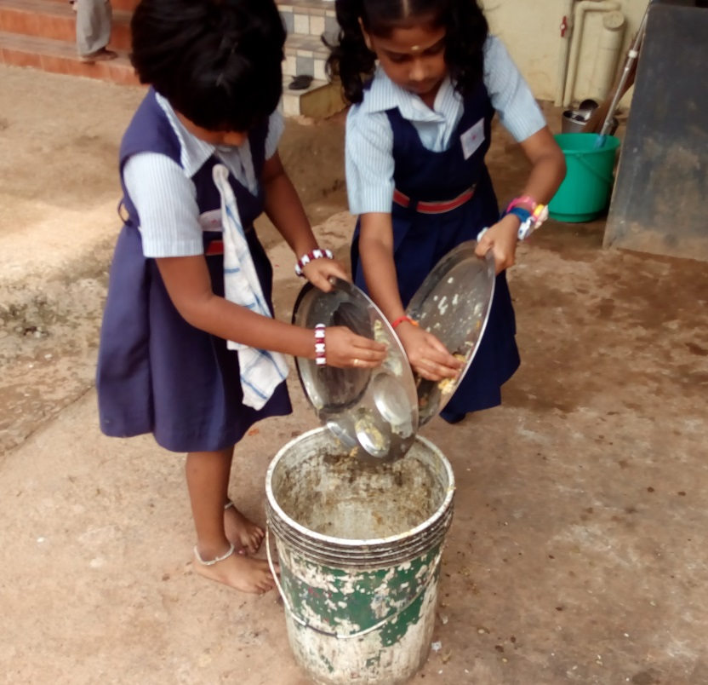
ACTIVITIES & PRACTICES
3. MONITORING OF ACTIVITIES
Activities were monitored by the project team for,
Accurate collection of data.
Opportunities for the students to interact with experts.
4. DATA ANALYSIS
Analysis of data for creating individual plans for schools to reduce their carbon foot print

Slide 11
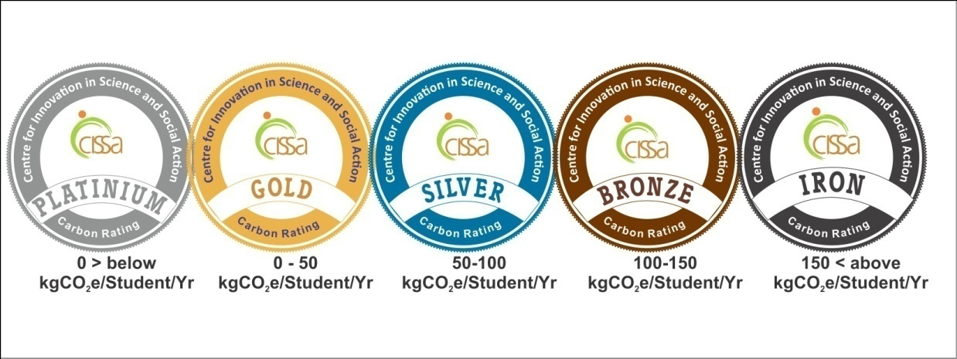
ACTIVITIES & PRACTICES
5. CARBON MITIGATION PLANS
‘Carbon Mitigation Plans’ were suggested for individual schools
Resource optimization.
Energy Efficiency
Renewable Energy resources.
6. GRADING OF SCHOOLS FOR ENCOURAGING ‘REDUCED CARBON FOOTPRINT’
Schools were graded to Platinum, Gold, Silver, Bronze and Iron
according to
Carbon footprint per
student
Percentage of implementation of carbon reduction plans

Slide 12
OUTCOME
Low carbon champions are now can
Estimate Carbon footprint
Motivate others for a low carbon life style
Recommend on carbon mitigation plans.
Created awareness among students regarding,
Ill effects of Green House Gases
Importance of Conserving Energy
Minimizing Waste
Sustainable way of leading a low carbon lifestyle
Mitigation of climate change

Slide 13
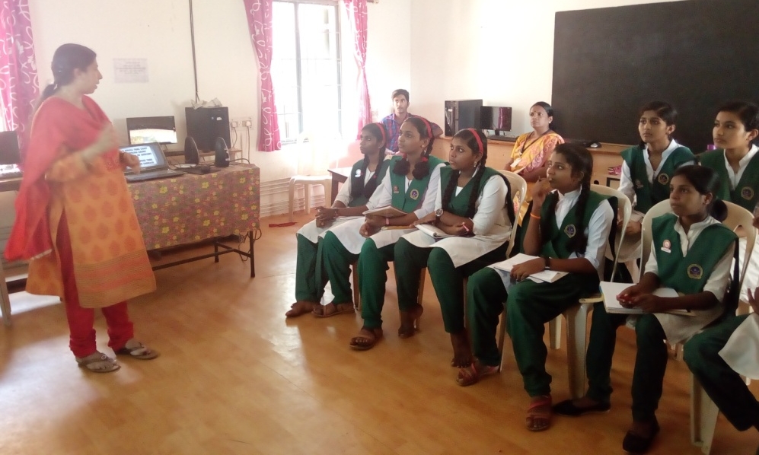
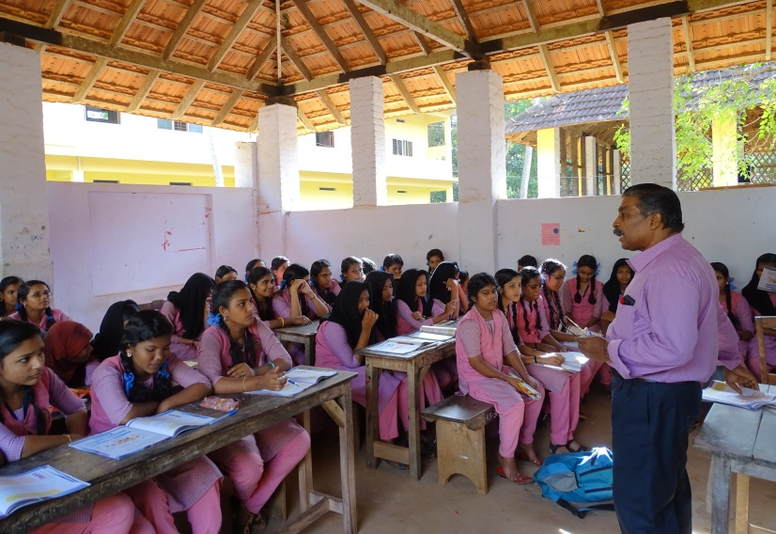
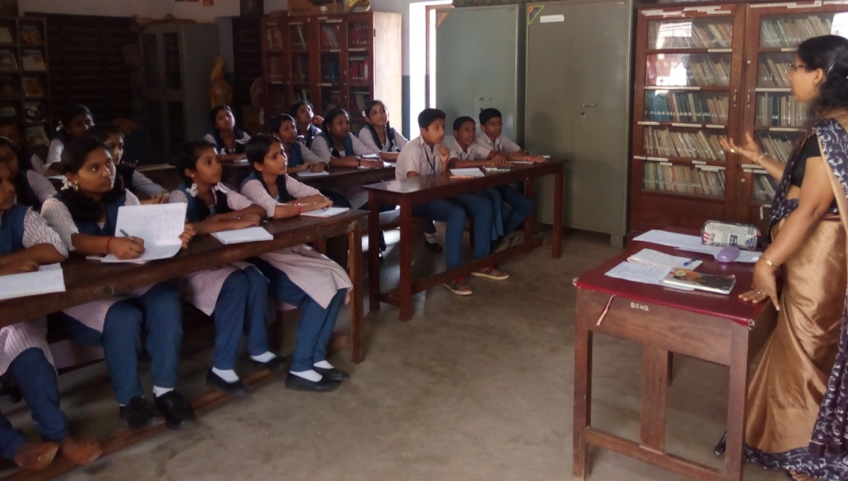
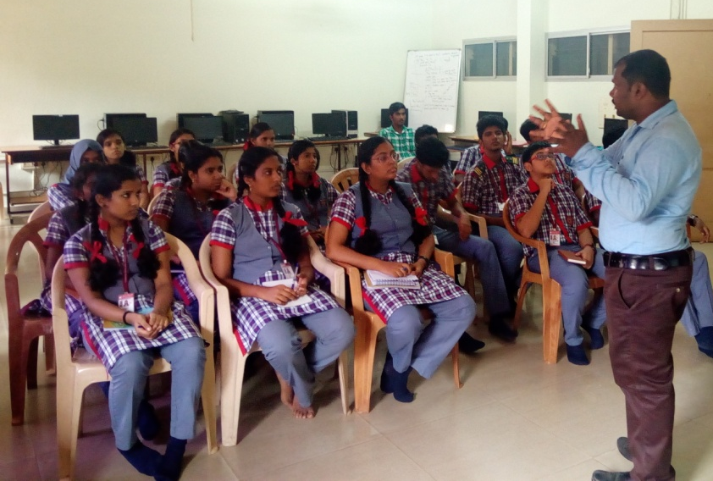
Sensitizing of Carbon Footprint

Slide 14
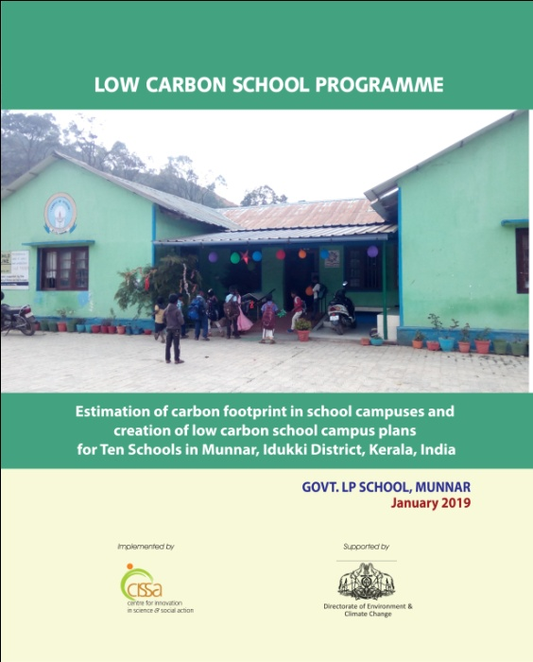
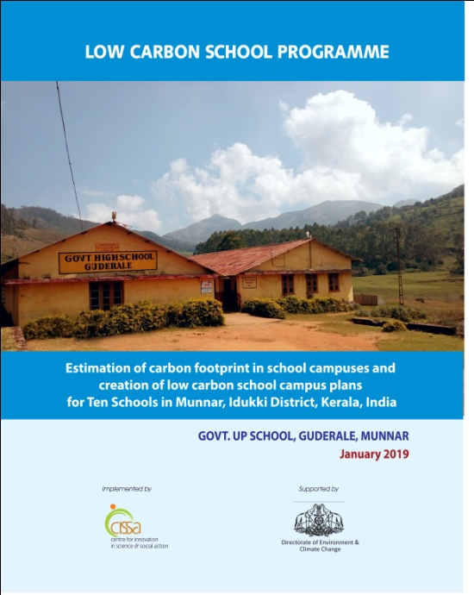
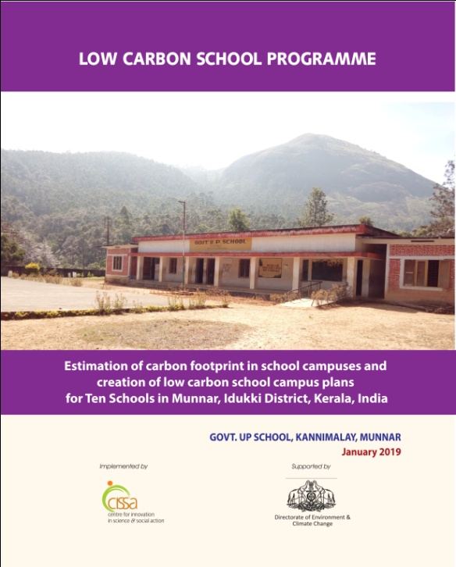
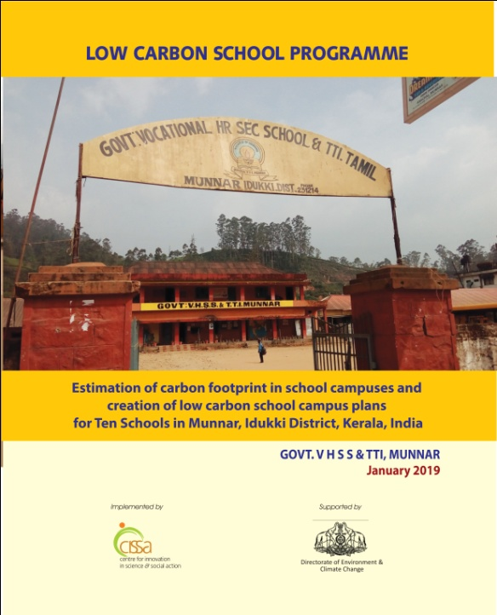
LOW CARBON SCHOOL REPORTS

Slide 15
RESULTS
Sl. No | Name of the school | No of students | Carbon footprint (tCO₂e) | Footprint per student (kgCO₂e/ Yr) | Carbon footprint after mitigation (tCO₂e) | Per student Footprint after mitigation (kgCO₂e/ Year)
1 | Little Flower Girls High School Nullathanni, Munnar | 1309 | 22.98 | 17.55 | -0.77 | -0.59
2 | Government UP School, Kannimalay | 17 | 0.33 | 19.43 | -0.74 | -43.82
3 | GLPS Devikulam | 69 | -2.96 | -42.85 | -4.15 | -60.09
4 | Government High School, Guderale | 70 | 5.43 | 77.52 | -0.11 | -1.61
5 | Vimalalayam UP School, Korandakad | 156 | 10.17 | 65.21 | -0.81 | -5.21
6 | Carmelagiri Public School, Korandakad | 1118 | 61.17 | 54.71 | -0.11 | -0.09
7 | Govt. ATP School, Munnar | 122 | 0.84 | 6.86 | -0.40 | -3.25

Slide 16
RESULTS
Sl. No | Name of the school | No of students | Carbon footprint (tCO₂e) | Footprint per student (kgCO₂e/ Yr) | Carbon footprint after mitigation (tCO₂e) | Per student Footprint after mitigation (kgCO₂e/ Yr)
8 | Govt. Higher secondary school, Devikulam | 93 | 1.40 | 15.11 | -1.19 | -12.84
9 | Government L.P School, Munnar | 68 | 0.54 | 0.48 | -0.51 | -0.39
10 | Govt. VHSS & TTI, Munnar | 675 | 5.82 | 8.62 | -0.09 | -0.13
11 | HSS for Girls, Venganoor, Thiruvananthapuram | 1033 | 25.31 | 24.50 | -0.58 | -0.56
12 | Bharatheeya Vidyapeedom, Parassala, Thiruvananthapuram | 1119 | 163.41 | 146.03 | -0.45 | -0.40
13 | Karthika Thirunnal Govt. VHSS for Girls, Thiruvananthapuram | 2038 | 62.59 | 30.71 | -0.68 | -0.33
 | TOTAL | 2861

Slide 17
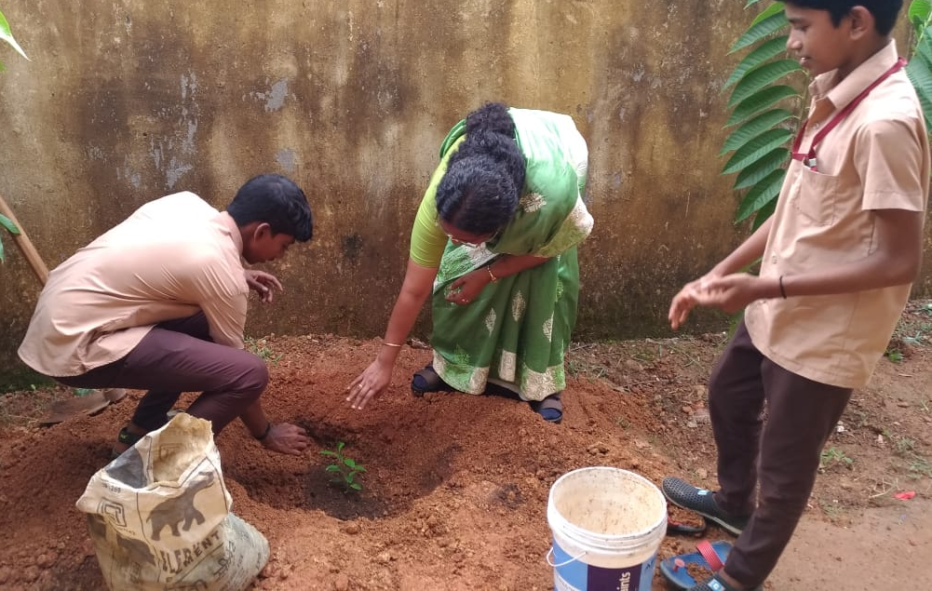
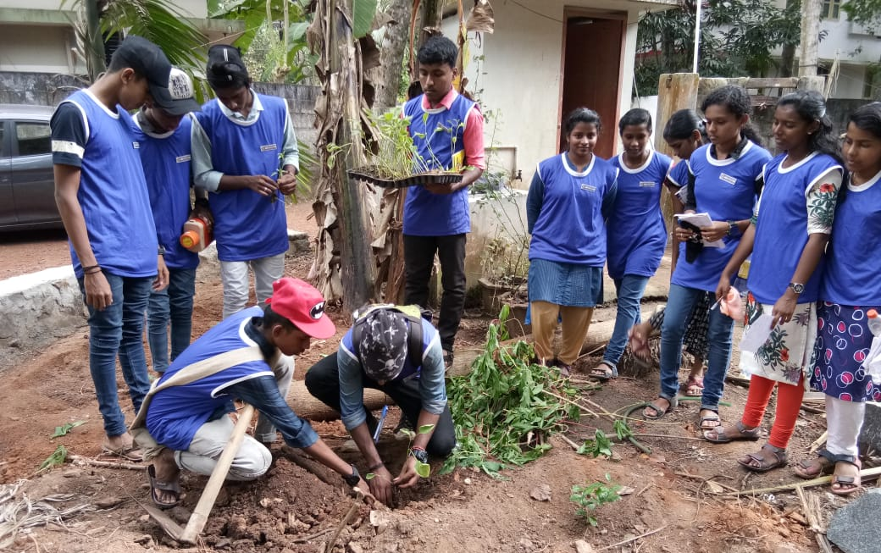
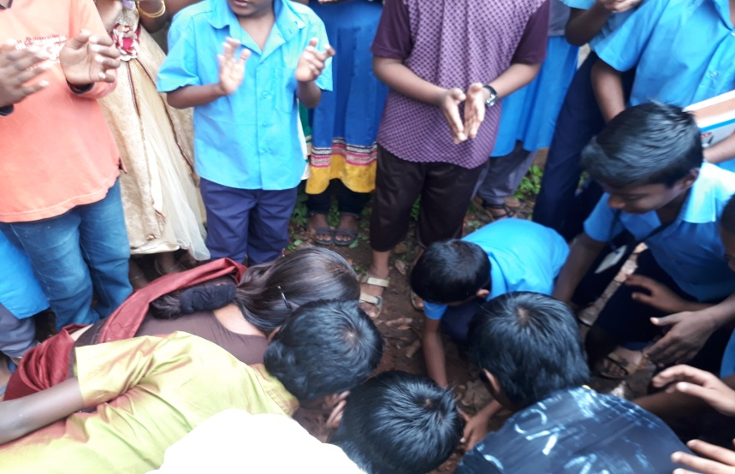
Carbon mitigation activities
Tree Planting s

Slide 18
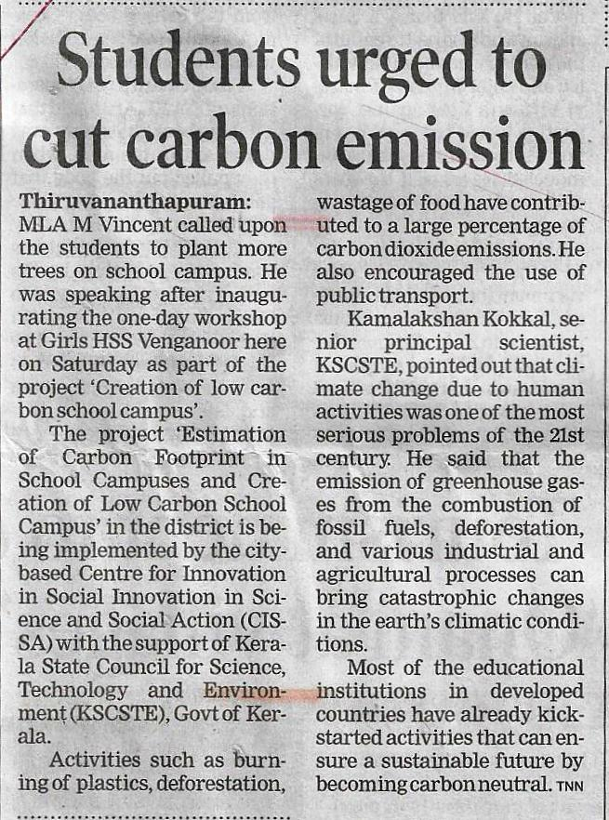
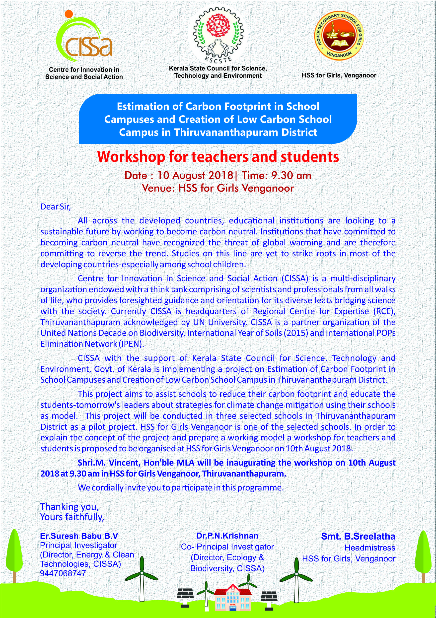
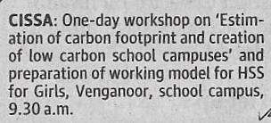
Steps towards realization

Slide 19
Reach OF THE CONCEPT
It is assumed that, through
7887 STUDENTS
the concept of Carbon footprint has reached about
7887 HOUSEHOLDS
This message will spread to at least
31548 INDIVIDUALS*
*Average household population in Kerala is 4

Slide 20
Scaling up, Main streaming and deepening ideas and actions of the projects
Expansion of Low Carbon Initiative is in progress
140 Schools
3 Colleges
2 Government Institutions
Popular Lectures
Awareness Programmes
Low Carbon House Camapign

Slide 21
Scaling up of ESD and sustainable development activities in the region with reference to UNESCO’s Global action programme and the SDGs.

Slide 22
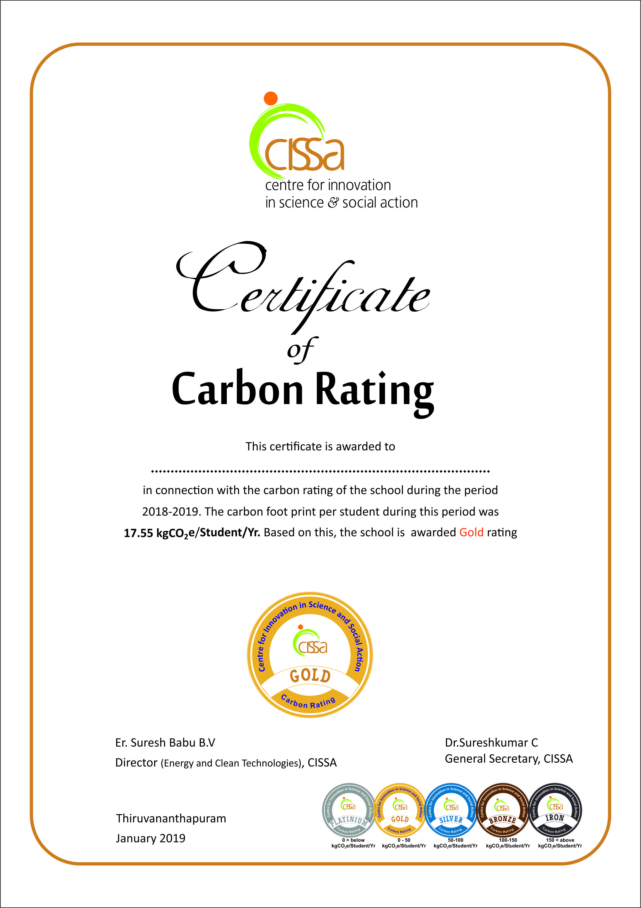
Publicity materials

Slide 23
THANK YOU...

