Slide 1
ACEWild Alternative Curriculum – Education out of the Wild!
Action Research Period 2
Philosophy

Slide 2
What is Outdoor Education?
Outdoor Education is an experiential method with the use of all senses in which most of the learning takes place in the outdoors. Outdoor education programs often involve residential or journey based experiences in which students participate in a variety of adventurous challenges.
Outdoor Education is education in, about, and for the out of doors.
In: outdoor education can occur in any outdoor setting from a school yard to a remote wilderness setting.
About: the topic is the outdoors itself and the cultural aspects related to the natural environment.
For: outdoor education is related to implementing the cognitive, psychomotor, and affective domains of learning for the sake of the ecosystem itself. It is learning for the sake of the natural world.

Slide 3
Philosophy/Aims of Outdoor Education
The aim of outdoor education is usually not the activity per se, but rather to learn how to overcome adversity, work alongside others, and to develop a deeper relationship with nature. The three domains of self, others, and the natural world are commonly understood as the main aims in outdoor education.
Outdoor education programs aims are to
Foster learning skills
Enhance teamwork
Teach outdoor survival skills
Promote spirituality
Understand natural environments
Develop communication and entrepeneurship skills
Improve problem solving skills

Slide 4
Components of Outdoor Education
Adventure Education
Interpersonal relationships – refer to how people get along in a group.
Intrapersonal relationships – refer to how an individual gets along with self-concept, spirituality, confidence, self-efficacy, etc.
Environmental Education
Ecosystemic relationships – refer to the interdependence of living organisms in ecological microclimate.
Cultural development – refer to the interactions between human society and the natural resources of an environment.

Slide 5
Didactical challenges
Classroom Culture
Told the information
Reading about topics
Physical distance from others
Limitations
The expected
Intellectual development
Physical inactivity
Outdoor Classroom Culture
Discover the information themselves through investigation
Experiencing topics first hand and relating them to real life situations
Working in collaboration with others
Testing one’s own limits and learning what is safe
The unexpected
Multi- Sensory/ Whole child development
Physical development

Slide 6
Aims of ACE Wild
Due to the nature of the learners, the main focus of the project ACEWild is to develop personal, social and emotional skills – which are vital in day to day life and to raise achievement.
The two main Learning Objectives were:
To improve emotional wellbeing and increase confidence of learners
To develop inter-personal and intra-personal skills of learners.

Slide 7
I. ACEWild - curriculum
A. Framework and guidelines

Slide 8
A. Curriculum ACEWild - guidelines
From nature to culture
From sensation to learning
From basics to complexity
Nature and environment as teachers
Teacher as learners, who learn from learners
Students as experts
Learning competencies

Slide 9
From nature to culture
Outdoor learning is about ...
... reminding the students how something started
... tracking the development of technologies
... building up a community
... respecting environment as a value

Slide 10
From nature to culture
Culture …
1. … as Distinct from Nature
Knowing that nature-culture-dichotomy is obsolete we start our activities outdoor as close as possible to a natural environment.
On one hand students should learn a sustainable way to make use of natural incidents and circumstances and to meet their needs
On the other hand they should respect the natural laws of the environment

Slide 11
From nature to culture
Culture …
2. … as Knowledge
Culture is knowledge about the environment and nature
Culture is knowing about nature and know-how to deal with environment
Culture is a mental construct of being part of nature

Slide 12
From nature to culture
Culture ...
3. ... as communication
Culture is shared knowledge
students need language skills; therefore students have to learn to express themselves and to understand the other.
Doing Culture needs collaboration and team skills

Slide 13
From nature to culture
Culture as ...
4. ... system of practices
way of using ressources of the environment
understanding how everything is interconnected
way of consuming and producing
Understanding how your way of life effects environment

Slide 14
From sensation to learning
We create learning situations which allow ...
1. ... sensation. That means direct and attractive action which has reasonable consequences. It is a risk, because we do not know what will happen in the learners mind. It is absolutely individual, different from every learner.
2. ... experience. Adventure, sensation is not experience. Learners have to reflect on the actions. Share their experiences with the group and understanding their role, needs and expectations.
3. ... Learning. Students lear to transfer their experiences into their biography and future life.

Slide 15
From sensation to learning
Outdoor learning means that learning happens on three levels.
On the sensation level teacher have no influences on what will happen. Teacher can prepare the environment as good as they can, but there is always a risk left, because student are individuals, you cannot foresee what they will do and how the interprete world and how the decide to act.
On the experience level students have to interact, to communicate and to share their ideas. That is why we support group learning in outdoor activities. Student have to communicate and reflect on what happens. The sensation becomes an experience. But a single experience is not really learned.
Learning is the next level. That is the moment of teaching. This happens in communities, schools in organized learning setting.
The table below gives an overview what is meant that outdoor learnin is process from sensation to learning.
Sensation | Risk | Individuals | Doing
Experience | Reflection | Group | Interaction
Learning | Life long learning | Community | Transition

Slide 16
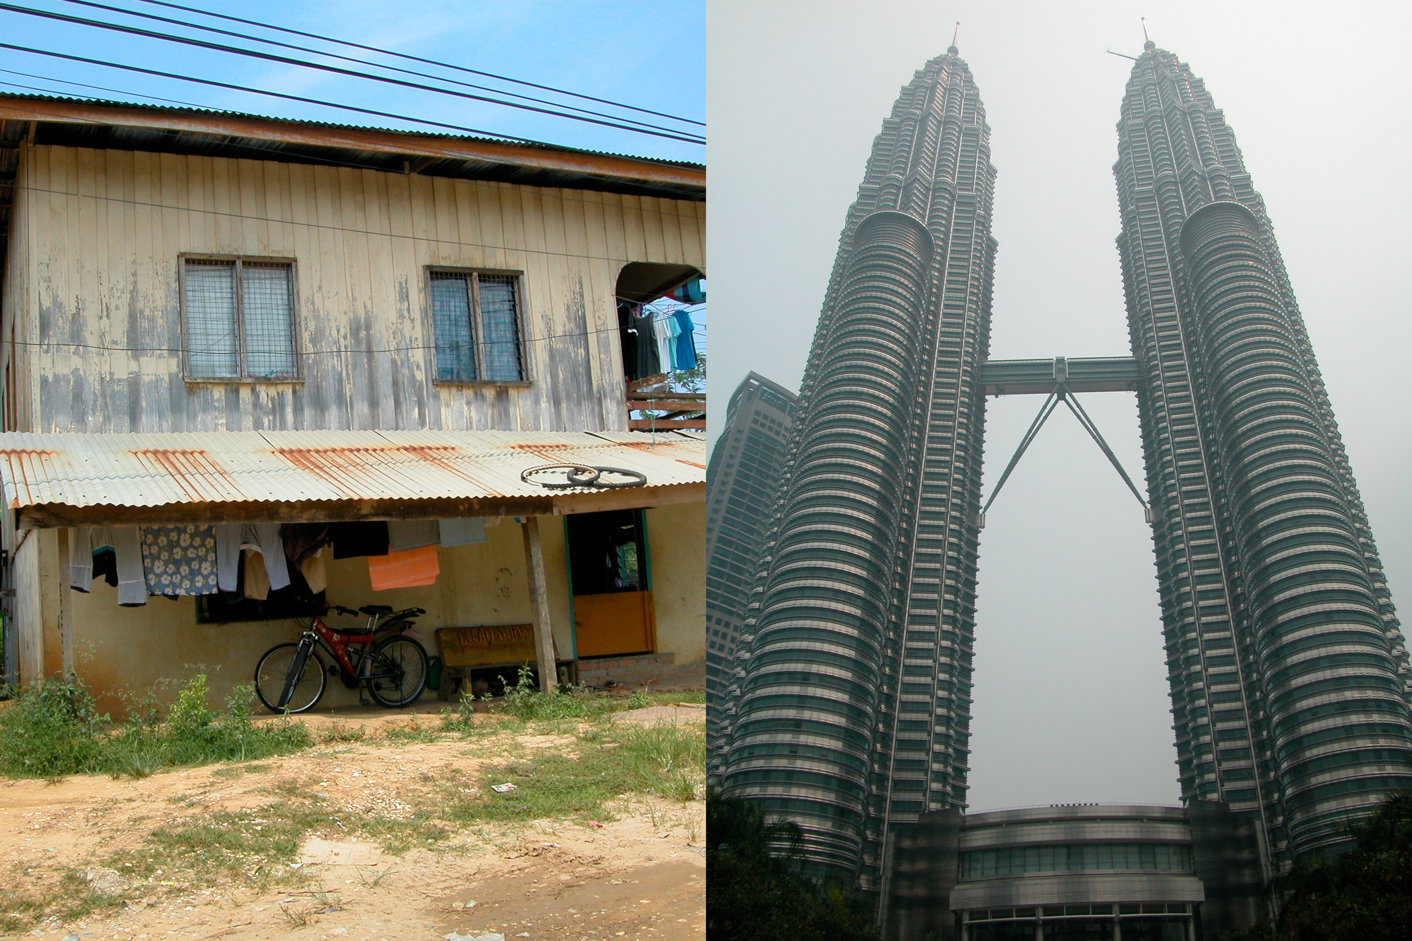
From basics to complexity
We begin with survival basics like making fire, cooking outdoors, using wild food and building shelters from natural materials.
We move on to use tools and technologies to keep the firewood dry and how to make more efficiant fires.
We finish by exploring our day-to-day habits, for example the way we heat our homes, use energy, cook and consume food.

Slide 17
B. Content and Competencies

Slide 18
Content of outdoor learning
What is being taught?
The content includes
information about the natural environment and its relationships,
specific skills to be used in the outdoors,
our relationship with the environment and
how our activities as individuals and as a society affect it.

Slide 19
Topics
Adventure Training
Decision making
Emotional Intelligence
Knowing the local environment
History and traditional knowledge
Respect
Responsibility
Resilience
Self Reliance
Inter/Intrapersonal understanding

Slide 20
Model of competencies
Dimensions Competence | Knowledge | skills | attitude
Issue competence | About nature and environment | Working with methods and instruments | respect
Social competence | Communication, teamwork | Solving conflicts Steering dialogues | Open-mindness Empathy Solidarity
Self competence | Personality, emotion behavior | Designing own life- and carreer curriculum | Courage and heart authenticity
Design competence | About process designing structure building | Designing processes and products | Dealing with variety and difference

Slide 21
Circle of competence development

Slide 22
C. Teachers and learners

Slide 23
Nature and environment as teacher
Authentic
Creating learning experiences that mirror real life
Aesthetic
A “classroom” that includes natural light , sound, texture and colour
Direct consequences
Instead of quantitative scores you got a relevant feedback in relation to a specific issue

Slide 24
The role of the teachers
Teachers as Facilitators …
have an attitude of assistance, encouragement
are coaching rather than providing facts.
Need to know why you are doing what you are doing
put the focus on the participants
encourage students to explore and discover meaning and understanding from the activities
design situations that will encourage students to want to learn or work something out
look for and be flexible enough to capitalize on learning opportunities that spontaneously arise

Slide 25
The role of the teachers
Teachers as learners …
put the focus on the participants
look for and be flexible enough to capitalize on learning opportunities that spontaneously arise
Use sequenced progressions that move from simple to complex
Anticipate how to use students’ failures as well as their successes to maximize learning
Follow an activity with opportunities for reflection, discussion, generalisation and application.
This is the moment when learner learns from learner

Slide 26
Outdoor Learning Process
APPLYING
EXPERIENCING
GENERALIZING
REFLECTING
Notes:
The process through which the learner constructs knowledge, skills, and values through direct experience.

Slide 27
Outdoor teaching Process
ADAPTATION
KNOWLEDGE
EVALUATION
PLANNING
REFLECTION
&
DISCUSSION
IMPLEMENTATION
Notes:
Knowledge
Usually begins with the teacher’s intention to teach experientially using interdisciplinary highlights and with an idea and basic information, such as knowing your class, time frame, facilities, equipment, and what objectives or standards you want to address.
Planning
Involves structuring activities in ways that enhance the opportunity to use each activity to illustrate a concept or skill. Also involves identifying standards from other areas that you can connect to the activity in order to reinforce it.
Implementation
Actively engaging students in the experiences, making observations and comments during the activity and asking leading, challenging questions that are pertinent to the planned objectives.
Reflection & Discussion
Time to talk about what happened. Question types to lead discussions: What? So what? Now what?
Evaluation
Evaluate the success of the lesson and determine if then objectives were accomplished.
Adaptation
How to structure the next experience based on lessons learned

